Slide 1
Lecture 16
Min Cut and Karger’s Algorithm

Slide 2
Announcements
HW8 Due Wednesday
Midterm 4 on Mon-Tue next week.
  Cannot be dropped
  Material covered this week is included

Slide 3
Last time
Minimum Spanning Trees!
  Prim’s Algorithm
  Kruskal’s Algorithm

Slide 4
Today
Minimum Cuts!
  Karger’s algorithm
  Karger-Stein algorithm
  Back to randomized algorithms!

Slide 5
Recall: cuts in graphs
*For today, all graphs are undirected and unweighted.
A cut is a partition of the vertices into two nonempty parts.

Slide 6
Recall: cuts in graphs
*For today, all graphs are undirected and unweighted.
A cut is a partition of the vertices into two nonempty parts.
Part 1
Part 2

Slide 7
This is not a cut

Slide 8
This is a cut

Slide 9
This is a cut
These edges cross the cut.
They go from one part to the other.

Slide 10
A (global) minimum cut
is a cut that has the fewest edges possible crossing it.

Slide 11
A (global) minimum cut
is a cut that has the fewest edges possible crossing it.

Slide 12
Why might we care about global minimum cuts?
Clustering:
Image Segmentation
big edge weights* between similar pixels.
*For the rest of today edges aren’t weighted; but the algorithm can be adapted to deal with edge weights.

Slide 13
Karger’s algorithm
Finds global minimum cuts in undirected graphs
Randomized algorithm
Karger’s algorithm might be wrong.
  Compare to QuickSort, which just might be slow.
Why would we want an algorithm that might be wrong?
  With high probability it won’t be wrong.
  Maybe the stakes are low and the cost of a deterministic algorithm is high.

Slide 14
Different sorts of gambling
QuickSort is a Las Vegas randomized algorithm
  It is always correct.
  It might be slow.
Yes, this is a technical term.

Slide 15
Different sorts of gambling
Karger’s Algorithm is a Monte Carlo randomized algorithm
  It is always fast.
  It might be wrong.

Slide 16
Karger’s algorithm
Pick a random edge.
Contract it.
Repeat until you only have two vertices left.
b
b
a
a
New node!
Why is this a good idea? We’ll see shortly.

Slide 17
Karger’s algorithm
f
b
a
g
e
c
d
h

Slide 18
Karger’s algorithm
random edge!
f
b
a
g
e
c
d
h

Slide 19
Karger’s algorithm
Create a supernode!
f
a
b
g
Create a superedge!
Create a superedge!
e
c
d
h

Slide 20
Karger’s algorithm
Create a supernode!
f
a,b
{e,b}
g
Create a superedge!
{c,a}
{c,b}
Create a superedge!
e
{d,a}
{d,b}
c
d
h

Slide 21
Karger’s algorithm
f
a,b
{e,b}
g
{c,a}
{c,b}
e
{d,a}
{d,b}
c
d
random edge!
h

Slide 22
Karger’s algorithm
f
a,b
{e,b}
Create a superedge!
g
{c,a}
{c,b}
e
Create a superedge!
{d,a}
{d,b}
h
c
d
Create a supernode!

Slide 23
Karger’s algorithm
f
a,b
{e,b}
Create a superedge!
g
{f,e}
{f,h}
{c,a}
{c,b}
e,h
{g,e}
{g,h}
Create a superedge!
{d,a}
{d,b}
{e,d}
c
d
Create a supernode!

Slide 24
Karger’s algorithm
f
a,b
{e,b}
g
{f,e}
{f,h}
{c,a}
{c,b}
e,h
{g,e}
{g,h}
{d,a}
{d,b}
{e,d}
c
random edge!
d

Slide 25
Karger’s algorithm
f
a,b
{e,b}
g
{f,e}
{f,h}
{c,a}
{c,b}
e,h
{g,e}
{g,h}
{d,a}
{d,b}
c,d
{e,d}

Slide 26
Karger’s algorithm
f
a,b
{e,b}
g
{f,e}
{f,h}
random edge!
{c,a}
{c,b}
e,h
{g,e}
{g,h}
{d,a}
{d,b}
c,d
{e,d}

Slide 27
Karger’s algorithm
f
a,b,c,d
g
{e,b}
{f,e}
{f,h}
{e,d}
e,h
{g,e}
{g,h}

Slide 28
Karger’s algorithm
f
a,b,c,d
g
{e,b}
{f,e}
{f,h}
{e,d}
random edge!
e,h
{g,e}
{g,h}

Slide 29
Karger’s algorithm
f
a,b,c,d
{f,g}
{e,b}
{f,e}
{f,h}
{e,d}
e,h,g

Slide 30
Karger’s algorithm
f
a,b,c,d
{f,g}
{e,b}
{f,e}
{f,h}
{e,d}
random edge!
e,h,g

Slide 31
Karger’s algorithm
Now stop!
There are only two nodes left.
The minimum cut is given by the remaining super-nodes:
{a,b,c,d} and {e,h,f,g}
a,b,c,d
{e,b}
{e,d}
e,h,g,f

Slide 32
Karger’s algorithm
The minimum cut is given by the remaining super-nodes:
{a,b,c,d} and {e,h,f,g}
f
b
a
g
e
c
d
h

Slide 33
Karger’s algorithm
Does it work?
Is it fast?

Slide 34
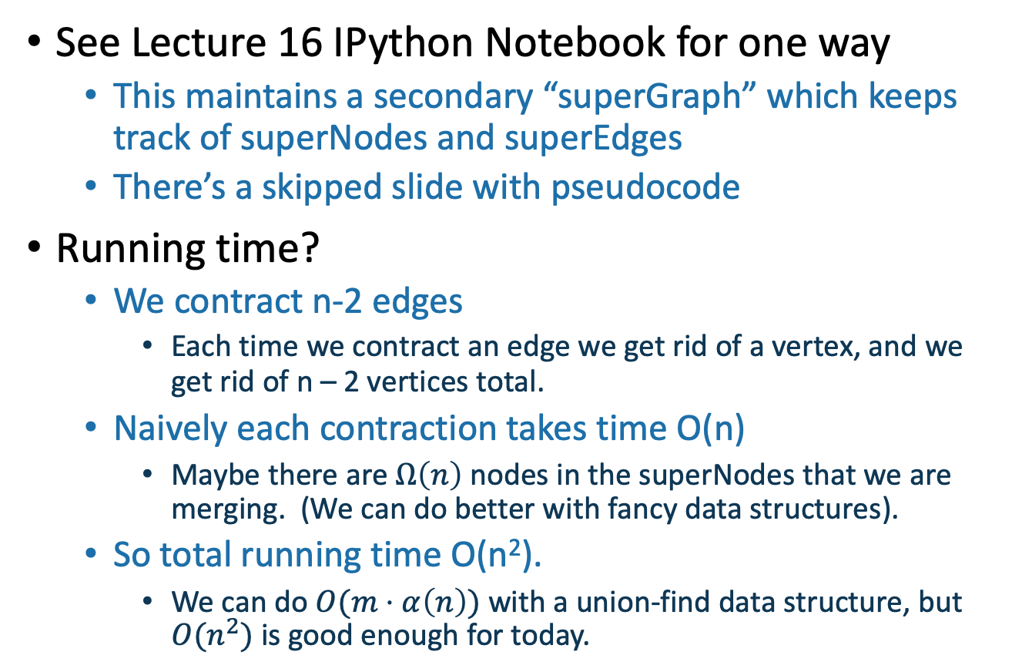
How do we implement this?
See Lecture 16 IPython Notebook for one way
  This maintains a secondary “superGraph” which keeps track of superNodes and superEdges
  There’s a skipped slide with pseudocode
Running time?
  We contract n-2 edges
    Each time we contract an edge we get rid of a vertex, and we get rid of n – 2 vertices total.
  Naively each contraction takes time O(n)
    Maybe there are $Ω\left(n\right)$ nodes in the superNodes that we are merging. (We can do better with fancy data structures).
  So total running time O(n²).
    We can do $O(m⋅α\left(n\right))$ with a union-find data structure, but $O(n^{2})$ is good enough for today.

Slide 35
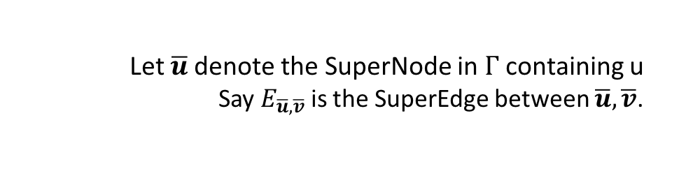
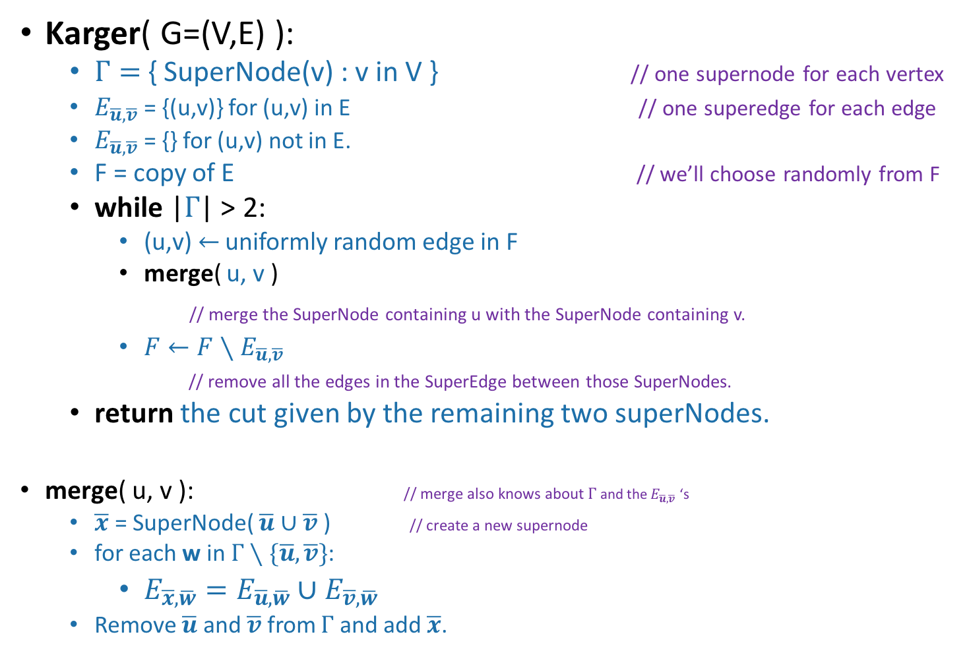
Pseudocode
  Let $\overline{u}$denote the SuperNode in $Γ$ containing u
Say $E_{\overline{u}, \overline{v}}$ is the SuperEdge between $\overline{u}, \overline{v}$.
This slide skipped in class
Karger( G=(V,E) ):
  $Γ=${ SuperNode(v) : v in V } // one supernode for each vertex
  $E_{\overline{u}, \overline{v}}$ = {(u,v)} for (u,v) in E // one superedge for each edge
  $E_{\overline{u}, \overline{v}}$ = {} for (u,v) not in E.
  F = copy of E // we’ll choose randomly from F
  while |$Γ$| > 2:
    (u,v) $←$ uniformly random edge in F
    merge( u, v )
    // merge the SuperNode containing u with the SuperNode containing v.
    $F←F∖E_{\overline{u}, \overline{v}}$
    // remove all the edges in the SuperEdge between those SuperNodes.
  return the cut given by the remaining two superNodes.
merge( u, v ): // merge also knows about $Γ$and the $E_{\overline{u}, \overline{v}}$ ‘s
  $\overline{x}$ = SuperNode( $\overline{u}∪\overline{v}$ ) // create a new supernode
  for each w in $Γ∖\{\overline{u}, \overline{v}\}$:
    $E_{\overline{x}, \overline{w}}=E_{\overline{u}, \overline{w}}∪E_{\overline{v}, \overline{w}}$
  Remove $\overline{u}$ and $\overline{v}$ from $Γ$ and add $\overline{x}$.
The while loop runs n-2 times
merge takes time O(n) naively
total runtime O(n²)
We can do a bit better with fancy data structures, but let’s go with this for now.

Slide 36
Karger’s algorithm
Does it work?
Is it fast?
  O(n²)
Think-share!
1 minute think
1 minute share
Create a supernode!
f
a
b
g
Create a superedge!
e
c
d
Create a superedge!
h
Algorithm:
Randomly contract edges until there are only two supernodes left.

Slide 37
Karger’s algorithm
Does it work?
Is it fast?
  O(n²)
No?
Create a supernode!
f
a
b
g
Create a superedge!
e
c
d
Create a superedge!
h
Algorithm:
Randomly contract edges until there are only two supernodes left.

Slide 38
Why did that work?
We got really lucky!
This could have gone wrong in so many ways.

Slide 39
Karger’s algorithm
Say we had chosen this edge
f
b
a
random edge!
g
e
c
d
h

Slide 40
Karger’s algorithm
Say we had chosen this edge
Now there is no way we could return a cut that separates b and e.
b,e
f
a
g
c
d
h

Slide 41
Even worse
If the algorithm EVER chooses either of these edges, it will be wrong.
f
b
a
g
e
c
d
h

Slide 42
How likely is that?
b
f
a
g
e
c
d
h
For this particular graph, I did it 10,000 times:
The algorithm is only correct about 20% of the time!

Slide 43
That doesn’t sound good
Too see why it’s good after all, we’ll first do a case study of this graph. Then we’ll generalize.
To see the first point, let’s compare Karger’s algorithm to the algorithm:
b
f
The plan:
See that 20% chance of correctness is actually nontrivial.
Use repetition to boost an algorithm that’s correct 20% of the time to an algorithm that’s correct 99% of the time.
a
g
e
c
d
h
Choose a completely random cut and hope that it’s a minimum cut.

Slide 44
Uniformly random cut in
Pick a random way to split the vertices into two parts:
etc

Slide 45
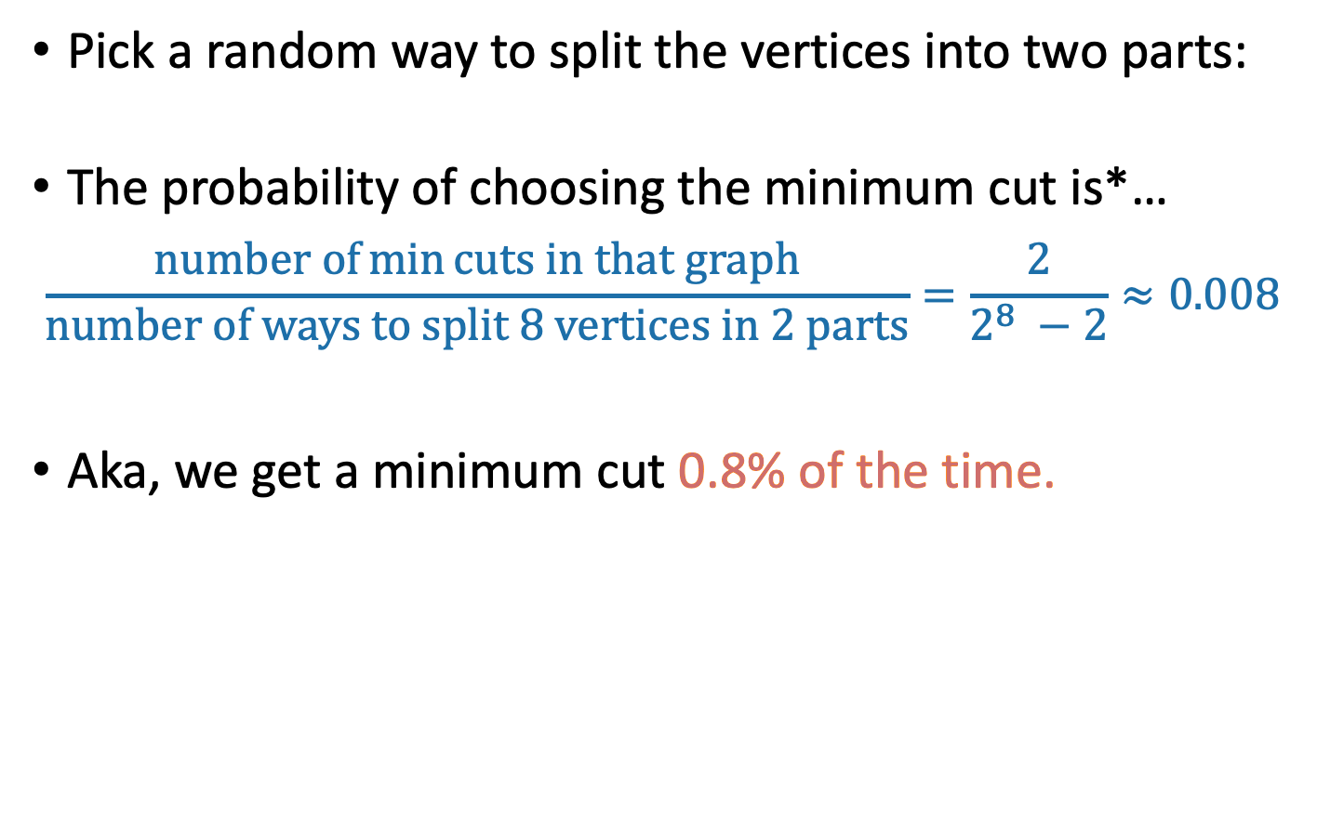
Uniformly random cut in
Pick a random way to split the vertices into two parts:
The probability of choosing the minimum cut is*…
$$\frac{number of\min{cuts in that graph}}{number of ways to split 8 vertices in 2 parts}=\frac{2}{2^{8} −2}≈0.008$$
Aka, we get a minimum cut 0.8% of the time.
*For this example in particular

Slide 46
Karger is better than completely random!
b
f
a
g
e
c
d
h
Karger’s alg. is correct about 20% of the time
Completely random is correct about 0.8% of the time

Slide 47
What’s going on?
Thing 1: It’s unlikely that Karger will hit the min cut since it’s so small!
Which is more likely?
Neither A nor B are very likely, but A is more likely than B.
Lucky the lackadaisical lemur
f
B: The algorithm never chooses any of the edges in this big cut.
b
a
g
e
c
d
h
f
b
a
g
A: The algorithm never chooses either of the edges in the minimum cut.
e
c
d
h

Slide 48
What’s going on?
Thing 2: By only contracting edges we are ignoring certain really-not-minimal cuts.
Lucky the lackadaisical lemur
f
b
B: This cut can’t be returned by Karger’s algorithm!
(Because how would a and g end up in the same super-node?)
a
g
e
c
d
h
f
b
a
g
A: This cut can be returned by Karger’s algorithm.
e
c
d
h
This cut actually separates the graph into three pieces, so it’s not minimal – either half of it is a smaller cut.

Slide 49
Why does that help?
Okay, so it’s better than completely random…
We’re still wrong about 80% of the time.
The main idea: repeat!
  If I’m wrong 80% of the time, then if I repeat it a few times I’ll eventually get it right.
The plan:
See that 20% chance of correctness is actually nontrivial.
Use repetition to boost an algorithm that’s correct 20% of the time to an algorithm that’s correct 99% of the time.

Slide 50
Thought experiment from pre-lecture exercise
Suppose you have a magic button that produces one of 5 numbers, {a,b,c,d,e}, uniformly at random when you push it.
You don’t know what {a,b,c,d,e} are.
Q: What is the minimum of a,b,c,d,e?
5
5
6
3
3
2
2
How many times do you have to push the button, in expectation, before you see the minimum value?
What is the probability that you have to push it more than 5 times? 10 times?

Slide 51

[This was done on the board]
This is the same calculation we’ve done a bunch of times:
Slide skipped in class
Number of times we push the button until we get the minimum value
E[ ] = 1/(0.20) = 5
Pr[ ] = $(1 − {0.2)}^{t}$
Pr[ ] = $(1 − {0.2)}^{5}≈0.33$
Pr[ ] = $(1 − {0.2)}^{10}≈0.1$
This one we’ve done less frequently:
We push the button t times and don’t ever get the min
We push the button 5 times and don’t ever get the min
We push the button 10 times and don’t ever get the min

Slide 52
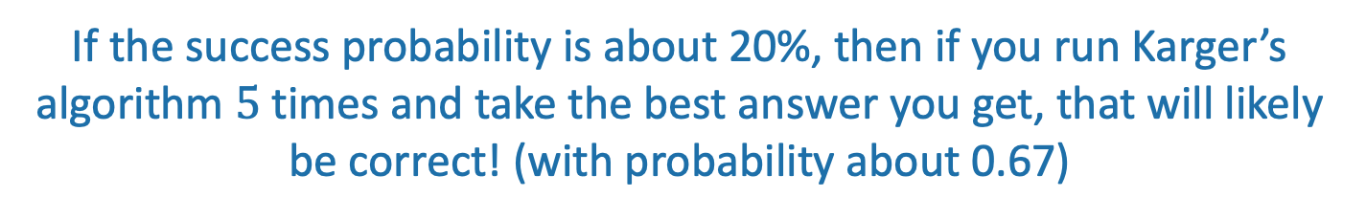
In this context
Run Karger’s! The cut size is 6!
Run Karger’s! The cut size is 3!
Run Karger’s! The cut size is 3!
Run Karger’s! The cut size is 2!
Run Karger’s! The cut size is 5!
Correct!
If the success probability is about 20%, then if you run Karger’s algorithm $5$ times and take the best answer you get, that will likely be correct! (with probability about 0.67)

Slide 53
For this particular graph
b
f
a
g
e
c
d
h
Repeat Karger’s algorithm about 5 times, and we will get a min cut with decent probability.
  In contrast, we’d have to choose a random cut about 1/0.008 = 125 times!
Hang on! This “20%” figure just came from running experiments on this particular graph. What about general graphs? Can we prove something?
The plan:
See that 20% chance of correctness is actually nontrivial.
Use repetition to boost an algorithm that’s correct 20% of the time to an algorithm that’s correct most of the time.
Also, we should be a bit more precise about this “about 5 times” statement.
Plucky the pedantic penguin

Slide 54
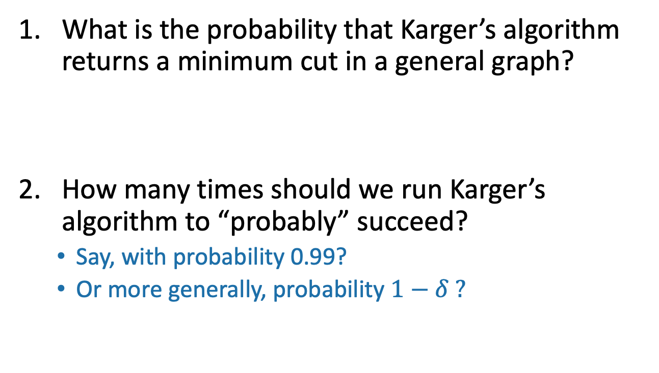
Questions
To generalize this approach to all graphs
What is the probability that Karger’s algorithm returns a minimum cut in a general graph?
How many times should we run Karger’s algorithm to “probably” succeed?
  Say, with probability 0.99?
  Or more generally, probability $1−δ ?$

Slide 55
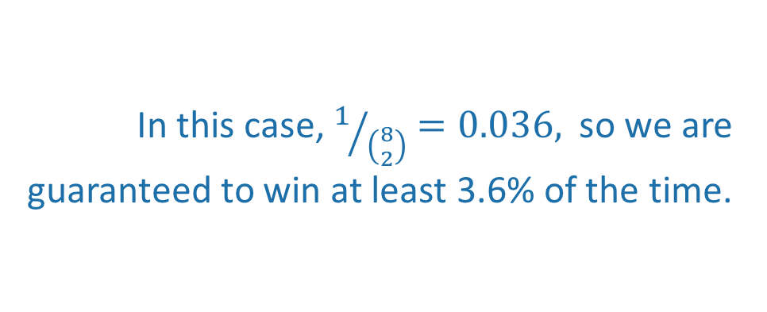
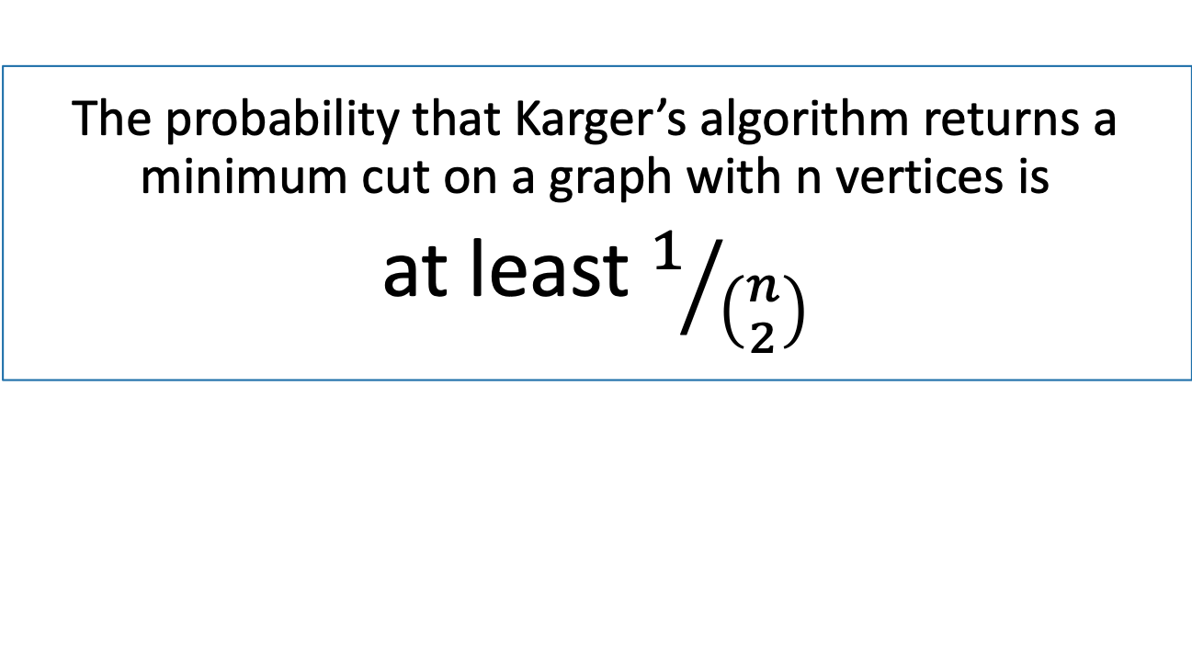
Answer to Question 1
Claim:
The probability that Karger’s algorithm returns a minimum cut on a graph with n vertices is
at least $1/{\left({n \atop 2}\right)}$
b
f
a
g
e
In this case, $1/{\left({8 \atop 2}\right)}=0.036,$so we are guaranteed to win at least 3.6% of the time.
c
d
h

Slide 56
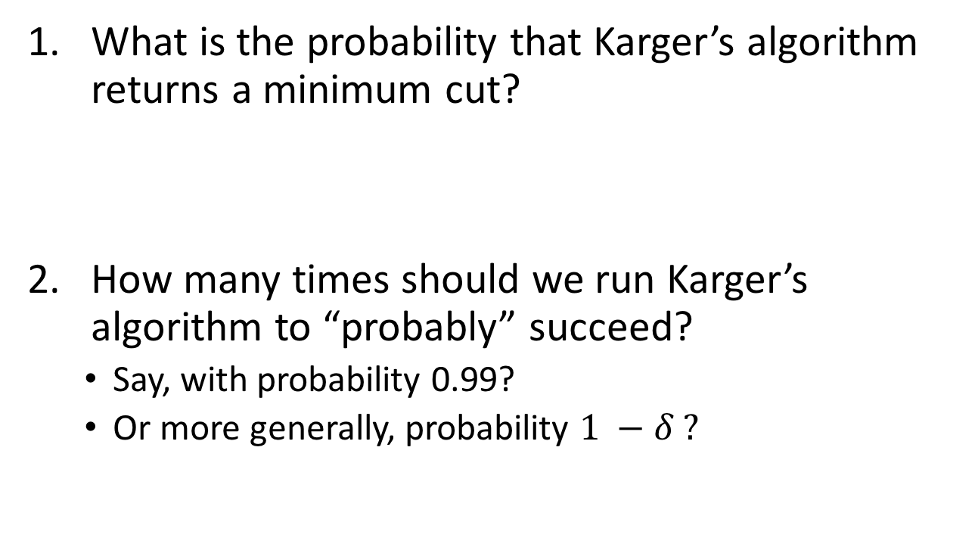
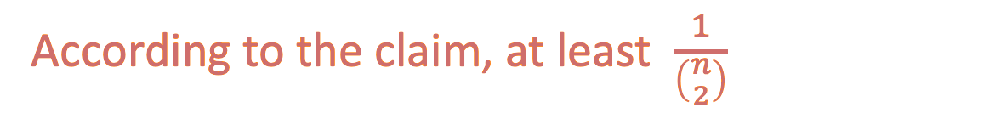
Questions
What is the probability that Karger’s algorithm returns a minimum cut?
How many times should we run Karger’s algorithm to “probably” succeed?
  Say, with probability 0.99?
  Or more generally, probability $1 −δ ?$
According to the claim, at least $\frac{1}{\left({n \atop 2}\right)}$

Slide 57

Before we prove the Claim
How many times should we run Karger’s algorithm to succeed with probability $1 −δ$?
b
f
a
g
e
c
d
h

Slide 58


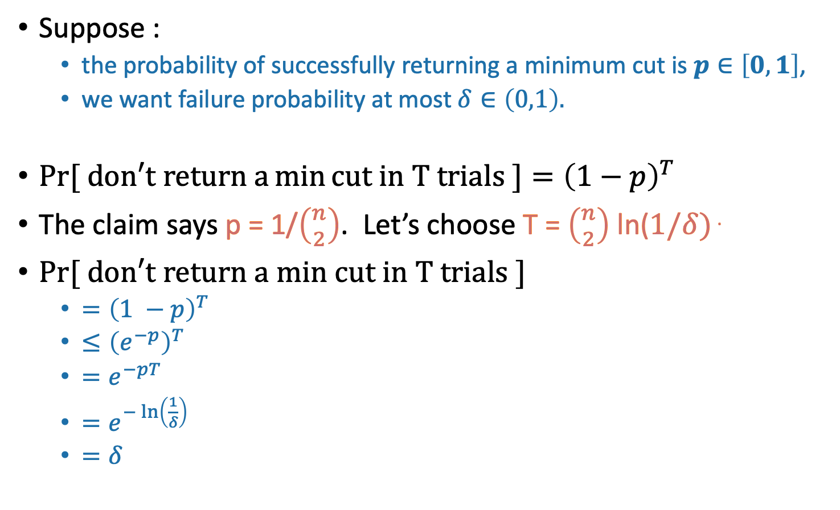

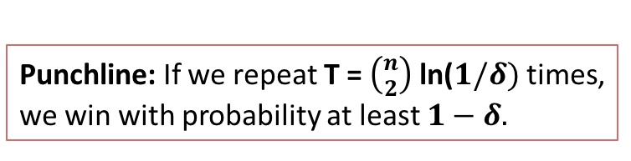
A computation
Punchline: If we repeat T = $\left({n \atop 2}\right)$ln($1/δ)$ times, we win with probability at least $1−δ.$
Suppose :
  the probability of successfully returning a minimum cut is $p∈\left[0,1\right]$,
  we want failure probability at most $δ∈\left(0,1\right).$
$Pr⁡[ \text{do}n′\text{t} \text{return} \text{a}\min{\text{cut} \text{in} \text{T} \text{trials} ]={\left(1−p\right)}^{T}}$
The claim says p = 1/$\left({n \atop 2}\right)$. Let’s choose T = $\left({n \atop 2}\right)$ln($1/δ)$ .
$Pr⁡[ \text{do}n′\text{t} \text{return} \text{a} \text{min} \text{cut} \text{in} \text{T} \text{trials}\text{ ]}$
  $={\left(1 −p\right)}^{T}$
  $≤{\left(e^{−p}\right)}^{T}$
  $=e^{−pT}$
  $=e^{−\ln\left(\frac{1}{δ}\right)}$
  $=δ$
$$e^{−p}$$
$$1−p$$
  $$1−p≤e^{−p}$$

Slide 59
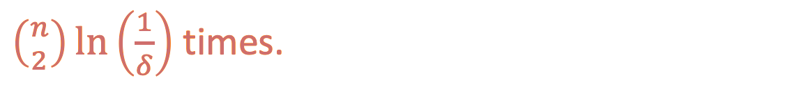
Answers
What is the probability that Karger’s algorithm returns a minimum cut?
How many times should we run Karger’s algorithm to “probably” succeed?
  Say, with probability 0.99?
  Or more generally, probability $1 −δ ?$
According to the claim, at least $\frac{1}{\left({n \atop 2}\right)}$
$\left({n \atop 2}\right)\ln\left(\frac{1}{δ}\right)$times.

Slide 60
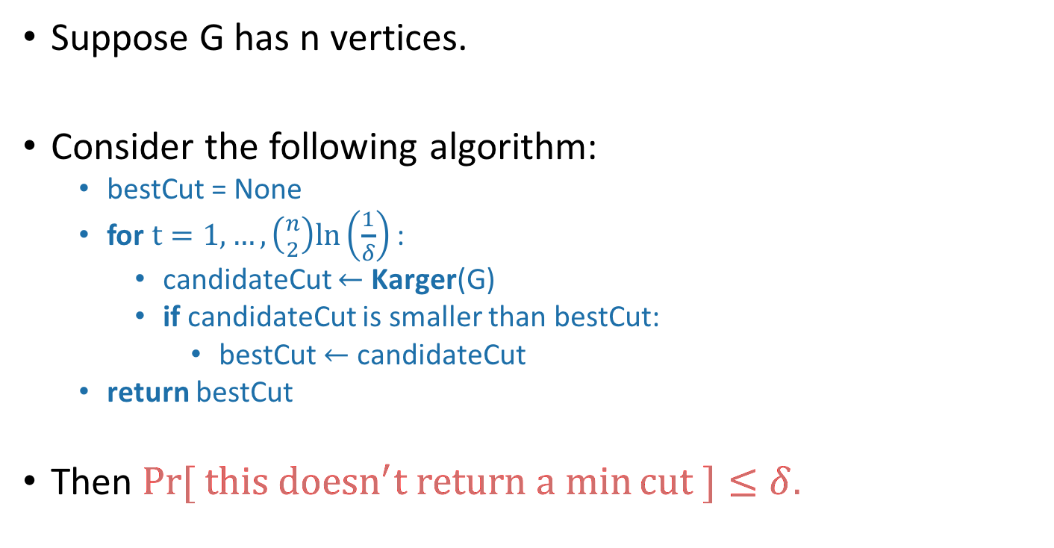
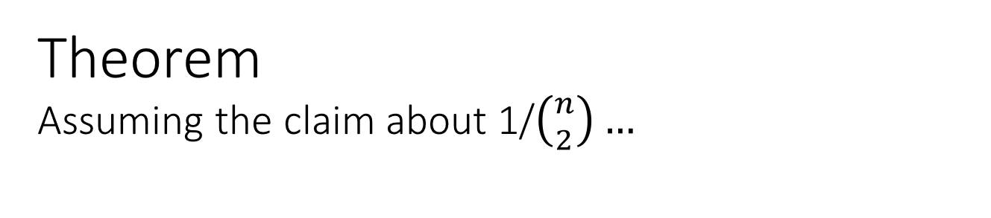
Theorem
Assuming the claim about 1/$\left({n \atop 2}\right)…$
Suppose G has n vertices.
Consider the following algorithm:
  bestCut = None
  for$t=1, …, \left({n \atop 2}\right)ln\left(\frac{1}{δ}\right)$ :
    candidateCut $←$ Karger(G)
    if candidateCut is smaller than bestCut:
      bestCut $←$ candidateCut
  return bestCut
Then $\operatorname{Pr}{[ this doesn^{′}t return a min}cut ]≤δ.$
How many repetitions would you need if instead of Karger we just chose a uniformly random cut?

Slide 61

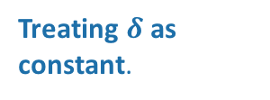
What’s the running time?
$\left({n \atop 2}\right)\ln\left(\frac{1}{δ}\right)$ repetitions, and O(n²) per repetition.
So, $O\left( n^{2}⋅\left({n \atop 2}\right)\ln\left(\frac{1}{δ}\right)\right)=O\left(n^{4}\right)$
Treating $δ$ as constant.
Again we can do better with a union-find data structure. Write pseudocode for—or better yet, implement—a fast version of Karger’s algorithm! How fast can you make the asymptotic running time?
Ollie the over-achieving ostrich

Slide 62
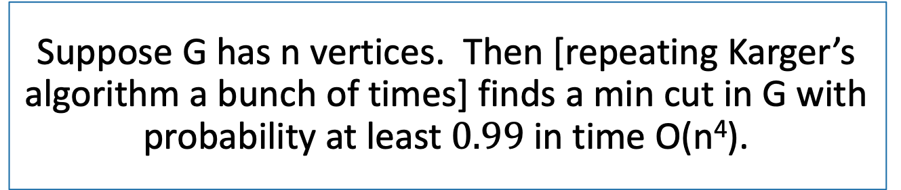
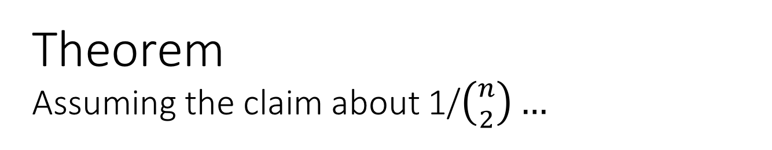
Theorem
Assuming the claim about 1/$\left({n \atop 2}\right)…$
Suppose G has n vertices. Then [repeating Karger’s algorithm a bunch of times] finds a min cut in G with probability at least $0.99$in time O(n⁴).
Now let’s prove the claim…

Slide 63
Break

Slide 64
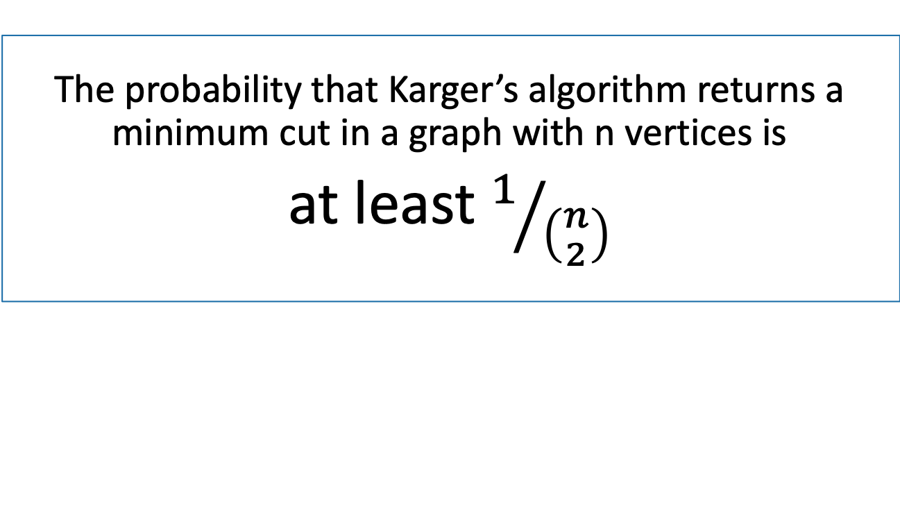
Claim
The probability that Karger’s algorithm returns a minimum cut in a graph with n vertices is
at least $1/{\left({n \atop 2}\right)}$

Slide 65
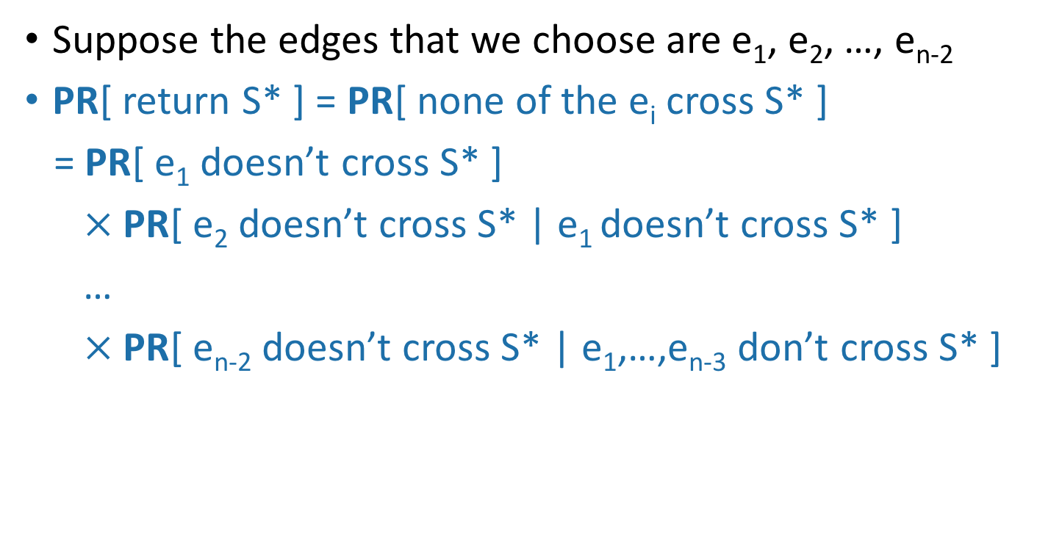
Proof of Claim
Say that S* is a minimum cut.
Suppose the edges that we choose are e₁, e₂, …, e_{n-2}
PR[ return S* ] = PR[ none of the e_{i} cross S* ]
= PR[ e₁ doesn’t cross S* ]
$×$PR[ e₂ doesn’t cross S* | e₁ doesn’t cross S* ]
…
$×$PR[ e_{n-2} doesn’t cross S* | e₁,…,e_{n-3} don’t cross S* ]
b
f
a
g
e
c
d
S*
h

Slide 66
Focus in on:
PR[ e_{j} doesn’t cross S* | e₁,…,e_{j-1} don’t cross S* ]
Suppose: After j-1 iterations, we haven’t messed up yet!
What’s the probability of messing up now?
These two edges haven’t been chosen for contraction!
f
a,b
{e,b}
g
{f,e}
{f,h}
{c,a}
{c,b}
e,h
{g,e}
{g,h}
{d,a}
{d,b}
{e,d}
c
d

Slide 67

Focus in on:
PR[ e_{j} doesn’t cross S* | e₁,…,e_{j-1} don’t cross S* ]
Suppose: After j-1 iterations, we haven’t messed up yet!
What’s the probability of messing up now?
Say there are k edges that cross S*
Every supernode has at least k (original) edges coming out.
  Otherwise we’d have a smaller cut.
Thus, there are at least (n-j+1)k/2 edges total.
  b/c there are n - j + 1 supernodes left, each with at least k edges.
So the probability that we choose one of the k edges crossing S* at step j is at most:
$\frac{k}{\left(\frac{\left(n−j+1\right)k}{2}\right)}=\frac{2}{n−j+1}$
f
a,b
g
e,h
c
d

Slide 68
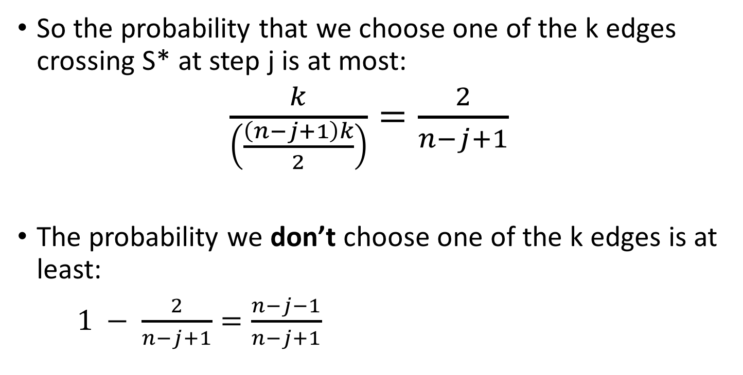
Focus in on:
PR[ e_{j} doesn’t cross S* | e₁,…,e_{j-1} don’t cross S* ]
So the probability that we choose one of the k edges crossing S* at step j is at most:
$\frac{k}{\left(\frac{\left(n−j+1\right)k}{2}\right)}=\frac{2}{n−j+1}$
The probability we don’t choose one of the k edges is at least:
$1 − \frac{2}{n−j+1}=\frac{n−j−1}{n−j+1}$
f
a,b
g
e,h
c
d

Slide 69
Proof of Claim
Say that S* is a minimum cut.
Suppose the edges that we choose are e₁, e₂, …, e_{n-2}
PR[ return S* ] = PR[ none of the e_{i} cross S* ]
= PR[ e₁ doesn’t cross S* ]
$×$PR[ e₂ doesn’t cross S* | e₁ doesn’t cross S* ]
…
$×$PR[ e_{n-2} doesn’t cross S* | e₁,…,e_{n-3} don’t cross S* ]
b
f
a
g
e
c
d
S*
h

Slide 70

Proof of Claim
Say that S* is a minimum cut.
Suppose the edges that we choose are e₁, e₂, …, e_{n-2}
PR[ return S* ] = PR[ none of the e_{i} cross S* ]
=$\left(\frac{n−2}{n}\right)\left(\frac{n−3}{n−1}\right)\left(\frac{n−4}{n−2}\right)\left(\frac{n−5}{n−3}\right)\left(\frac{n−6}{n−4}\right)⋯\left(\frac{4}{6}\right)\left(\frac{3}{5}\right)\left(\frac{2}{4}\right)\left(\frac{1}{3}\right)$
b
f
a
g
e
c
d
S*
h

Slide 71
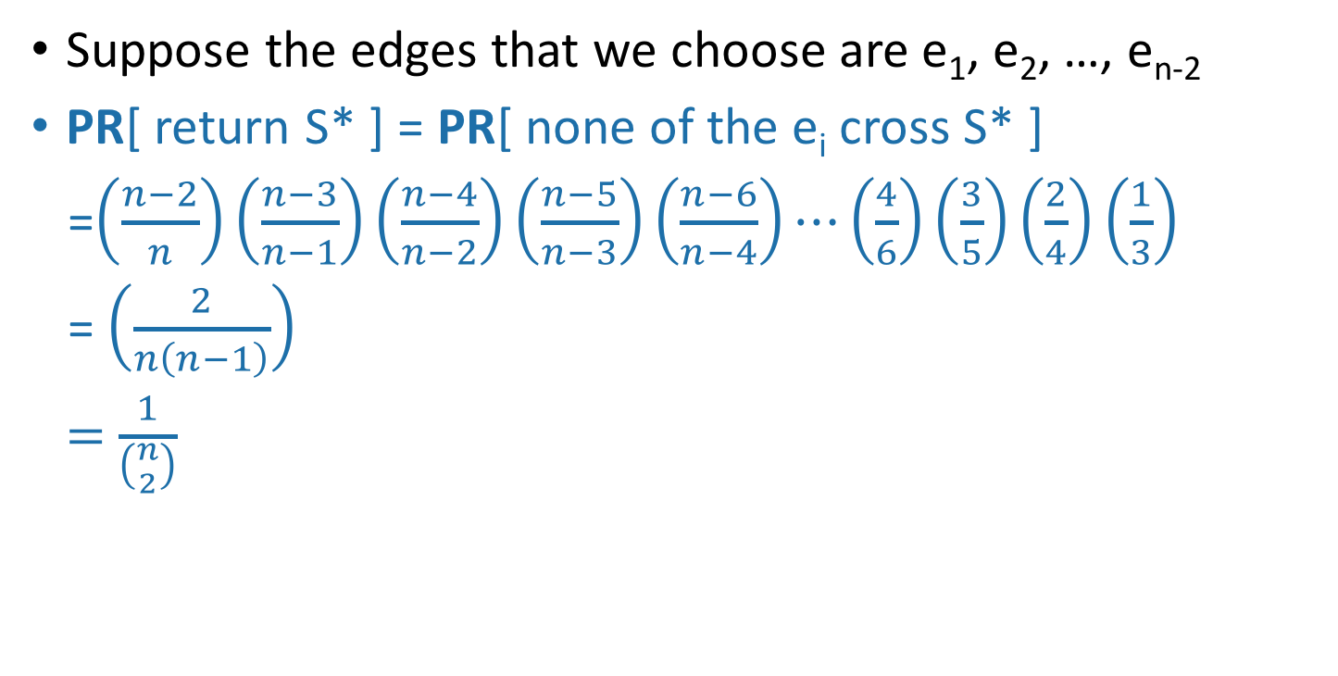
Proof of Claim
Say that S* is a minimum cut.
Suppose the edges that we choose are e₁, e₂, …, e_{n-2}
PR[ return S* ] = PR[ none of the e_{i} cross S* ]
=$\left(\frac{n−2}{n}\right)\left(\frac{n−3}{n−1}\right)\left(\frac{n−4}{n−2}\right)\left(\frac{n−5}{n−3}\right)\left(\frac{n−6}{n−4}\right)⋯\left(\frac{4}{6}\right)\left(\frac{3}{5}\right)\left(\frac{2}{4}\right)\left(\frac{1}{3}\right)$
= $\left(\frac{2}{n\left(n−1\right)}\right)$
= $\frac{1}{\left({n \atop 2}\right)}$
CLAIM PROVED
b
f
a
g
e
c
d
S*
h

Slide 72
Theorem
Assuming the claim about 1/$\left({n \atop 2}\right)…$
Suppose G has n vertices. Then [repeating Karger’s algorithm a bunch of times] finds a min cut in G with probability at least $0.99$in time O(n⁴).
That proves this Theorem!

Slide 73
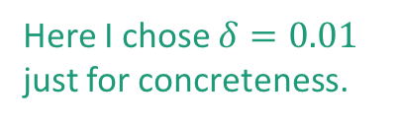
What have we learned?
If we randomly contract edges:
  It’s unlikely that we’ll end up with a min cut.
  But it’s not TOO unlikely
  By repeating, we likely will find a min cut.
Repeating this process:
  Finds a global min cut in time O(n⁴), with probability 0.99.
  We can run a bit faster if we use a union-find data structure.
Here I chose $δ=0.01$ just for concreteness.

Slide 74
More generally
If we have a Monte-Carlo algorithm with a small success probability,
and we can check how good a solution is,
Then we can boost the success probability by repeating it a bunch and taking the best solution.

Slide 75
Can we do better?
Repeating O(n²) times is pretty expensive.
  O(n⁴) total runtime to get success probability 0.99.
The Karger-Stein Algorithm will do better!
  The trick is that we’ll do the repetitions in a clever way.
  O( n²log²(n) ) runtime for the same success probability.
  Warning! This is a tricky algorithm! We’ll sketch the approach here: the important part is the high-level idea, not the details of the computations.
To see how we might save on repetitions,
let’s run through Karger’s algorithm again.

Slide 76
Karger’s algorithm
f
b
a
g
e
c
d
h

Slide 77
Karger’s algorithm
Probability that we didn’t mess up:
12/14
There are 14 edges, 12 of which are good to contract.
random edge!
f
b
a
g
e
c
d
h

Slide 78
Karger’s algorithm
Create a supernode!
f
a
b
g
Create a superedge!
Create a superedge!
e
c
d
h

Slide 79
Karger’s algorithm
Create a supernode!
f
a,b
{e,b}
g
Create a superedge!
{c,a}
{c,b}
Create a superedge!
e
{d,a}
{d,b}
c
d
h

Slide 80
Karger’s algorithm
Probability that we didn’t mess up:
11/13
Now there are only 13 edges, since the edge between a and b disappeared.
f
a,b
{e,b}
g
{c,a}
{c,b}
e
{d,a}
{d,b}
c
d
random edge!
h

Slide 81
Karger’s algorithm
f
a,b
{e,b}
Create a superedge!
g
{c,a}
{c,b}
e
Create a superedge!
{d,a}
{d,b}
h
c
d
Create a supernode!

Slide 82
Karger’s algorithm
f
a,b
{e,b}
Create a superedge!
g
{f,e}
{f,h}
{c,a}
{c,b}
e,h
{g,e}
{g,h}
Create a superedge!
{d,a}
{d,b}
{e,d}
c
d
Create a supernode!

Slide 83
Karger’s algorithm
Probability that we didn’t mess up:
10/12
Now there are only 12 edges, since the edge between e and h disappeared.
f
a,b
{e,b}
g
{f,e}
{f,h}
{c,a}
{c,b}
e,h
{g,e}
{g,h}
{d,a}
{d,b}
{e,d}
c
random edge!
d

Slide 84
Karger’s algorithm
f
a,b
{e,b}
g
{f,e}
{f,h}
{c,a}
{c,b}
e,h
{g,e}
{g,h}
{d,a}
{d,b}
c,d
{e,d}

Slide 85
Karger’s algorithm
Probability that we didn’t mess up:
9/11
f
a,b
{e,b}
g
{f,e}
{f,h}
random edge!
(We pick at random from the original edges).
{c,a}
{c,b}
e,h
{g,e}
{g,h}
{d,a}
{d,b}
c,d
{e,d}

Slide 86
Karger’s algorithm
f
a,b,c,d
g
{e,b}
{f,e}
{f,h}
{e,d}
e,h
{g,e}
{g,h}

Slide 87
Karger’s algorithm
Probability that we didn’t mess up:
5/7
f
a,b,c,d
g
{e,b}
{f,e}
{f,h}
{e,d}
random edge!
e,h
{g,e}
{g,h}

Slide 88
Karger’s algorithm
f
a,b,c,d
{f,g}
{e,b}
{f,e}
{f,h}
{e,d}
e,h,g

Slide 89
Karger’s algorithm
Probability that we didn’t mess up:
3/5
f
a,b,c,d
{f,g}
{e,b}
{f,e}
{f,h}
{e,d}
random edge!
e,h,g

Slide 90
Karger’s algorithm
a,b,c,d
{e,b}
{e,d}
e,h,g,f

Slide 91
Karger’s algorithm
Now stop!
There are only two nodes left.
a,b,c,d
{e,b}
{e,d}
e,h,g,f

Slide 92
Probability of not messing up
At the beginning, it’s pretty likely we’ll be fine.
The probability that we mess up gets worse and worse over time.
12/14
11/13
10/12
9/11
5/7
Moral:
Repeating the stuff from the beginning of the algorithm is wasteful!
probability of success
3/5
iteration

Slide 93
Instead…
b
f
a
g
e
c
d
h
Contract!
a,b
f
g
e
c
d
h
a,b
f,g
Contract!
But it’s okay since this branch made a good choice.
This branch made a bad choice.
e
c
d
h
a,b
f,g
a,b
f,g
FORK!
e
e
c
d
c
d
h
Contract!
h
a,b,e
f,g
Contract!
f,g,h
a,b
e
c
d
c
etc
etc
h
d

Slide 94
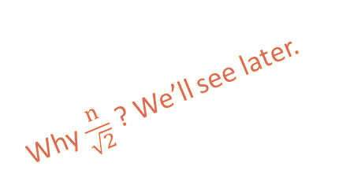
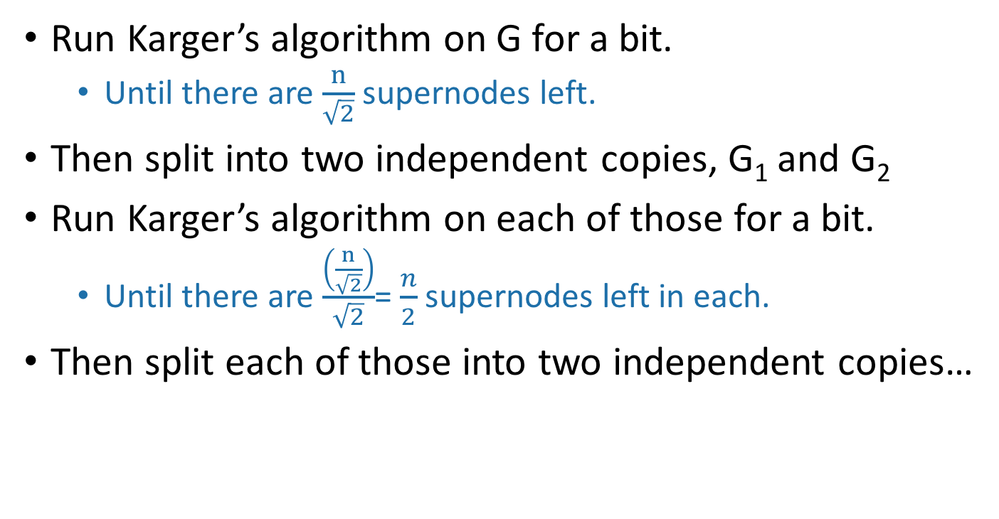
In words
Run Karger’s algorithm on G for a bit.
  Until there are $\frac{n}{\sqrt{2}}$ supernodes left.
Then split into two independent copies, G₁ and G₂
Run Karger’s algorithm on each of those for a bit.
  Until there are $\frac{\left(\frac{n}{\sqrt{2}}\right)}{\sqrt{2}}$= $\frac{n}{2}$ supernodes left in each.
Then split each of those into two independent copies…
Why $\frac{n}{\sqrt{2}}$ ? We’ll see later.

Slide 95
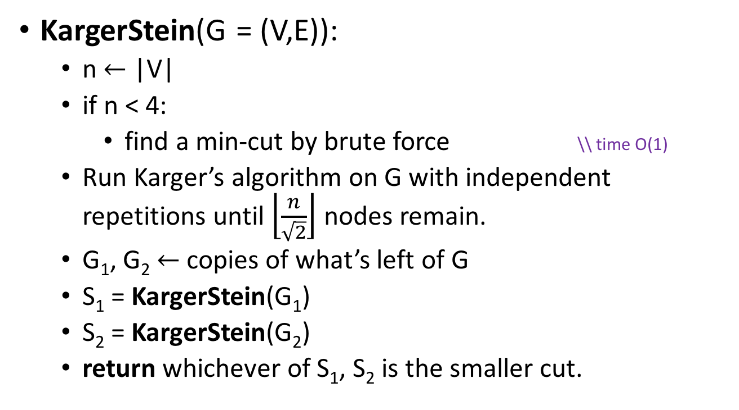
In pseudocode
KargerStein(G = (V,E)):
  n $←$ |V|
  if n < 4:
    find a min-cut by brute force \\ time O(1)
  Run Karger’s algorithm on G with independent repetitions until $\left\lfloor \frac{n}{\sqrt{2}}\right\rfloor$ nodes remain.
  G₁, G₂ $←$ copies of what’s left of G
  S₁ = KargerStein(G₁)
  S₂ = KargerStein(G₂)
  return whichever of S₁, S₂ is the smaller cut.

Slide 96
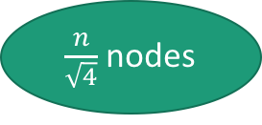
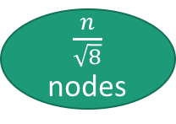
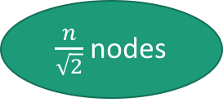
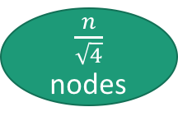
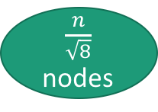
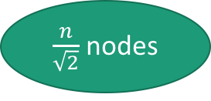
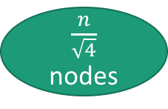
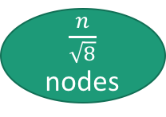
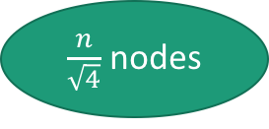
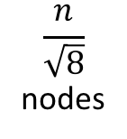
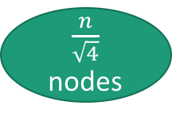

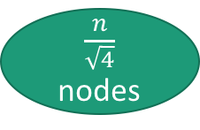
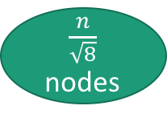
Recursion tree
n nodes
Contract a bunch of edges
$\frac{n}{\sqrt{2}}$ nodes
$\frac{n}{\sqrt{2}}$ nodes
Make 2 copies
$\frac{n}{\sqrt{2}}$ nodes
Contract a bunch of edges
Contract a bunch of edges
$\frac{n}{\sqrt{4}}$ nodes
$\frac{n}{\sqrt{4}}$ nodes
Make 2 copies
$\frac{n}{\sqrt{4}}$ nodes
Make 2 copies
$\frac{n}{\sqrt{4}}$ nodes
$\frac{n}{\sqrt{4}}$ nodes
$\frac{n}{\sqrt{4}}$ nodes
$\frac{n}{\sqrt{8}}$ nodes
$\frac{n}{\sqrt{8}}$ nodes
$\frac{n}{\sqrt{8}}$ nodes
$\frac{n}{\sqrt{8}}$ nodes
$$\frac{n}{\sqrt{8}}$$
nodes

Slide 97
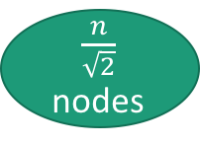
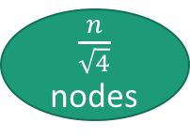


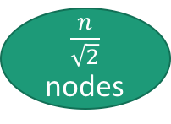

Recursion tree
depth is $\log_{\sqrt{2}}\left(n\right)=\frac{\log\left(n\right)}{log⁡(\sqrt{2})}=2log⁡(n)$
number of leaves is 2^{2log(n)} = n²
n nodes
This counts as one level
for this analysis
Contract a bunch of edges
$\frac{n}{\sqrt{2}}$ nodes
$\frac{n}{\sqrt{2}}$ nodes
Make 2 copies
$\frac{n}{\sqrt{2}}$ nodes
This counts as one level
for this analysis
Contract a bunch of edges
Contract a bunch of edges
$\frac{n}{\sqrt{4}}$ nodes
$\frac{n}{\sqrt{4}}$ nodes

Slide 98
Two questions
Does this work?
Is it fast?

Slide 99
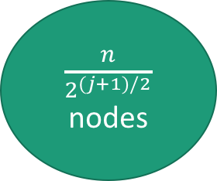
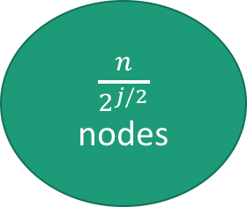



At the j^{th} level
The amount of work per level is the amount of work needed to reduce the number of nodes by a factor of $\sqrt{2}$.
That’s at most O(n²).
  since that’s the time it takes to run Karger’s algorithm once, cutting down the number of supernodes to two.
Our recurrence relation is…
  T(n) = 2T(n/$\sqrt{2}$) + O(n²)
The Master Theorem says…
  T(n) = O(n²log(n))
$\frac{n}{2^{j/2}}$ nodes
Contract a bunch of edges
$\frac{n}{2^{(j+1)/2}}$ nodes
Make 2 copies
$\frac{n}{2^{(j+1)/2}}$ nodes
$\frac{n}{2^{(j+1)/2}}$ nodes
Jedi Master Yoda

Slide 100
Two questions
Does this work?
Is it fast?
  Yes, O(n²log(n)).

Slide 101


Why $n/\sqrt{2}$ ?
Suppose we contract n – t edges, until there are t supernodes remaining.
Suppose the first n-t edges that we choose are
e₁, e₂, …, e_{n-t}
PR[ none of e₁, e₂, …, e_{n-t} cross S*]
= PR[ e₁ doesn’t cross S* ]
$×$PR[ e₂ doesn’t cross S* | e₁ doesn’t cross S* ]
…
$×$PR[ e_{n-t} doesn’t cross S* | e₁,…,e_{n-t-1} don’t cross S* ]

Slide 102


Why $n/\sqrt{2}$ ?
Suppose we contract n – t edges, until there are t supernodes remaining.
Suppose the first n-t edges that we choose are
e₁, e₂, …, e_{n-t}
PR[ none of e₁, e₂, …, e_{n-t} cross S*]
= $\left(\frac{n−2}{n}\right)\left(\frac{n−3}{n−1}\right)\left(\frac{n−4}{n−2}\right)\left(\frac{n−5}{n−3}\right)\left(\frac{n−6}{n−4}\right)⋯\left(\frac{t+1}{t+3}\right)\left(\frac{t}{t+2}\right)\left(\frac{t−1}{t+1}\right)$
= $\frac{t⋅(t−1)}{n⋅(n−1)}$
= $\frac{\frac{n}{\sqrt{2}}⋅\left(\frac{n}{\sqrt{2}}−1\right)}{n⋅(n−1)}≈\frac{1}{2}$
Choose $t=n/\sqrt{2}$
when n is large

Slide 103
Recursion tree
n nodes
Contract a bunch of edges
Pr[ failure ] = 1/2
$\frac{n}{\sqrt{2}}$ nodes
$\frac{n}{\sqrt{2}}$ nodes
Make 2 copies
$\frac{n}{\sqrt{2}}$ nodes
Contract a bunch of edges
Contract a bunch of edges
Pr[ failure ] = 1/2
Pr[ failure ] = 1/2
$\frac{n}{\sqrt{4}}$ nodes
$\frac{n}{\sqrt{4}}$ nodes
Make 2 copies
$\frac{n}{\sqrt{4}}$ nodes
Make 2 copies
$\frac{n}{\sqrt{4}}$ nodes
$\frac{n}{\sqrt{4}}$ nodes
$\frac{n}{\sqrt{4}}$ nodes
Pr[ failure ] = 1/2
Pr[ failure ] = 1/2
$\frac{n}{\sqrt{8}}$ nodes
$\frac{n}{\sqrt{8}}$ nodes
$\frac{n}{\sqrt{8}}$ nodes
$\frac{n}{\sqrt{8}}$ nodes
etc.

Slide 104
Probability of success
n nodes
or
Each with probability 1/2
Is the probability that there’s a path from the root to a leaf with no failures.
$\frac{n}{\sqrt{2}}$ nodes
$\frac{n}{\sqrt{2}}$ nodes
Make 2 copies
$\frac{n}{\sqrt{2}}$ nodes
$\frac{n}{\sqrt{4}}$ nodes
$\frac{n}{\sqrt{4}}$ nodes
Make 2 copies
$\frac{n}{\sqrt{4}}$ nodes
Make 2 copies
$\frac{n}{\sqrt{4}}$ nodes
$\frac{n}{\sqrt{4}}$ nodes
$\frac{n}{\sqrt{4}}$ nodes
$\frac{n}{\sqrt{8}}$ nodes
$\frac{n}{\sqrt{8}}$ nodes
$\frac{n}{\sqrt{8}}$ nodes
$\frac{n}{\sqrt{8}}$ nodes

Slide 105

The problem we need to analyze
Let T be binary tree of depth 2log(n)
Each node of T succeeds or fails independently with probability 1/2
What is the probability that there’s a path from the root to any leaf that’s entirely successful?
It turns out that this is $Ω\left(\frac{1}{\log{n}}\right)$.
  See skipped slides for proof, or try to do it yourself!
  (Proof not covered on exam, but it’s good practice with recurrence relations!)

Slide 106














Success Probability
n nodes
The probability that one run of Karger-Stein succeeds is $Ω\left(\frac{1}{\log{n}}\right)$
$\frac{n}{\sqrt{2}}$ nodes
$\frac{n}{\sqrt{2}}$ nodes
Make 2 copies
$\frac{n}{\sqrt{2}}$ nodes
$\frac{n}{\sqrt{4}}$ nodes
$\frac{n}{\sqrt{4}}$ nodes
$\frac{n}{\sqrt{4}}$ nodes
Make 2 copies
$\frac{n}{\sqrt{4}}$ nodes
$\frac{n}{\sqrt{4}}$ nodes
Make 2 copies
$\frac{n}{\sqrt{4}}$ nodes
$\frac{n}{\sqrt{8}}$ nodes
$\frac{n}{\sqrt{8}}$ nodes
$\frac{n}{\sqrt{8}}$ nodes
$\frac{n}{\sqrt{8}}$ nodes
106

Slide 107





Analysis
Slide skipped in class
$$2^{d/2}$$
nodes
Say the tree has height d.
Let $p_{d}$ be the probability that there’s a path from the root to a leaf that doesn’t fail.
$p_{d}=\frac{1}{2}⋅Pr\left[ \begin{matrix} & \\ & \\ & \end{matrix} \right]$
= $\frac{1}{2}⋅\left(\begin{aligned}Pr\left[ \begin{matrix} & \\ & \\ & \end{matrix}\right]+Pr\left[ \begin{matrix} & \\ & \\ & \end{matrix}\right] \\ −Pr\left[ \begin{matrix} & \\ & \\ & \end{matrix}\right]\end{aligned}\right)$
= $\frac{1}{2}⋅\left(p_{d−1}+p_{d−1} −p_{d−1}^{2}\right)$
= $p_{d−1} −\frac{1}{2}⋅p_{d−1}^{2}$
Contract a bunch of edges
$2^{(d−1)/2}$ nodes
at least one subtree has a successful path
Make 2 copies
wins
wins
$2^{(d−1)/2}$ nodes
$2^{(d−1)/2}$ nodes
both win

Slide 108

It’s a recurrence relation!
Slide skipped in class
$p_{d}= p_{d−1} −\frac{1}{2}⋅p_{d−1}^{2}$
$p_{0}=1$
We are real good at those.
In this case, the answer is:
  Claim: for all d, $p_{d}≥\frac{1}{d+1}$

Slide 109



Recurrence relation
$p_{d}= p_{d−1} −\frac{1}{2}⋅p_{d−1}^{2}$
$p_{0}=1$
Claim: for all d, $p_{d}≥\frac{1}{d+1}$
Proof: induction on d.
Base case: $1≥1.$ YEP.
Inductive step: say d > 0.
  Suppose that $p_{d−1}≥\frac{1}{d}$.
  $p_{d}= p_{d−1} −\frac{1}{2}⋅p_{d−1}^{2}$
  $≥\frac{1}{d}−\frac{1}{2}⋅\frac{1}{d^{2}}$
  $≥\frac{1}{d}−\frac{1}{d\left(d+1\right)}$
  $=\frac{1}{d+1 }$
This slide skipped in class

Slide 110


What does that mean for Karger-Stein?
Slide skipped in class
Claim: for all d, $p_{d}≥\frac{1}{d+1}$
For d = 2log(n)
  that is, d = the height of the tree:
$$p_{2log⁡(n)}≥\frac{1}{2log⁡(n)+1}$$
aka,
Pr[ Karger-Stein is successful ] = $Ω\left(\frac{1}{\log\left(n\right)}\right)$

Slide 111

Altogether now
Karger-Stein succeeds with probability$Ω\left(\frac{1}{\log{n}}\right)$.
We can amplify the success probability by repetition:
  Run Karger-Stein $O\left(\log\left(n\right)⋅log\left(\frac{1}{δ}\right)\right)$times to achieve success probability $1 −δ.$
Each iteration takes time $O\left(n^{2}\log\left(n\right)\right)$
  That’s what we proved before.
Choosing $δ=0.01$ as before, the total runtime is
$O\left(n^{2}\log\left(n\right)⋅log\left(n\right)\right)$ $= O\left(n^{2}\log^{2}{{\left(n\right)}^{ }}\right)$
Much better than O(n⁴)!

Slide 112

What have we learned?
Just repeating Karger’s algorithm isn’t the best use of repetition.
  We’re probably going to be correct near the beginning.
Instead, Karger-Stein repeats when it counts.
  If we wait until there are $\frac{n}{\sqrt{2}}$ nodes left, the probability that we fail is close to ½.
This lets us (probably) find a global minimum cut in an undirected graph in time O(n² log²(n) ).
  Notice that we can’t do better than n² in a dense graph (we need to look at all the edges), so this is pretty good.

Slide 113
Recap
Some algorithms:
  Karger’s algorithm for global min-cut
  Improvement: Karger-Stein
Some concepts:
  Monte Carlo algorithms:
    Might be wrong, are always fast.
  We can boost their success probability with repetition.
  Sometimes we can do this repetition very cleverly.

Slide 114
Next time
More min-cuts…and max flows!
Pre-lecture exercise: routing on rickety bridges!
Before next time

