Slide 1
CS 161 Section 4
[CA Name]

Slide 2
Agenda
Comparison based sorting
Lower-bound on performance
Non-comparison based sorting
Models of computation
Bucket sort
Radix sort
Tree data-structures
Heaps
Binary search trees
Red-Black trees

Slide 3
Comparisons & Sorting

Slide 4
A note on algorithm design
When designing an algorithm, how can I know when it has reached its best possible asymptotic behavior?
What ensures us that an algorithm in O(n^2) can or can’t be further optimized into O(n*log n) or O(n^1.8)?
Most times we don’t know…

Slide 5
A note on algorithm design
Matrix Multiplication algorithm (one of the most important algorithms ever)
O(n^3) – Base naïve version (1800s)
O(n^2.808) – Strassen 1969
O(n^2.795) – Pan 1978
O(n^2.780) – Bini, Capovani, Romani 1979
O(n^2.522) – Schönhage 1981
O(n^2.517) – Romani 1981
O(n^2.496) - Coppersmith and Winograd 1981
O(n^2.374) – Strassen 1986
O(n^2.3755) - Coppersmith and Winograd 1990
O(n^2.3737) – Slothers 2010
O(n^2.372873) – Vassilevska-Williams 2012
O(n^2.372864) – Le Gall 2014
O(n^2.3728596) – Alman and Vassilevska-Williams 2020
Is it possible to achieve O(n^2)? Are we converging to O(n^2.3)?

Slide 6
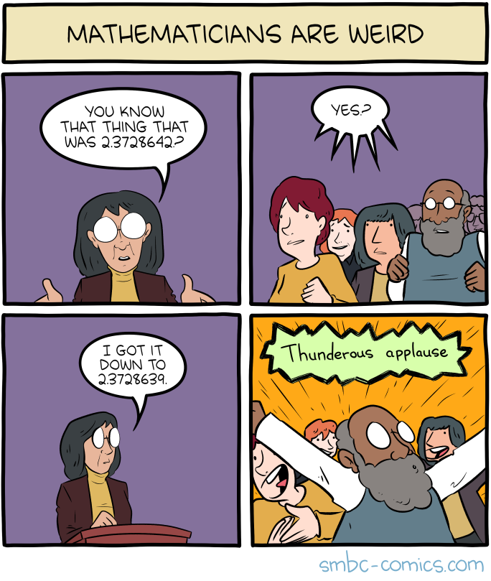
Incentive: you get an A+ in the course if you provide a proof of O(n^2) matrix multiplication on the back of your final exam :)

Slide 7
A note on algorithm design
Good news: sometimes we do know!
Comparison-based sorting is Ω(n logn)
It all relates to what is our “model computation”
Which operations can be performed
What information can be obtained and stored
Limits in power and memory

Slide 8
Lower bound of Ω(n log(n)).
Theorem:
Any deterministic comparison-based sorting algorithm must take Ω(n log(n)) steps.
Proof recap:
Any deterministic comparison-based algorithm can be represented as a decision tree with n! leaves.
The worst-case running time is at least the depth of the decision tree.
All decision trees with n! leaves have depth Ω(n log(n)).
So any comparison-based sorting algorithm must have worst-case running time at least Ω(n log(n)).

Slide 9
A: At least the length of the path from the root to the corresponding leaf.
If we take this path through the tree, the runtime is
Ω(length of the path).
?
YES
NO
?
?
YES
NO
YES
NO
?
?
?
?

Slide 10
How long is the longest path?
We want a statement: in all such trees, the longest path is at least _____
?
This is a binary tree with at least _____ leaves.
The shallowest tree with n! leaves is the completely balanced one, which has depth ______.
So in all such trees, the longest path is at least log(n!).
YES
NO
n!
?
?
YES
NO
YES
NO
?
?
?
?
log(n!)
n! is about (n/e)^{n} (Stirling’s approximation).
log(n!) is about n log(n/e) = Ω(n log(n)).
Conclusion: the longest path has length at least Ω(n log(n)).

Slide 11
Some “bad” news
Theorem:
Any deterministic comparison-based sorting algorithm must take Ω(n log(n)) steps.
Theorem:
Any randomized comparison-based sorting algorithm must take Ω(n log(n)) steps in expectation.
Bad Side: we can’t improve on n*log(n)
Bright Side: we know we’re done and can focus on other problems
There’s some keywords on this theorem…

Slide 12
Non-comparison based model of computation
The items you are sorting have meaningful values, meaning we can somehow evaluate them without the need of a direct comparison
9
6
3
5
2
1
2
instead of

Slide 13
Implement the buckets as linked lists. They are first-in, first-out. This will be useful later.
Bucket Sort:
9
6
3
5
2
1
2
2
1
2
3
5
6
9
1
2
3
4
5
6
7
8
9
Concatenate the buckets!
SORTED!
In time O(n).

Slide 15
Radix Sort
Clearly however we were only sorting 1-digit numbers, so it’s easy to know in which bucket they go
How can we generalize to sorting arbitrary U-digit numbers?
Could we sort strings?
For sorting integers up to size U or lexicographically sorting strings
Idea: Bucket Sort on the least-significant digit/letter first, then the next least-significant, and so on until the maximum length

Slide 16
Step 1: BucketSort on least significant digit
21
345
13
101
50
234
1
1
101
234
345
50
13
21
0
1
2
3
4
5
6
7
8
9
50
21
101
1
13
234
345

Slide 17
Step 2: BucketSort on the 2nd least sig. digit
50
21
101
1
13
234
345
1
345
13
21
234
50
101
0
1
2
3
4
5
6
7
8
9
101
1
13
21
234
345
50

Slide 18
Step 3: BucketSort on the 3rd least sig. digit
101
1
13
21
234
345
50
50
21
13
234
345
1
101
0
1
2
3
4
5
6
7
8
9
1
13
21
50
101
234
345

Slide 19
Why does this work?
Original array:
21
345
13
101
50
234
1
Next array is sorted by the first digit.
50
21
101
1
13
234
345
50
21
101
1
13
234
345
Next array is sorted by the first two digits.
101
1
13
21
234
345
50
101
01
13
21
234
345
50
Next array is sorted by all three digits.
1
13
21
50
101
234
345
001
013
021
050
101
234
345
Sorted array

Slide 20
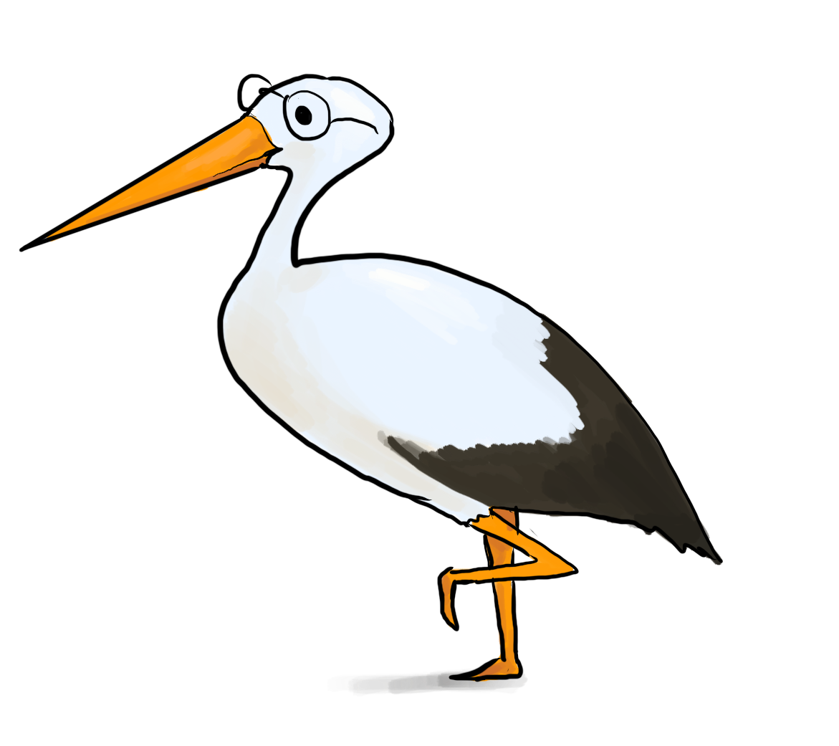
General running time of Radix Sort
Convince yourself that this is the right formula for d.

Slide 21
Choosing a good value for num buckets r=n

Slide 22
Tree data-structures

Slide 23
Heaps
A (binary min) heap is a complete binary tree so that:
Every descendant of a node has key larger than that node.
Example of a heap:
1
2
5
4
3
8
7

Slide 24
INSERT in a Heap
EXAMPLE: Insert 4.5
INSERT(key):
\\ insert to bottom of heap:
x = new-node()*
x.key = key
\\ “bubble” up:
while x.key < parent(x).key
Swap keys of x and parent(x)
x = parent(x)
1
3
6
5
4
7
NIL

Slide 25
EXTRACT-MIN in a Heap
EXTRACT-MIN():
x = root
min = x.key
\\ replace root w/ last element:
y = pointer to last node*
x.key = y.key
delete(y)
\\ “bubble down”:
while true
if left(x).key < x.key,right(x).key
Swap keys of x and left(x)
x = left(x)
else-if right(x).key < x.key
Swap keys of x and right(x)
x = right(x)
else
return min
1
4
5
8
7
9

Slide 26
Complexity of Heap operations
How long do these take? INSERT / EXTRACT-MIN
O(1) for each swap up the tree
O(1) for each swap down the tree
In total: O(height) = O(log(n))
(equal since we are in a complete binary tree)

Slide 27
Binary Search Trees
A BST is a binary tree so that:
Every LEFT descendant of a node has key less than that node.
Every RIGHT descendant of a node has key larger than that node.
Example of building a binary search tree:
5
Q: Is this the only binary search tree I could possibly build with these values?
3
7
A: No. I made choices about which nodes to choose when. Any choices would have been fine.
2
4
8
1

Slide 28
SEARCH in a Binary Search Tree definition by example
EXAMPLE: Search for 4
5
EXAMPLE: Search for 4.5
It turns out it will be convenient to return 4 in this case
(that is, return the last node before we went off the tree)
3
7
!!!!
2
4
8
Write pseudocode (or actual code) to implement this!
1
Ollie the over-achieving ostrich

Slide 29
Red-Black Trees obey the following rules (which are a proxy for balance)
Every node is colored red or black.
The root node is a black node.
NIL children count as black nodes.
Children of a red node are black nodes.
For all nodes x:
all paths from x to NIL’s have the same number of black nodes on them.
5
3
7
2
4
6
8
The NIL children are treated as black nodes.
NIL
NIL
NIL
NIL
NIL
NIL
NIL
NIL

Slide 30
The height of a RB-tree with $n$ non-NIL nodes is at most $2log⁡(n+1)$
x
Define b(x) to be the number of black nodes in any path from x to NIL.
(excluding x, including NIL).
Claim:
There are at least 2^{b(x)} – 1 non-NIL nodes in the subtree underneath x. (Including x).
[Proof by induction – see lecture notes]
y
z
NIL
Claim: at least 2^{b(x)} – 1 nodes in this WHOLE subtree (of any color).
Then:
$$n≥2^{b\left(root\right)} −1$$
$≥2^{{height}/2 } −1$
Rearranging:
$$n+1≥2^{{height}/2 } ⇒height≤2log⁡(n+1)$$
using the Claim
b(root) >= height/2 because of RBTree rules.

Slide 31
Running times Heap vs. BST(Red-Black Trees)
 | Sorted Arrays | Linked Lists | Heaps | Red-Black Binary Search Trees
Search | O(log(n)) | O(n) | O(n) | O(log(n))
Delete | O(n) | Search +O(1) | Search +O(log(n)) | O(log(n))
Insert | O(n) | O(1) | O(log(n)) | O(log(n))
Extract-min | O(1) | O(n) | O(log(n)) | O(log(n))

