Slide 1
CS 161
Design and Analysis of Algorithms
Lecture 1:
Logistics, introduction, and multiplication!
Slides originally created by Mary Wootters.

Slide 2
How was your break?

Slide 3
The big questions
Who are we?
  Professors, TAs, students?
Why are we here?
  Why learn about algorithms?
What is going on?
  What is this course about?
  Logistics?
  Embedded ethics?
Can we multiply integers?
  And can we do it quickly?

Slide 4
Who are we?
Instructors
EthiCS
Awesome TAs
Course Coordination

Slide 5
Who are you?
Frosh
Sophomores
Juniors
Seniors
MA/MS Students
PhD Students
NDO Students
Concentrating in:
Art Practice
Bioengineering
Biology
Biomedical Informatics
Chemical Eng.
Civil & Env. Eng.
Comparative Literature
Computation and Mathematical Eng.
Computer Science
Earth Systems
East Asian Studies
Economics
Electrical Eng.
Engineering
Energy Resources Eng.
History
Material Sci & Eng.
Math
Math & CS
Mechanical Eng.
MS&E
Philosophy
Physics
Political Science
Psychology
Sociology
Spanish
Statistics
Symbolic Systems
Theater & Performative Studies
Undeclared

Slide 6
Where are you?

Slide 7
Why are we here?
I’m here because I’m super excited about algorithms!
Yay Algorithms!

Slide 8
Why are you here?
You are better equipped to answer this question, but I’ll give it a go …
Algorithms are fundamental.
Algorithms are useful.
Algorithms are fun!
CS161 is a required course.
Why is CS161 required?
Algorithms are fundamental.
Algorithms are useful.
Algorithms are fun!

Slide 9
Algorithms are fundamental
The
Algorithmic
Lens
Operating Systems (CS 140)
Machine learning (CS 229)
Cryptography (CS 255)
Compilers (CS 143)
Networking (CS 144)
Computational Biology (CS 262)

Slide 10
Algorithms are useful
All those things without the course numbers.
As inputs get bigger and bigger, having good algorithms becomes more and more important!

Slide 11
Algorithms are fun!
Algorithm design is both an art and a science.
Many surprises!
Many exciting research questions!

Slide 12
What’s going on?
Course goals/overview
Logistics

Slide 13
Course goals
The design and analysis of algorithms
  They go hand-in-hand
In this course you will:
  Learn to think analytically about algorithms
  Flesh out an “algorithmic toolkit”
  Learn to communicate clearly about algorithms

Slide 14
Roadmap
More detailed schedule on the website!
5 lectures
Randomized Algs
2 lectures
Asymptotic Analysis
Data structures
Sorting
Today
MIDTERM
Divide and conquer
Recurrences
Dynamic Programming
Greedy Algs
Graphs!
Longest, Shortest, Max and Min…
FINAL
9 lectures
The
Future!
1 lecture

Slide 15

Our guiding questions:
Does it work?
Is it fast?
Can I do better?

Slide 16
Our internal monologue…
What exactly do we mean by better? And what about that corner case? Shouldn’t we be zero-indexing?
Dude, this is just like that other time. If you do the thing and the stuff like you did then, it’ll totally work real fast!
Does it work?
Is it fast?
Can I do better?
Plucky the
Pedantic Penguin
Lucky the
Lackadaisical Lemur
Detail-oriented
Precise
Rigorous
Big-picture
Intuitive
Hand-wavey
Both sides are necessary!

Slide 17
Aside: the bigger picture
Does it work?
Is it fast?
Can I do better?
Should it work?
Should it be fast?
We want to reduce crime.
It would be more “efficient” to put cameras in everyone’s homes/cars/etc.
We want advertisements to reach to the people to whom they are most relevant.
It would be more “efficient” to make everyone’s private data public.
We want to design algorithms, that work well, on average, in the population.
It would be more “efficient” to focus on the majority population.

Slide 18
Course elements and resources
Course website:
  cs161.stanford.edu
Lectures
  Pre-Lecture Exercises
  Lecture Notes
  IPython Notebooks
  Concept Check Questions
References
Sections
Homework
Exams
Office Hours and Ed

Slide 19
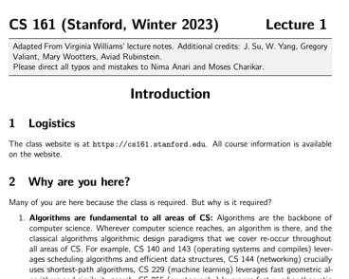
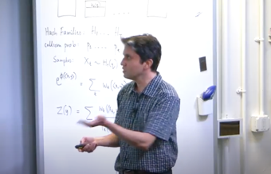
Lectures
Mon/Wed 9:30am-10:50am (Nvidia Auditorium)
  Live on Zoom (you can ask questions)
  Note: lecture ends at 10:50am and NOT 11:20am
Resources available:
  Pre-lecture exercises
  Slides, Videos, Notes, IPython notebooks, Concept Check Qns
Videos from lecture are available!
Slides are the slides from lecture.
Hand-outs and references have mathy details that slides may omit
IPython notebooks have implementation details that slides may omit.

Slide 20
Embedded EthiCS Lectures
Pre-recorded videos (by Diana Acosta-Navas) with embedded concept check questions.
  You are responsible for watching them.
EthiCS questions will also be in your homework and your exams.
More on EthiCS in a bit …

Slide 21
How to get the most out of lectures
During lecture:
  Participate live (if you can), ask questions.
  Engage with in-class questions.
Before lecture:
  Do pre-lecture exercises on the website.
After lecture:
  Go through the exercises on the slides.
Do the reading
  either before or after lecture, whatever works best for you.
  do not wait to “catch up” the week before the exam.
Think-Pair-Share Terrapins (in-class questions)
Siggi the Studious Stork
(recommended exercises)
Ollie the Over-achieving Ostrich
(challenge questions)

Slide 22
IPython Notebooks
Lectures will occasionally be accompanied by IPython notebooks (but not homework)
  For the next lecture, the pre-lecture exercise is to get started with Jupyter Notebooks and with Python.
  See the course website for details.
The goal is to make the algorithms (and their runtimes) more tangible.

Slide 23
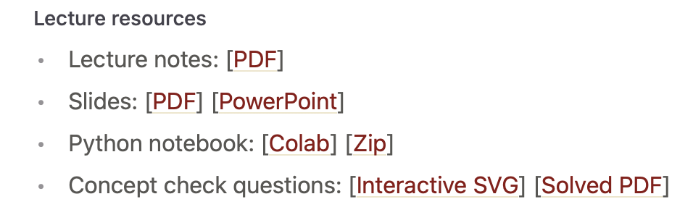
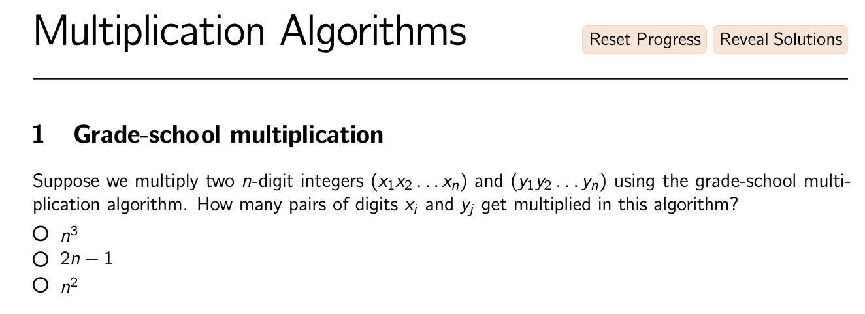
Concept Check Questions
Not part of grade; will not be graded
Links to question sets part of resources for each lecture (via Lectures tab on website)

Slide 24
Optional References
Algorithms Illuminated, Vols 1,2 and 3 by Tim Roughgarden
Additional resources at algorithmsilluminated.org
We may also refer to the following (optional) books:
”CLRS”: Introduction to Algorithms by Cormen, Leiserson, Rivest, and Stein. Available FOR FREE ONLINE through the Stanford library.
“Algorithm Design” by Kleinberg and Tardos

Slide 25
Sections
Taught by your amazing TAs and will
recap lecture
show you how to apply the ideas you learned in lecture
can occasionally cover new material
Sections are as “mandatory” as lectures:
we will not track attendance, but
sections (practice, practice, practice) are the best way to learn the material in CS 161
also, a good place to find community

Slide 26
Homework
Weekly assignments, posted Wednesday by 12:30pm, due the next Wednesday 11:59pm.
First HW will be posted this Wednesday
There are 8 total (no HW the week before midterm)
  HW1, HW2, HW3: solo submissions
  HW4, HW5, HW6, HW7, HW8: solo/pair submissions

Slide 27
How to get the most out of homework
HW has two parts: exercises and problems.
Do the exercises on your own.
Try the problems on your own before discussing it with classmates.
If you get help from a CA during office hours:
  Try the problem first.
  Ask: “I was trying this approach and I got stuck here.”
  After you’ve figured it out, write up your solution from scratch, without the notes you took during office hours.

Slide 28
Exams
There will be a midterm and a final
  Midterm: Thu Feb 16, 6:00pm–9:00pm
    Covers lectures 1-7
  Final: Thu Mar 23, 8:30am–11:30am
    Covers everything, but more focus on lectures 8-18
8 homeworks, lowest score dropped
Weighting: HW (50%), Midterm (20%), Final (30%)
If you have a conflict with the midterm time, email
cs161-win2223-staff@lists.stanford.edu ASAP!!!!!

Slide 29

Talk to us!
Ed discussion forum:
  Link on top of the course website
  Course announcements will be posted there
  Discuss material with TAs and your classmates
Office hours:
  See course website for schedule
  Some online, some in-person
  They start later this week

Slide 30
Talk to each other!
Answer your peers’ questions on Ed!

Slide 31
Course elements and resources
Course website:
  cs161.stanford.edu
Lectures
  Pre-Lecture Exercises
  Lecture Notes
  IPython Notebooks
  Concept Check Questions
References
Sections
Homework
Exams
Office Hours and Ed

Slide 32

A note on course policies
Course policies are listed on the website.
Read them and adhere to them.
That’s all I’m going to say about course policies
(except for a couple of slides on collaboration and the honor code)

Slide 33
Collaboration
We encourage collaboration on homework (but strongly recommend you do exercises on your own)
Valid and invalid modes of collaboration are detailed on the course website.
  Briefly, you can exchange ideas with classmates but must write up solutions on your own (except for pair submissions from HW4 onwards).
  For pair submissions (HW4 onwards), each person must understand and contribute to the solution for each individual problem.
You must cite all collaborators, as well as all sources used (outside of course materials).

Slide 34
Honor code
Updated two years ago: “In all cases, it is not permissible for students to enter exam questions into any software, apps, or websites. Accessing resources that directly explain how to answer questions from the actual assignment or exam is a violation of the Honor Code.”
Course policy for homework: “In all cases, it is not permissible for students to enter homework questions into any software, apps, or websites. Accessing resources that directly explain how to answer questions from the actual assignment or exam is a violation of course policy.”

Slide 35
Bug bounty!
We hope all PSETs and slides will be bug-free.
Howover, we sometmes maek typos.
If you find a typo (that affects understanding*) on slides, IPython notebooks, Section material or PSETs:
  Let us know! (Post on Ed or tell a CA).
  The first person to catch a serious bug might get a good citizenship bonus point.
Bug Bounty Hunter
*So, typos lke thees onse don’t count, although please point those out too. Typos like 2 + 2 = 5 do count, as does pointing out that we omitted some crucial information.

Slide 36
For SCPD Students (and all students)
Some office hours held online
One of the recitation sections will be recorded.
See the website for more details! (coming soon…)

Slide 37
OAE forms
Please send OAE forms to
cs161-win2223-staff@lists.stanford.edu

Slide 38
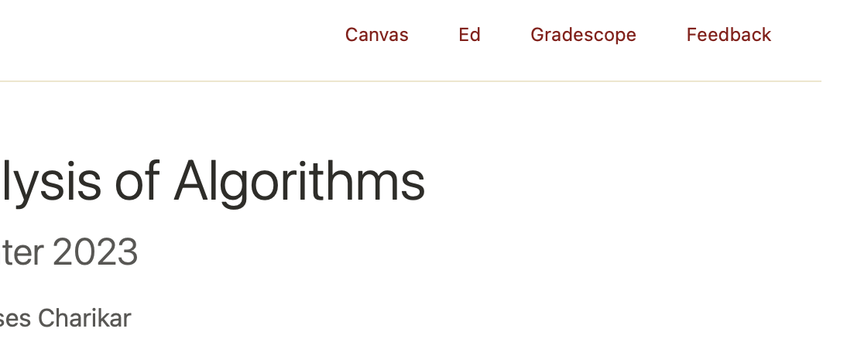
Feedback!
We will have high-resolution feedback throughout the course (subset of you randomly asked each week, starting week 2), as well as an anonymous feedback form.
Please help us improve the course!

Slide 39
How are you approaching CS 161?

Slide 40
Everyone can succeed in this class!
Work hard
Work smart
Ask for help

Slide 41
The big questions
Who are we?
  Professor, TA’s, students?
Why are we here?
  Why learn about algorithms?
What is going on?
  What is this course about?
  Logistics?
  Embedded Ethics?
Can we multiply integers?
  And can we do it quickly?

Slide 42
Introducing Embedded Ethics
Diana Acosta-Navas
Postdoctoral Fellow, McCoy Family Center for Ethics in Society and Institute for Human Centered Artificial Intelligence

Slide 43
Other big questions
Who am I?
Why am I here?
What is Embedded Ethics?
What has ethics got to do with algorithms?

Slide 44
Who am I?
I’m Diana, a post-doctoral fellow at the McCoy Family Center for Ethics in Society and Stanford Institute for Human-Centered Artificial Intelligence
I finished my Ph.D. in Philosophy at Harvard University
I taught ethics at the Harvard Kennedy School of Government
I also became part of Embedded EthiCS@Harvard
Now I’m helping Stanford to develop our Embedded Ethics program

Slide 45
What is Embedded Ethics?
Training the next generation of computer scientists to “consider ethical issues from the outset rather than building technology and letting problems surface downstream” by integrating skills and habits of ethical analysis throughout the Stanford Computer Science curriculum.
Elan the Ethical Emu

Slide 46
What is Embedded Ethics?
The Vision
Responsible ethical reasoning is a highly valuable skill.
One that needs to be integrated with technical, managerial, and other skills we apply in our professional lives
Successfully integrating these skills requires a distributed pedagogy approach
Elan the Ethical Emu

Slide 47
What is Embedded Ethics?
What we teach
Issue spotting and ethical sensitivity.
Recognizing values in design choices.
Developing language to talk about moral choices.
Professional responsibilities of computer scientists & software engineers.
Important topics in technology ethics: bias & fairness, inequality, privacy, surveillance, data control & consent, trust, disinformation, participatory design, concentration of power.
Elan the Ethical Emu

Slide 48
Where is Embedded Ethics?
Outside Stanford
At Stanford
Harvard (2017)
Georgetown (2017)
Brown (2019)
Northeastern (2019)
MIT (2020)
Andover (2021)
… and many other places
CS106A
CS106B
CS107
CS109
CS221
CS247
CS147
... and more over the next two years

Slide 49
And what does ethics have to do with algorithms?

Slide 50
If algorithms are fundamental (which they are) …
Then some of the most consequential choices you will make as computer scientists are:
  Deciding which problem to solve
    This often is a huge ethical question
  Deciding how to turn that problem into something algorithmically tractable
    This also can involve serious ethical decisions
  Deciding which algorithm to use to solve it and what tradeoffs to accept
    Which often requires ethical reasoning

Slide 51
Algorithms & the Good
Turn a real-world problem into a formal problem
Use an algorithm to solve the problem
Happiness ensues

Slide 52
Algorithms & the Good
Turn a real-world problem into a formal problem
Use an algorithm to solve the problem
Happiness ensues

Slide 53
Some (potentially impactful) decisions:
We often need to ignore or change aspects of a real-world situation in order to turn it into an algorithmically solvable problem. For example, we can write an algorithm that sorts a numbered list without knowing what the numbers are numbers of.
  Abstraction is when we omit details of the real-world situation.
    Omit the kind of thing being sorted by our algorithm, or what condition it is in, or what color it is, or how long it has been in the list.
  Idealization is when we deliberately change aspects of the real-world situation.
    Round the numbers being sorted to make them whole numbers.

Slide 54
Real-world problem? I don’t see you all the way over there …
Turn a real-world problem into a formal problem
Use an algorithm to solve the problem
Happiness ensues

Slide 55
So how do we make sure we aren’t losing important features of the real-world problem when we formalize it?
Turn a real-world problem into a formal problem
Use an algorithm to solve the problem
Happiness ensues

Slide 56
By the time you finish 161 you will have an “algorithmic tool kit”– which one is right for the job?
Turn a real-world problem into a formal problem
Use an algorithm to solve the problem
Happiness ensues

Slide 57
Did we achieve what we set out achieve in the first place? What did we lose along the way? Is this a desirable outcome?
Turn a real-world problem into a formal problem
Use an algorithm to solve the problem
Happiness –or something– ensues

Slide 58

Our guiding questions:
Does it work?
Is it fast?
Can I do better?
Can I do it right?

Slide 59
Thank you!
You can always email me at dacostan@stanford.edu

Slide 60
The big questions
Who are we?
  Professor, TA’s, students?
Why are we here?
  Why learn about algorithms?
What is going on?
  What is this course about?
  Logistics?
  Embedded Ethics?
Can we multiply integers?
  And can we do it quickly?

Slide 61
Today’s goals
Course goals
Think analytically about algorithms
Flesh out an “algorithmic toolkit”
Learn to communicate clearly about algorithms
Karatsuba Integer Multiplication
Algorithmic Technique:
  Divide and conquer
Algorithmic Analysis tool:
  Intro to asymptotic analysis

Slide 62
Let’s start at the beginning

Slide 63
Etymology of “Algorithm”
Al-Khwarizmi was a 9th-century scholar, born in present-day Uzbekistan, who studied and worked in Baghdad during the Abbassid Caliphate.
Among many other contributions in mathematics, astronomy, and geography, he wrote a book about how to multiply with Arabic numerals.
His ideas came to Europe in the 12th century.
Dixit algorizmi
(so says Al-Khwarizmi)
Originally, “Algorisme” [old French] referred to just the Arabic number system, but eventually it came to mean “Algorithm” as we know today.
Notes:
So in some sense, the grade-school multiplication algorithm is the ultimate “algorithm!”

Slide 64
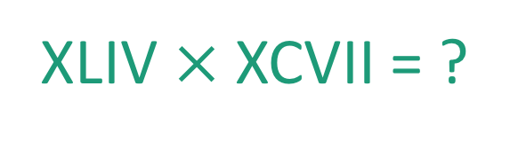
This was kind of a big deal
44
97
XLIV $×$XCVII = ?
x

Slide 65
Integer Multiplication
44
97
x

Slide 66
Integer Multiplication
1234567895931413
4563823520395533
x

Slide 67

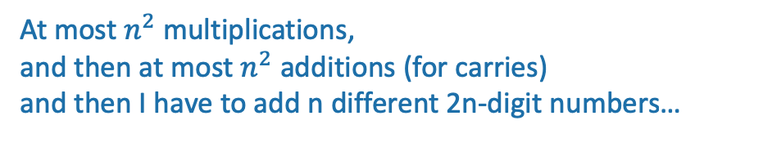
Integer Multiplication
n
1233925720752752384623764283568364918374523856298
4562323582342395285623467235019130750135350013753
x
How fast is the grade-school multiplication algorithm?
???
(How many one-digit operations?)
About $n^{2}$one-digit operations
Think-pair-share Terrapins
At most $n^{2}$multiplications,
and then at most $n^{2}$ additions (for carries)
and then I have to add n different 2n-digit numbers…
Plucky the Pedantic Penguin

Slide 68
Big-Oh Notation
We say that Grade-School Multiplication
“runs in time O(n²)”
Formal definition coming Wednesday!
Informally, big-Oh notation tells us how the running time scales with the size of the input.

Slide 69
Implemented in Python, on a laptop
highly non-optimized
The runtime “scales like” n²
Looks like it’s roughly
T_{laptop}(n) = 0.0063 n² – 0.5 n + 12.7 ms...

Slide 70

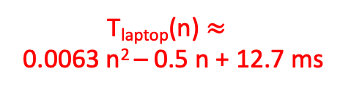
Implemented by hand
The runtime still “scales like” n²
Some other quadratic function of n
T_{laptop}(n) $≈$
0.0063 n² – 0.5 n + 12.7 ms
Notes:
It totally takes me less than 30 seconds to multiply two 500-digit numbers…

Slide 71



Why is big-Oh notation meaningful?
Wizard’s algorithm
$≈\frac{n^{1.6}}{10}+100$
$$≈.0063n^{2}$$
Notes:
It totally takes me less than 30 seconds to multiply two 500-digit numbers…

Slide 72
Let n get bigger…
$≈\frac{n^{1.6}}{10}+100$
Time (ms)
$$≈.0063n^{2}$$
Wizard’s algorithm

Slide 73
Take-away
An algorithm that runs in time O(n^{1.6}) is “better” than an algorithm that runs in time O(n²).
So the question is…

Slide 74

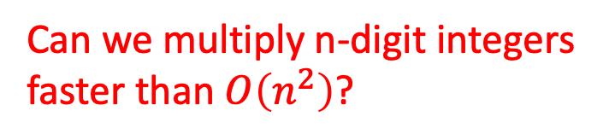

Can we do better?
Can we multiply n-digit integers faster than $O\left(n^{2}\right)$?
$$n^{2}$$
$$n$$

Slide 75
Let’s dig into our algorithmic toolkit…

Slide 76
Divide and conquer
Break problem up into smaller (easier) sub-problems
Big problem
Smaller problem
Smaller problem
Yet smaller problem
Yet smaller problem
Yet smaller problem
Yet smaller problem

Slide 77
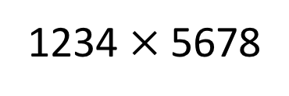
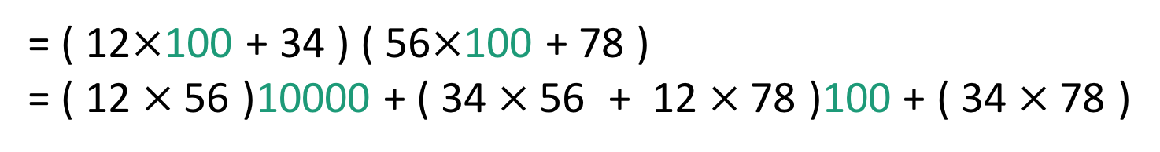
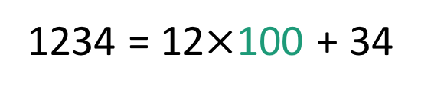
Divide and conquer for multiplication
Break up an integer:
1234 = 12$×$100 + 34
1234$×$5678
= ( 12$×$100 + 34 ) ( 56$×$100 + 78 )
= ( 12$×$56 )10000 + ( 34$×$56 + 12$×$78 )100 + ( 34$×$78 )
1
2
3
4
One 4-digit multiply
Four 2-digit multiplies

Slide 78
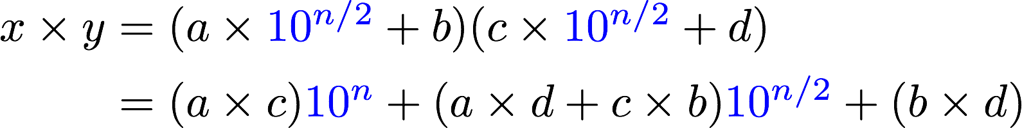
More generally
Suppose n is even
Break up an n-digit integer:
1
2
3
4
One n-digit multiply
Four (n/2)-digit multiplies

Slide 79
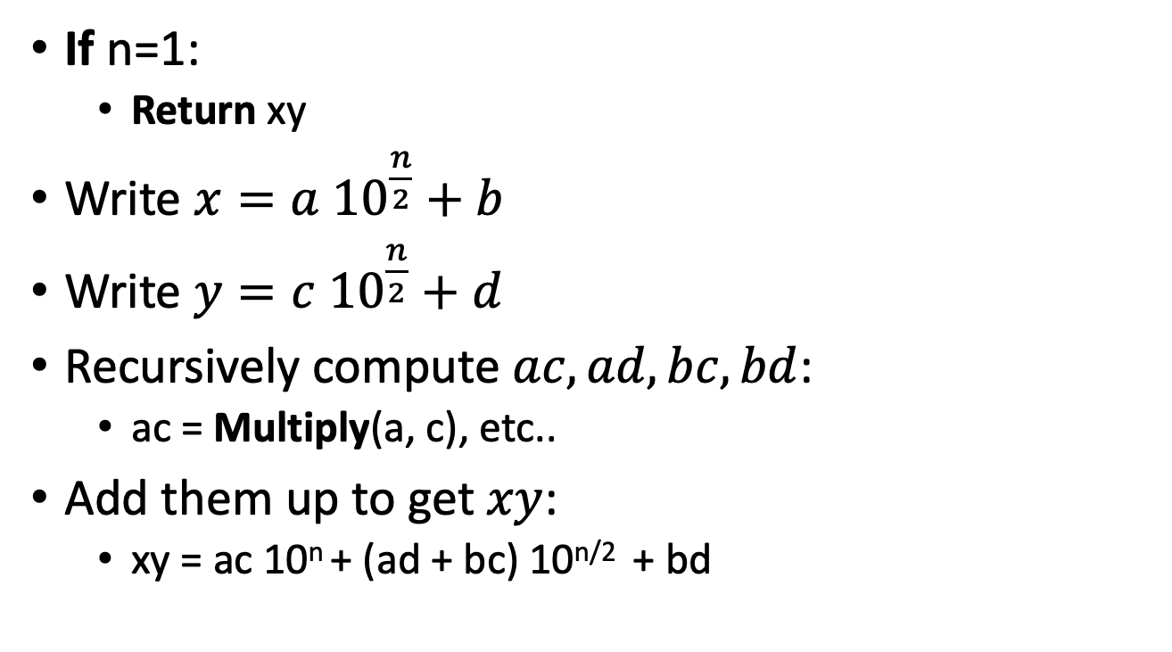
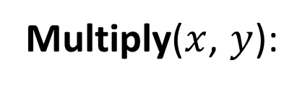
Divide and conquer algorithm not very precisely…
x,y are n-digit numbers
(Assume n is a power of 2…)
Multiply($x$, $y$):
Base case: I’ve memorized my 1-digit multiplication tables…
If n=1:
  Return xy
Write $x=a {10}^{\frac{n}{2}}+b$
Write $y=c {10}^{\frac{n}{2}}+d$
Recursively compute $ac, ad,bc,bd$:
  ac = Multiply(a, c), etc..
Add them up to get $xy$:
  xy = ac 10^{n} + (ad + bc) 10^{n/2} + bd
a, b, c, d are
n/2-digit numbers
Make this pseudocode more detailed! How should we handle odd n? How should we implement “multiplication by 10^{n}”?
See the Lecture 1 Python notebook for actual code!
Siggi the Studious Stork

Slide 80
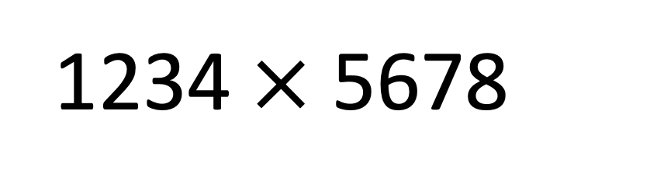
Think-Pair-Share
We saw that this 4-digit multiplication problem broke up into four 2-digit multiplication problems
If you recurse on those 2-digit multiplication problems, how many 1-digit multiplications do you end up with in total?
1234$×$5678

Slide 81
Recursion Tree
16 one-digit multiplies!
4 digits
2 digits
2 digits
2 digits
2 digits
1 digit
1 digit
1 digit
1 digit
1 digit
1 digit
1 digit
1 digit
1 digit
1 digit
1 digit
1 digit
1 digit
1 digit
1 digit
1 digit

Slide 82
What is the running time?
Better or worse than the grade school algorithm?
How do we answer this question?
  Try it.
  Try to understand it analytically.

Slide 83
1. Try it.
Check out the Lecture 1 IPython Notebook
Conjectures about running time?
Doesn’t look too good but hard to tell…
Maybe one implementation is slicker than the other?
Maybe if we were to run it to n=10000, things would look different.
Something funny is happening at powers of 2…

Slide 84
2. Try to understand the running time analytically
Proof by meta-reasoning:
It must be faster than the grade school algorithm, because we are learning it in an algorithms class.
Not sound logic!
Plucky the Pedantic Penguin

Slide 85
2. Try to understand the running time analytically
Think-Pair-Share:
We saw that multiplying 4-digit numbers resulted in 16 one-digit multiplications.
How about multiplying 8-digit numbers?
What do you think about n-digit numbers?

Slide 86
Recursion Tree
64 one-digit multiplies!
8 digits
4 digits
4 digits
4 digits
4 digits
2 digit
2 digit
2 digit
2 digit
2 digit
2 digit
2 digit
2 digit
2 digit
2 digit
2 digit
2 digit
2 digit
2 digit
2 digit
2 digit
1
1
1
1
1
1
1
1
1
1
1
1
1
1
1
1
1
1
1
1
1
1
1
1
1
1
1
1
1
1
1
1
1
1
1
1
1
1
1
1
1
1
1
1
1
1
1
1
1
1
1
1
1
1
1
1
1
1
1
1
1
1
1
1

Slide 87
2. Try to understand the running time analytically
Claim:
The running time of this algorithm is
AT LEAST n² operations.

Slide 88
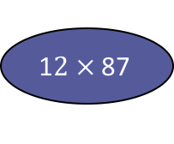
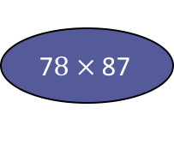
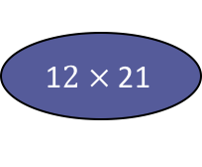

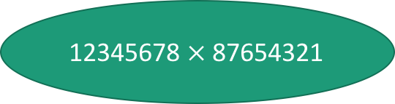
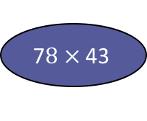
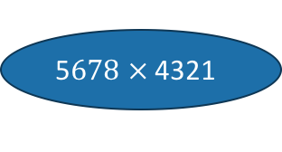
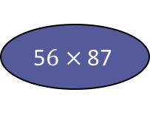
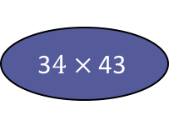

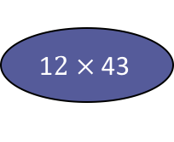
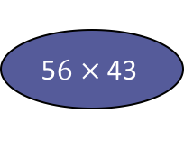
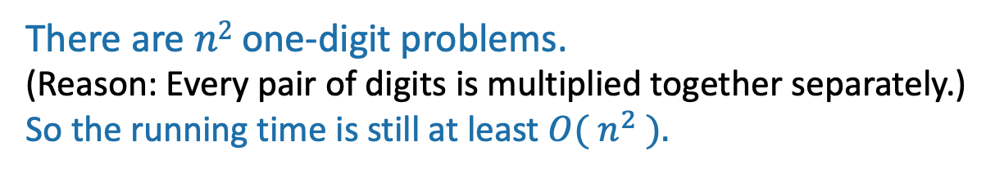
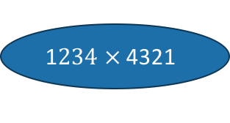
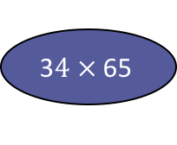

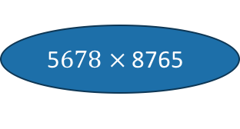
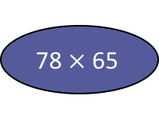
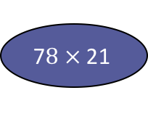

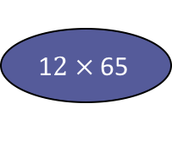
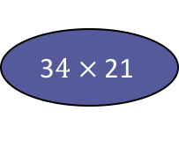
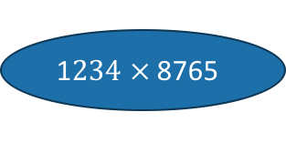
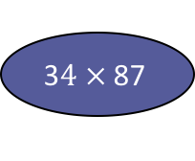
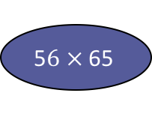


How many one-digit multiplies?
This slide skipped in class, here in case this view is more helpful for you.
12345678 $×$ 87654321
1$234 ×$ 8765
5$678 ×$ 8765
1$234 ×$ 4321
5$678 ×$ 4321
1$2 ×$ 87
5$6 ×$ 87
1$2 ×$ 43
5$6 ×$ 43
3$4 ×$ 87
7$8 ×$ 87
3$4 ×$ 43
7$8 ×$ 43
1$2 ×$ 65
5$6 ×$ 65
1$2 ×$ 21
5$6 ×$ 21
3$4 ×$ 65
78$×$ 65
3$4 ×$ 21
7$8 ×$ 21
…
3$×4$
…
1$×$8
1$×7$
2$×$8
There are $n2$ one-digit problems.
(Reason: Every pair of digits is multiplied together separately.)
So the running time is still at least ${O( n}^{2} ).$
2$×7$
etc...

Slide 89

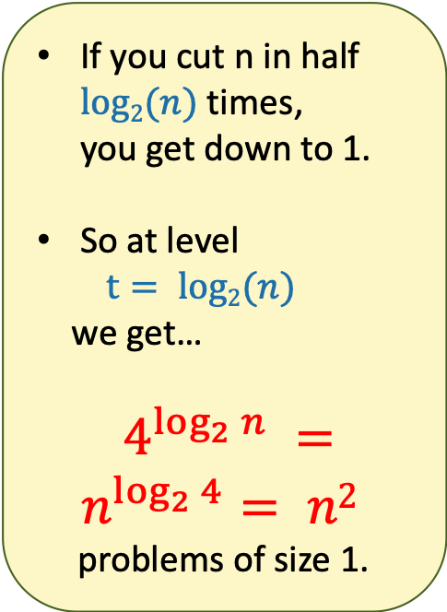
There are n² 1-digit problems
1 problem
of size n
If you cut n in half $log2(n)$times, you get down to 1.
So at level
$t= log2(n)$
we get…
$4^{\log_{2}{n}} =n^{\log_{2}{4}}= n2$
problems of size 1.
4 problems
of size n/2
…
4^{t} problems
of size n/2^{t}
Note: this is just a cartoon – I’m not going to draw all 4^{t} circles!
…
____ problems
of size 1

Slide 90

That’s a bit disappointing
All that work and still (at least) $O\left(n^{2}\right)$…
$$n^{2}$$
But wait!!
$$n$$

Slide 91
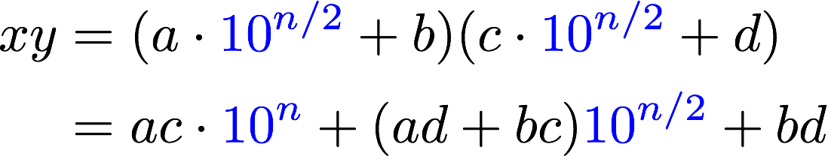
Divide and conquer can actually make progress
Karatsuba figured out how to do this better!
If only we could recurse on three things instead of four…
Need these three things

Slide 92
Karatsuba integer multiplication
Recursively compute these THREE things:
  ac
  bd
  (a+b)(c+d)
Subtract these off
get this
(a+b)(c+d) = ac + bd + bc + ad
Assemble the product:

Slide 93
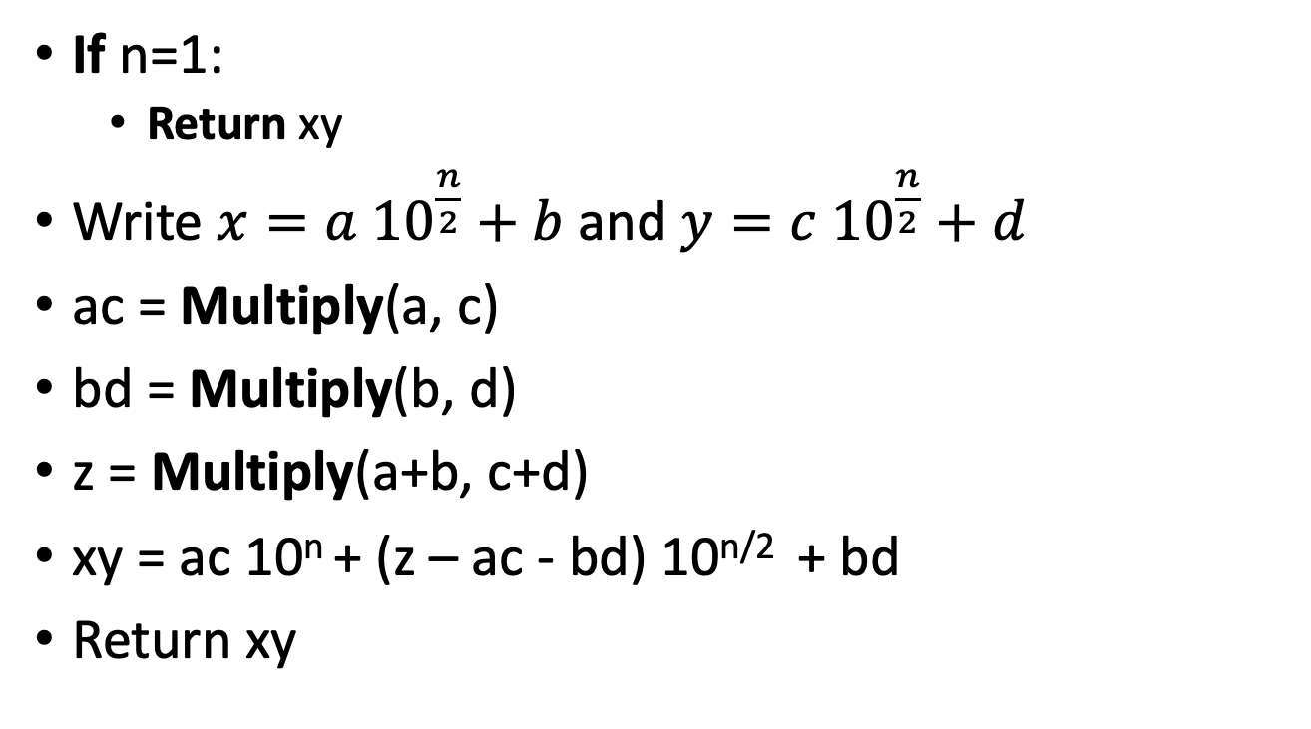
How would this work?
(Still not super precise, see IPython notebook for detailed code. Also, still assume n is a power of 2.)
x,y are n-digit numbers
Multiply($x$, $y$):
If n=1:
  Return xy
Write $x=a {10}^{\frac{n}{2}}+b$ and $y=c {10}^{\frac{n}{2}}+d$
ac = Multiply(a, c)
bd = Multiply(b, d)
z = Multiply(a+b, c+d)
xy = ac 10^{n} + (z – ac - bd) 10^{n/2} + bd
Return xy
a, b, c, d are
n/2-digit numbers

Slide 94
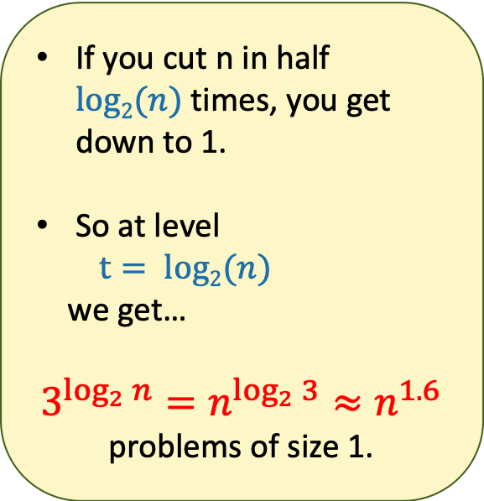

What’s the running time?
1 problem
of size n
If you cut n in half $log2(n)$times, you get down to 1.
So at level
$t= log2(n)$
we get…
$$3^{\log_{2}{n}}=n^{\log_{2}{3}}≈n^{1.6}$$
problems of size 1.
3 problems
of size n/2
…
3^{t} problems
of size n/2^{t}
Note: this is just a cartoon – I’m not going to draw all 3^{t} circles!
…
We aren’t accounting for the work at the higher levels! But we’ll see later that this turns out to be okay.
$$n^{1.6}$$
____ problems
of size 1

Slide 95


This is much better!
$$n^{2}$$
$$n^{1.6}$$
$$n$$

Slide 96
We can even see it in real life!

Slide 97
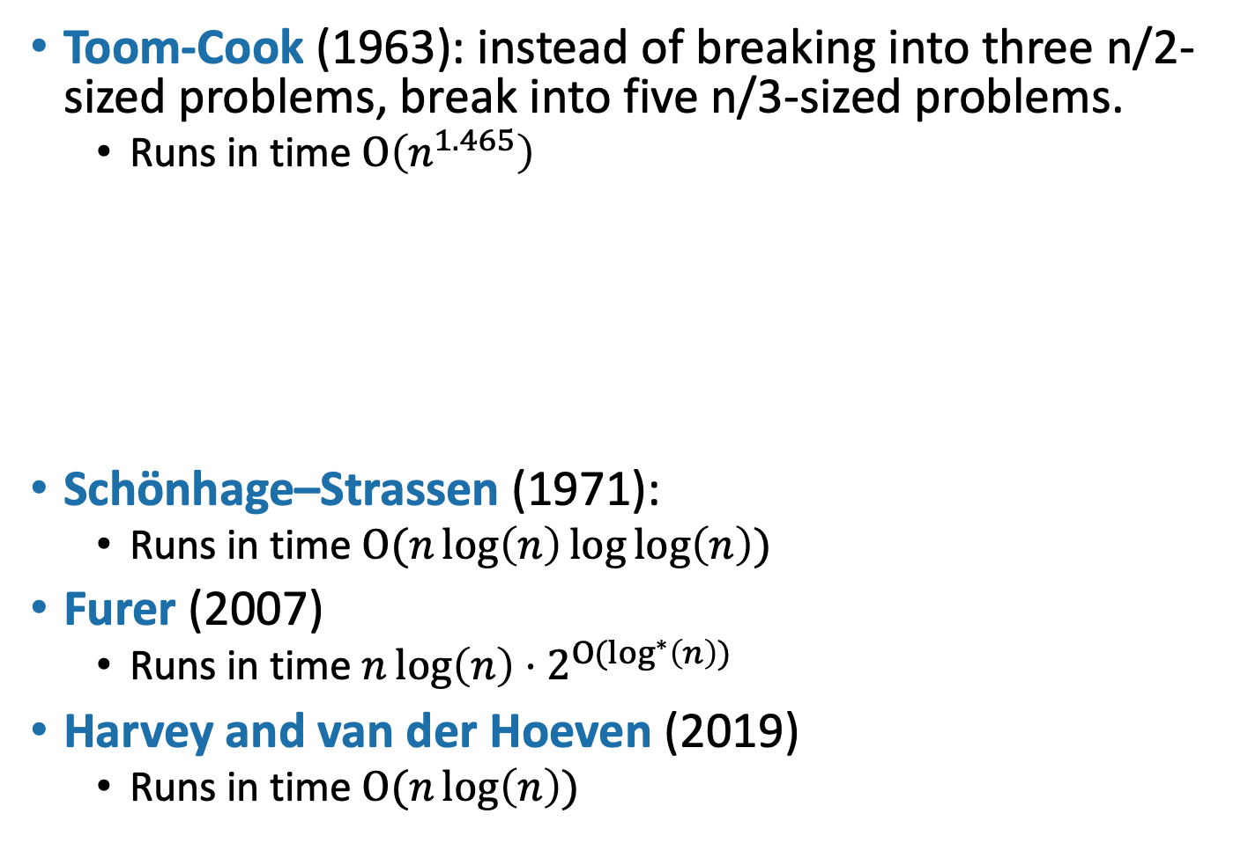
Can we do better?
Toom-Cook (1963): instead of breaking into three n/2-sized problems, break into five n/3-sized problems.
  Runs in time $O\left(n^{1.465}\right)$
Schönhage–Strassen (1971):
  Runs in time $O(n\log\left(n\right)\log{\log\left(n\right)) }$
Furer (2007)
  Runs in time $n\log\left(n\right)⋅2^{{O(log}^{∗}\left(n\right)) }$
Harvey and van der Hoeven (2019)
  Runs in time $O(n\log\left(n\right))$
Try to figure out how to break up an n-sized problem into five n/3-sized problems! (Hint: start with nine n/3-sized problems).
Given that you can break an n-sized problem into five n/3-sized problems, where does the 1.465 come from?
Siggi the Studious Stork
Ollie the Over-achieving Ostrich
[This is just for fun, you don’t need to know these algorithms!]

Slide 98
Today’s goals
Course goals
Think analytically about algorithms
Flesh out an “algorithmic toolkit”
Learn to communicate clearly about algorithms
Karatsuba Integer Multiplication
Algorithmic Technique:
  Divide and conquer
Algorithmic Analysis tool:
  Intro to asymptotic analysis

Slide 99
How was the pace today?

Slide 100
The big questions
Who are we?
  Professor, TA’s, students?
Why are we here?
  Why learn about algorithms?
What is going on?
  What is this course about?
  Logistics?
Can we multiply integers?
  And can we do it quickly?
Wrap-up

Slide 101
Wrap up
cs161.stanford.edu
Algorithms are fundamental, useful and fun!
In this course, we will develop both algorithmic intuition and algorithmic technical chops
Karatsuba Integer Multiplication:
  You can do better than grade school multiplication!
  Example of divide-and-conquer in action
  Informal demonstration of asymptotic analysis

Slide 102
Next time
Sorting!
Asymptotics and (formal) Big-Oh notation
Divide and Conquer some more
BEFORE Next time
Pre-lecture exercise! On the course website!

