Slide 1
CS 161
Section 5
[Name of the CA]

Slide 2
Agenda
Recap
Hashing
Graphs, BFS and DFS
Handout

Slide 3
Hashing

Slide 4
This is a hash table (with chaining)
For demonstration purposes only!
This is a terrible hash function! Don’t use this!
Array of n buckets.
Each bucket stores a linked list.
We can insert into a linked list in time O(1)
To find something in the linked list takes time O(length(list)).
h:U → {1,…,n} can be any function:
but for concreteness let’s stick with h(x) = least significant digit of x.
INSERT:
1
2
22
13
22
43
9
3
13
43
SEARCH 43:
…
Scan through all the elements in bucket h(43) = 3.
9
9
n buckets (say n=9)

Slide 5
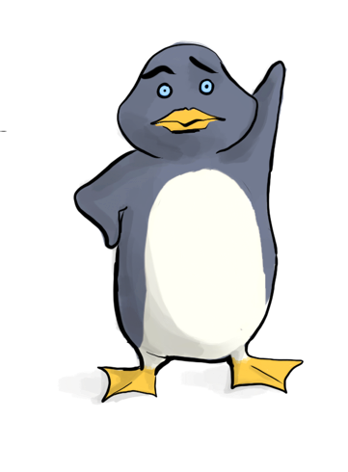
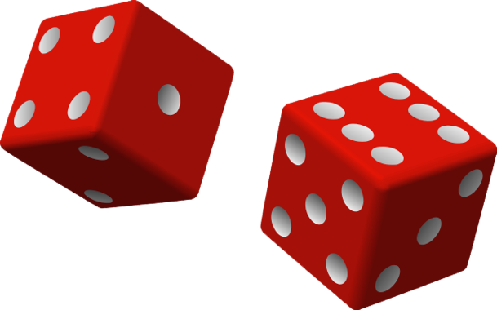
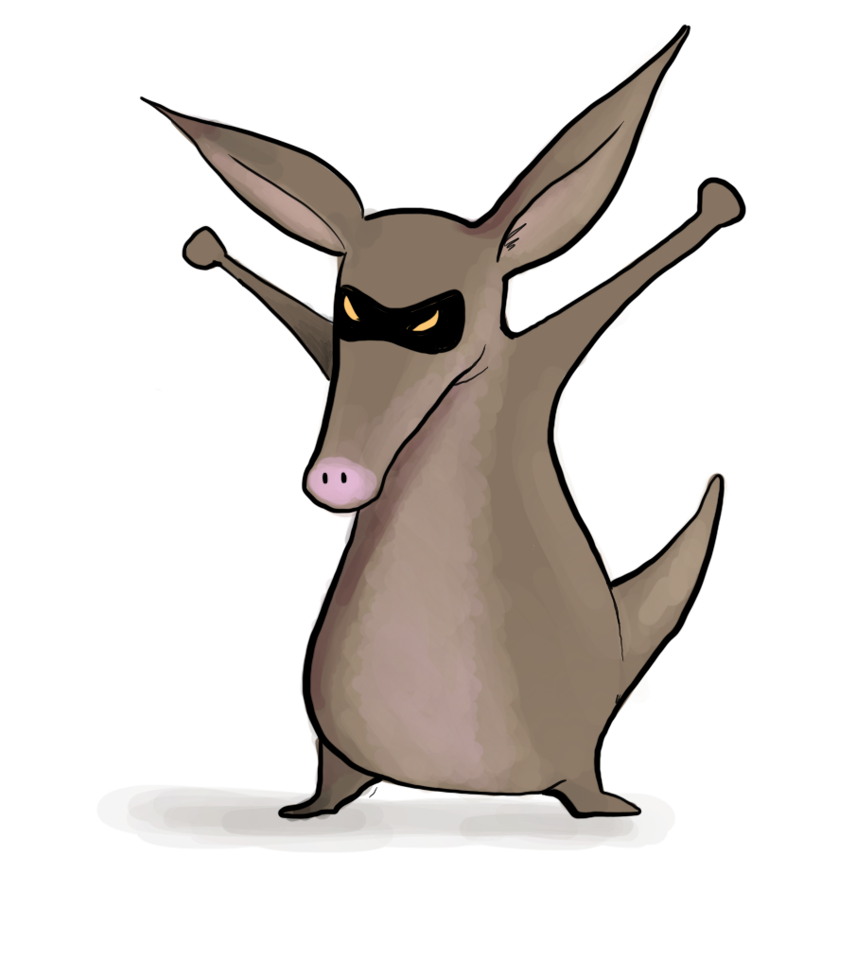
The game
What does random mean here? Uniformly random?
Plucky the pedantic penguin
HASH IT OUT
#hashpuns
13
22
43
92
7
1
43
INSERT 13, INSERT 22, INSERT 43, INSERT 92, INSERT 7, SEARCH 43, DELETE 92, SEARCH 7, INSERT 92
22
2
3
13
u_{j}
…
u_{k}
7
u_{i}
n
92

Slide 6
What if we have lots of collisions?
Solution: Randomness

Slide 7
Example
Universe U
h
n buckets
Say that h is uniformly random.
That means that h(1) is a uniformly random number between 1 and n.
h(2) is also a uniformly random number between 1 and n, independent of h(1).
h(3) is also a uniformly random number between 1 and n, independent of h(1), h(2).
…
h(n) is also a uniformly random number between 1 and n, independent of h(1), h(2), …, h(n-1).

Slide 8
Expected number of items in u_{i}’s bucket?
h is uniformly random
That’s what we wanted.
Universe U
h
u_{k}
u_{i}
n buckets
u_{j}
u_{i}
u_{j}
COLLISION!

Slide 9
Expected number of items in u_{i}’s bucket?
All that we needed was that this is 1/n
Universe U
h
u_{k}
u_{i}
n buckets
u_{j}
u_{i}
u_{j}
COLLISION!

Slide 10
Universal hash family Let’s stare at this definition

Slide 11
Sounds good? But How to pick the Hash functions?
Solution: Universal Hash Family

Slide 12
Why Do We Need Hash Family?
Remember that after we select the hash function, we need to store the hash function for search/delete.
What will happen if we did not remember the hash function?
The set of all hash functions contains n^{M} functions. So to store the index of a function, we need log(n^{M})=Mlog(n) bits ☹.
A smaller universal hash family it’s easier to remember which function from the family we’re using.

Slide 13
An example of small universal hash family
??

Slide 14
So the whole scheme will be
Choose a and b at random and form the function h_{a,b}
We can store h in space O(log(M)) since we just need to store a and b.
u₁
u_{k}
Probably these buckets will be pretty balanced.
u_{i}
u_{j}
h_{a,b}
n buckets
u_{i}
Universe U

Slide 15
Conclusion:
We can build a hash table that supports INSERT/DELETE/SEARCH in O(1) expected time,
if we know that only n items are every going to show up, where n is waaaayyyyyy less than the size M of the universe.
The space to implement this hash table is
O(n log(M)) bits.
O(n) buckets
O(n) items with log(M) bits per item
O(log(M)) to store the hash fn.
M is waaayyyyyy bigger than n, but log(M) probably isn’t.

Slide 16
Graphs, BFS and DFS

Slide 17
What is a graph?
Definition: A graph G = (V,E) consists of two things: A collection V of vertices and a collection E of edges.
Ways of representing a graph:
Adjacency matrix
Adjacency list

Slide 18
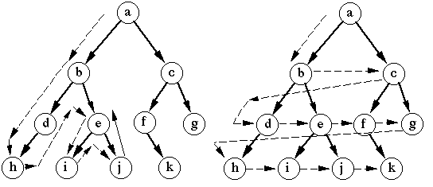
Exploring a graph
Depth First Search (DFS)
Breadth First Search (BFS)

Slide 19
BFS (More detail than you’ve seen in class)
BFS(G, v)
Input: graph G = (V, E); node v in V, edge e in E
Output:
Array visited: V -> {True, False}
Queue Q of vertices. Initialize with start vertex v.
Queue is a data structure that will pop the element that first came in. In a phrase, “first in, first out.”

Slide 20
BFS (More detail than you’ve seen in class)
BFS(G, v)
Input: graph G = (V, E); node v in V, edge e in E
Output:
Array visited: V -> {True, False}
Queue Q of vertices. Initialize with start vertex v.
While Q is non-empty: # keep looping as we have unexplored vertices
Pop u from queue Q # u is the vertex currently explored

Slide 21
BFS (More detail than you’ve seen in class)
BFS(G, v)
Input: graph G = (V, E); node v in V, edge e in E
Output:
Array visited: V -> {True, False}
Queue Q of vertices. Initialize with start vertex v.
While Q is non-empty: # keep looping as we have unexplored vertices
Pop u from queue Q # u is the vertex currently explored
If not visited[u]: # only work on vertices we have not explored
visited[u] = True
for (u, v) in E: #push every neighbor of u into queue
Push v onto queue Q

Slide 22
BFS (More detail than you’ve seen in class)
BFS(G, v)
Input: graph G = (V, E); node v in V, edge e in E
Output:
Array visited: V -> {True, False}
Queue Q of vertices. Initialize with start vertex v.
While Q is non-empty: # keep looping as we have unexplored vertices
Pop u from queue Q # u is the vertex currently explored
If not visited[u]: # only work on vertices we have not explored
visited[u] = True
for (u, v) in E: #push every neighbor of u into queue
Push v onto queue Q
What if we used a stack instead of a queue?
Stack is a data struture that will pop the element that last came in. In a phrase, “last in, first out.”

Slide 23
DFS (Iterative Implementation)
DFS(G, v)
Input: graph G = (V, E); node v in V, edge e in E
Output:
Array visited: V -> {True, False}
Stack F of vertices. Initialize with start vertex v.

Slide 24
DFS (Iterative Implementation)
DFS(G, v)
Input: graph G = (V, E); node v in V, edge e in E
Output:
Array visited: V -> {True, False}
Stack F of vertices. Initialize with start vertex v.
While F is non-empty: # keep looping as we have unexplored vertices
Pop u from stack # u is the vertex currently explored

Slide 25
DFS (Iterative Implementation)
DFS(G, v)
Input: graph G = (V, E); node v in V, edge e in E
Output:
Array visited: V -> {True, False}
Stack F of vertices. Initialize with start vertex v.
While F is non-empty: # keep looping as we have unexplored vertices
Pop u from stack # u is the vertex currently explored
If not visited[u]: # only work on vertices we have not explored
visited[u] = True
for (u, v) in E: #push every neighbor of u into stack
Push v onto stack F

Slide 26
StartTime and FinishTime
DFS(w, currentTime):
w.startTime = currentTime
currentTime ++
Mark w as in progress.
for v in w.neighbors:
if v is unvisited:
currentTime
= DFS(v, currentTime)
currentTime ++
w.finishTime = currentTime
Mark w as all done
return currentTime

Slide 27
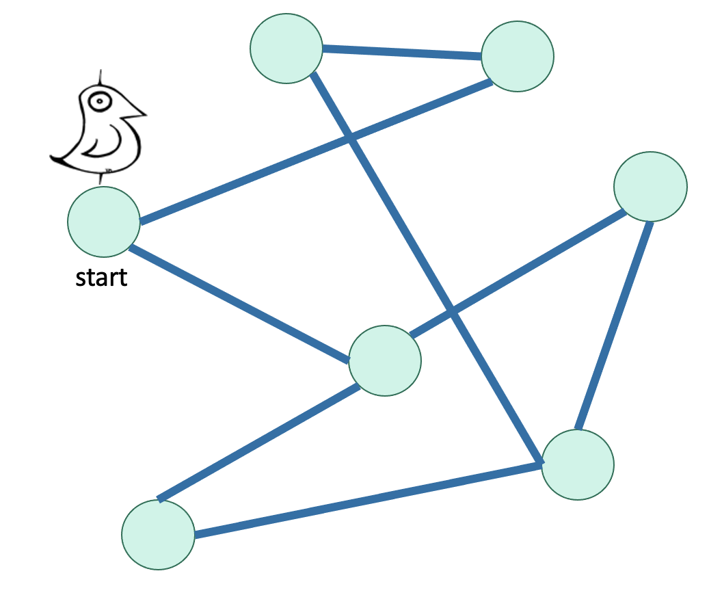
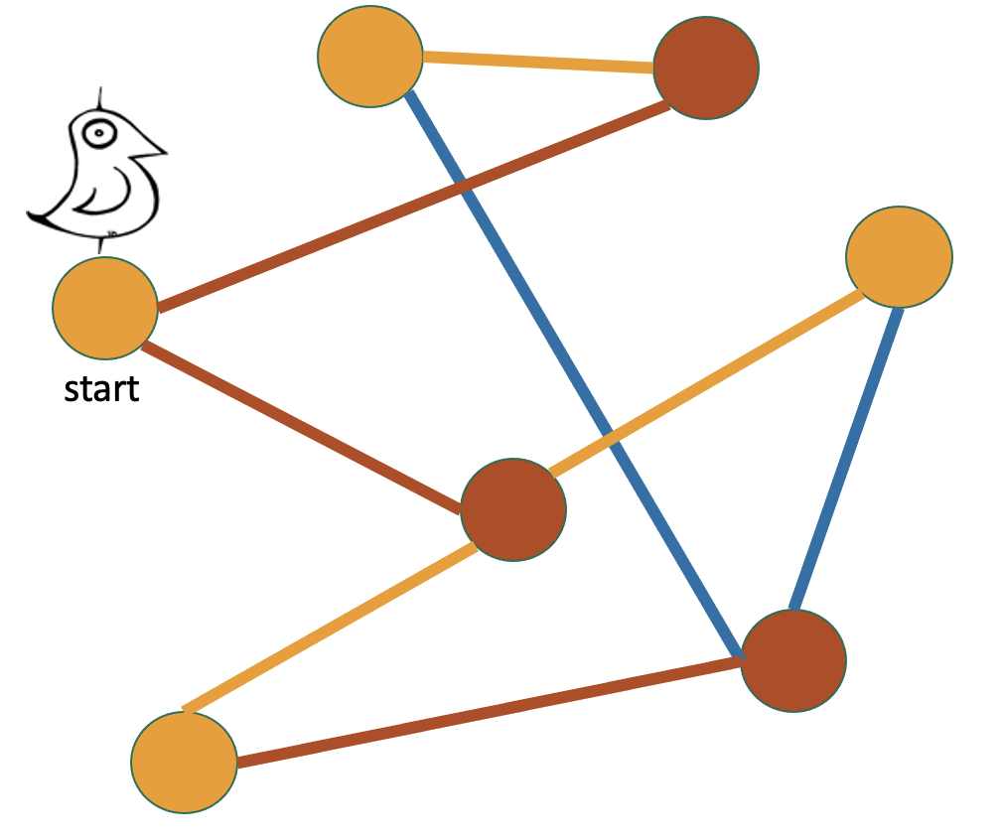
What can we do with BFS?
Find all vertices reachable from the start vertex
Find the shortest paths from a vertex to all the others
When should we use BFS instead of Bellman-Ford?
Check if a graph is bipartite graph.
Color the levels of the BFS tree in alternating colors.
If you never color two connected nodes the same color, then it is bipartite.
Otherwise, it’s not.

Slide 28
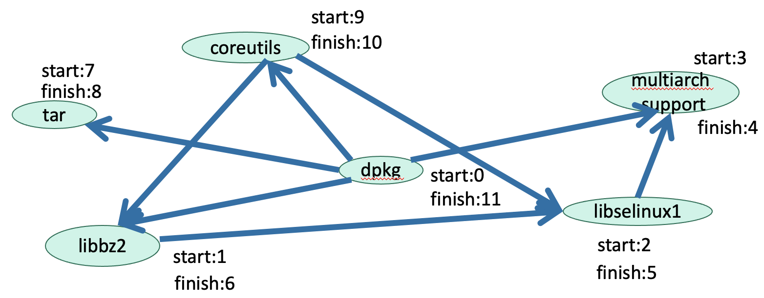
What can we do with DFS?
Find all vertices reachable from the start vertex
Check if a graph is bipartite graph. (Similar to BFS. Will go over this in the handout)
Topological sort for directed graph without any cycle (DAG)
In reverse order of finishing time in DFS!
Both algorithms run in O(|V| + |E|).

Slide 29
Thank you!
Notes:
https://www.stanfordlawreview.org/online/privacy-and-big-data-big-data-and-its-exclusions/

