Slide 1
CS161 Section 6
[CA Name]

Slide 2
Agenda
Graphs
SCC
Dijkstra’s
Dynamic Programming
Graphs
Bellman-Ford
Floyd-Warshall
PSet

Slide 3
Graphs: SCC

Slide 4
Strongly vs Connected Components
Please do not confuse them!
Undirected graphs Connected Components (CC)
Directed graphs Strongly Connected Components (SCC)
Find with BFS/DFS
Find with DFS

Slide 5
Algorithm
[Actual algorithm!]
Running time: O(n + m)
(This is basically “PretendTopoSort”)
Run DFS.
Choose starting vertices in any order.
Order vertices by reverse finishing times.
Reverse all the edges in the graph.
Do DFS again to create a new DFS forest.
(Using the reverse-finish-time order from the first DFS run.)
The SCCs are the different trees in the new DFS forest.
(This doesn’t change SCCs)

Slide 6
Example

Slide 7
Example

Slide 8
Example
Start with an arbitrary vertex and do DFS.

Slide 9
Example
Start:0
Start with an arbitrary vertex and do DFS.

Slide 10
Example
Start:0
Start:1
Start with an arbitrary vertex and do DFS.

Slide 11
Example
Start:0
Start:1
Start:2
Start with an arbitrary vertex and do DFS.

Slide 12
Example
Start:0
Start:1
Start:2
Start with an arbitrary vertex and do DFS.
Start:3

Slide 13
Example
Start:0
Start:1
Start:2
Start with an arbitrary vertex and do DFS.
Start:3
Finish:4

Slide 14
Example
Start:0
Start:1
Start:2
Finish:5
Start with an arbitrary vertex and do DFS.
Start:3
Finish:4

Slide 15
Example
Start:0
Start:1
Start:2
Finish:5
Start with an arbitrary vertex and do DFS.
Start:3
Finish:4

Slide 16
Example
Start:0
Start:1
Start:2
Finish:5
Start:7
Start with an arbitrary vertex and do DFS.
Start:3
Finish:4

Slide 17
Example
Start:0
Start:1
Start:2
Finish:5
Start:7
Finish:8
Start with an arbitrary vertex and do DFS.
Start:3
Finish:4

Slide 18
Example
Start:0
Start:1
Finish:9
Start:2
Finish:5
Start:7
Finish:8
Start with an arbitrary vertex and do DFS.
Start:3
Finish:4

Slide 19
Example
Start:0
Finish:10
Start:1
Finish:9
Start:2
Finish:5
Start:7
Finish:8
Start with an arbitrary vertex and do DFS.
Start:3
Finish:4

Slide 20
Example
Start:0
Finish:10
Start:1
Finish:9
Start:2
Finish:5
Start:7
Finish:8
Start with an arbitrary vertex and do DFS.
Repeat until done.
Start:3
Finish:4

Slide 21
Example
Start:0
Finish:10
Start:1
Finish:9
Start:11
Finish:12
Start:2
Finish:5
Start:7
Finish:8
Start with an arbitrary vertex and do DFS.
Repeat until done.
Start:3
Finish:4

Slide 22
Example
Start:0
Finish:10
Start:1
Finish:9
Start:11
Finish:12
Start:2
Finish:5
Start:7
Finish:8
Reverse all the edges.
Start:3
Finish:4

Slide 23
Example
Start:0
Finish:10
Start:1
Finish:9
Start:11
Finish:12
Start:2
Finish:5
Start:7
Finish:8
Reverse all the edges.
Start:3
Finish:4

Slide 24
Example
Start:0
Finish:10
Start:1
Finish:9
Start:11
Finish:12
Start:2
Finish:5
Start:7
Finish:8
Do DFS again, but this time, start with the vertices with the largest finish time.
Start:3
Finish:4

Slide 25
Example
Start:0
Finish:10
Start:1
Finish:9
Start:11
Finish:12
Start:2
Finish:5
Start:7
Finish:8
Do DFS again, but this time, start with the vertices with the largest finish time.
Start:3
Finish:4

Slide 26
Example
Start:0
Finish:10
Start:1
Finish:9
Start:11
Finish:12
Start:2
Finish:5
Start:7
Finish:8
This is one DFS tree in the DFS forest!
Do DFS again, but this time, start with the vertices with the largest finish time.
Start:3
Finish:4

Slide 27
Example
Start:0
Finish:10
Start:1
Finish:9
Start:11
Finish:12
Start:2
Finish:5
Start:7
Finish:8
This is one DFS tree in the DFS forest!
Do DFS again, but this time, start with the vertices with the largest finish time.
Start:3
Finish:4

Slide 28
Example
Start:0
Finish:10
Start:1
Finish:9
Start:11
Finish:12
Start:2
Finish:5
Start:7
Finish:8
This is one DFS tree in the DFS forest!
Do DFS again, but this time, start with the vertices with the largest finish time.
Start:3
Finish:4

Slide 29
Example
Start:0
Finish:10
Start:1
Finish:9
Start:11
Finish:12
Start:2
Finish:5
Start:7
Finish:8
This is one DFS tree in the DFS forest!
Do DFS again, but this time, start with the vertices with the largest finish time.
Start:3
Finish:4

Slide 30
Example
Start:0
Finish:10
Start:1
Finish:9
Start:11
Finish:12
Start:2
Finish:5
Start:7
Finish:8
This is one DFS tree in the DFS forest!
Do DFS again, but this time, start with the vertices with the largest finish time.
Start:3
Finish:4
Notice that I’m not changing the start and finish times – I’m keeping them from the first run.

Slide 31
Example
Start:0
Finish:10
Start:1
Finish:9
Start:11
Finish:12
Start:2
Finish:5
Start:7
Finish:8
This is one DFS tree in the DFS forest!
Do DFS again, but this time, start with the vertices with the largest finish time.
Start:3
Finish:4
Notice that I’m not changing the start and finish times – I’m keeping them from the first run.

Slide 32
Example
Start:0
Finish:10
Start:1
Finish:9
Start:11
Finish:12
Start:2
Finish:5
Start:7
Finish:8
This is one DFS tree in the DFS forest!
Do DFS again, but this time, start with the vertices with the largest finish time.
Start:3
Finish:4
Notice that I’m not changing the start and finish times – I’m keeping them from the first run.

Slide 33
Example
Start:0
Finish:10
Start:1
Finish:9
Start:11
Finish:12
Start:2
Finish:5
Start:7
Finish:8
This is one DFS tree in the DFS forest!
Do DFS again, but this time, start with the vertices with the largest finish time.
Start:3
Finish:4
Notice that I’m not changing the start and finish times – I’m keeping them from the first run.

Slide 34
Example
Here’s another DFS tree in the DFS forest!
Start:0
Finish:10
Start:1
Finish:9
Start:11
Finish:12
Start:2
Finish:5
Start:7
Finish:8
This is one DFS tree in the DFS forest!
Do DFS again, but this time, start with the vertices with the largest finish time.
Start:3
Finish:4

Slide 35
Example
Here’s another DFS tree in the DFS forest!
Start:0
Finish:10
Start:1
Finish:9
Start:11
Finish:12
Start:2
Finish:5
Start:7
Finish:8
This is one DFS tree in the DFS forest!
Do DFS again, but this time, start with the vertices with the largest finish time.
Start:3
Finish:4

Slide 36
Example
Here’s another DFS tree in the DFS forest!
Start:0
Finish:10
Start:1
Finish:9
Start:11
Finish:12
Start:2
Finish:5
Start:7
Finish:8
This is one DFS tree in the DFS forest!
Do DFS again, but this time, start with the vertices with the largest finish time.
Start:3
Finish:4

Slide 37
Example
Here’s another DFS tree in the DFS forest!
Start:0
Finish:10
Start:1
Finish:9
Start:11
Finish:12
Start:2
Finish:5
Start:7
Finish:8
This is one DFS tree in the DFS forest!
Do DFS again, but this time, start with the vertices with the largest finish time.
Start:3
Finish:4

Slide 38
Example
Here’s another DFS tree in the DFS forest!
Start:0
Finish:10
Start:1
Finish:9
Start:11
Finish:12
Start:2
Finish:5
Start:7
Finish:8
This is one DFS tree in the DFS forest!
Do DFS again, but this time, start with the vertices with the largest finish time.
Start:3
Finish:4

Slide 39
Example
Here’s another DFS tree in the DFS forest!
Start:0
Finish:10
Start:1
Finish:9
Start:11
Finish:12
Start:2
Finish:5
Start:7
Finish:8
This is one DFS tree in the DFS forest!
Do DFS again, but this time, start with the vertices with the largest finish time.
Start:3
Finish:4

Slide 40
Example
Here’s another DFS tree in the DFS forest!
Start:0
Finish:10
Start:1
Finish:9
Start:11
Finish:12
Start:2
Finish:5
Start:7
Finish:8
This is one DFS tree in the DFS forest!
The last DFS tree!
Do DFS again, but this time, start with the vertices with the largest finish time.
Start:3
Finish:4

Slide 41
Example
Here’s another DFS tree in the DFS forest!
Start:0
Finish:10
Start:1
Finish:9
Start:11
Finish:12
Start:2
Finish:5
Start:7
Finish:8
This is one DFS tree in the DFS forest!
The last DFS tree!
Do DFS again, but this time, start with the vertices with the largest finish time.
Start:3
Finish:4
IT WORKED!

Slide 42
Graphs: Dijkstra’s

Slide 43
Dijkstra visual intuition
YOINK!
Stanford
Portland
New Orleans
Nashville
Las Vegas
Mexico City

Slide 44
Dijkstra visual intuition
YOINK!
This creates a tree!
Stanford
The highlighted + fully stretched edges along this tree are the shortest paths!
8
10
Las Vegas
Portland
25
30
Nashville
Mexico City
7
New Orleans

Slide 45
Dijkstra Pseudocode
Dijkstra(G,s):
Shouldn’t be used on graphs with negative edges!
Runtime? Will need to use Fibonacci heaps
to make operations highlighted operations run faster!
Notes:
Feel free to skip if time does not allow for it, but emphasize that the algorithm shouldn’t be used on graphs with negative edges!!

Slide 46
Need to use Fibonacci Heap to implement fastest Dijkstra
* - amortized time
 | Sorted Arrays | Linked Lists | Binary Heap | Fibonacci Heap | Red-Black Trees
Search | O(log(n)) | O(n) | O(n) | O(n) | O(log(n))
Delete | O(n) | Search +O(1) | Search +O(log(n)) | Search +O(log(n))* | O(log(n))
Insert | O(n) | O(1) | O(log(n)) | O(1) | O(log(n))
Extract-min | O(1) | O(n) | O(log(n)) | O(log(n))* | O(log(n))
Decrease-key | O(n) | Search +O(1) | Search +O(log(n) | O(1)* | O(log(n)
Notes:
Emphasize that students don’t need to know the implementation details of the Fibonacci heap

Slide 47
Amortized Analysis
0000
0001
0010
0011
0100
0101
0110
0111
1000
1001
1010
1011
1100
1101
1110
1111
Example:
Incrementing a binary counter n times.
Say that flipping a bit is costly.
Some steps are very expensive.
Many are very cheap.
Amortized over all the inputs, it turns out to be pretty cheap.
O(n) for all n increments = O(1) per increment (amortized).
1 2 1 3 1 2 1 4 1 2 1 3 1 2 1

Slide 48
Dijkstra with Fibonacci Heap
T(extractMin) = O(log(n)) (amortized time*)
T(decreaseKey) = O(1) (amortized time*)
See CS166 for more! (or CLRS)
Running time of Dijkstra
O(n( T(extractMin) ) + m T(decreaseKey))
O(nlog(n) + m)
*This means that any sequence of d extractMin calls takes time at most O(dlog(n)). But a few of the d may take longer than O(log(n)) and some may take less time..

Slide 49
Dynamic Programming

Slide 50
What is dynamic programming?
It is an algorithm design paradigm
like divide-and-conquer is an algorithm design paradigm.
Usually it is for solving optimization problems
eg, shortest path, or longest common subsequence
(Fibonacci numbers aren’t an optimization problem, but they are a good example…)

Slide 51
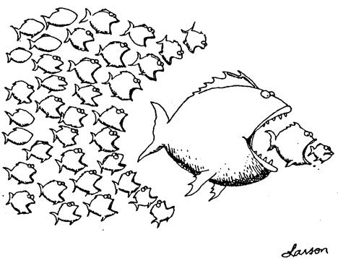
Bottom up approach what we just saw.
For Fibonacci:
Solve the small problems first
fill in F[0],F[1]
Then bigger problems
fill in F[2]
…
Then bigger problems
fill in F[n-1]
Then finally solve the real problem.
fill in F[n]

Slide 52
Top down approach
Think of it like a recursive algorithm.
To solve the big problem:
Recurse to solve smaller problems
Those recurse to solve smaller problems
etc..
The difference from divide and conquer:
Memo-ization
Keep track of what small problems you’ve already solved to prevent re-solving the same problem twice.

Slide 53
What have we learned?
Dynamic programming:
Paradigm in algorithm design.
Uses optimal substructure
Uses overlapping subproblems
Can be implemented bottom-up or top-down.
It’s a fancy name for a pretty common-sense idea:
Don’t duplicate work if you don’t have to!

Slide 54
Longest Common Subsequence
Subsequence:
BDFH is a subsequence of ABCDEFGH
If X and Y are sequences, a common subsequence is a sequence which is a subsequence of both.
BDFH is a common subsequence of ABCDEFGH and of ABDFGHI
A longest common subsequence…
…is a common subsequence that is longest.
The longest common subsequence of ABCDEFGH and ABDFGHI is ABDFGH.

Slide 55
Recipe for applying Dynamic Programming
Step 1: Identify optimal substructure.
Step 2: Find a recursive formulation for the length of the longest common subsequence.
Step 3: Use dynamic programming to find the length of the longest common subsequence.
Step 4: If needed, keep track of some additional info so that the algorithm from Step 3 can find the actual LCS.

Slide 56
Step 1: Optimal substructure
Prefixes:
X
A
C
G
G
T
Y
A
C
G
C
T
T
A
Notation: denote this prefix ACGC by Y₄
Our sub-problems will be finding LCS’s of prefixes to X and Y.
Let C[i,j] = length_of_LCS( X_{i}, Y_{j} )

Slide 57
Recipe for applying Dynamic Programming
Step 1: Identify optimal substructure.
Step 2: Find a recursive formulation for the length of the longest common subsequence.
Step 3: Use dynamic programming to find the length of the longest common subsequence.
Step 4: If needed, keep track of some additional info so that the algorithm from Step 3 can find the actual LCS.

Slide 58
Goal
Write C[i,j] in terms of the solutions to smaller sub-problems
i
X_{i}
A
C
G
G
A
j
Y_{j}
A
C
G
C
T
T
A
C[i,j] = length_of_LCS( X_{i}, Y_{j} )

Slide 59
Two cases
Our sub-problems will be finding LCS’s of prefixes to X and Y.
Let C[i,j] = length_of_LCS( X_{i}, Y_{j} )
Case 1: X[i] = Y[j]
i
These are the same
X_{i}
A
C
G
G
A
j
Y_{j}
A
C
G
C
T
T
A
Then C[i,j] = 1 + C[i-1,j-1].
because LCS(X_{i},Y_{j}) = LCS(X_{i-1},Y_{j-1}) followed by
A

Slide 60
Two cases
Our sub-problems will be finding LCS’s of prefixes to X and Y.
Let C[i,j] = length_of_LCS( X_{i}, Y_{j} )
Case 2: X[i] != Y[j]
i
These are not the same
X_{i}
A
C
G
G
T
j
Y_{j}
A
C
G
C
T
T
A
Then C[i,j] = max{ C[i-1,j], C[i,j-1] }.
either LCS(X_{i},Y_{j}) = LCS(X_{i-1},Y_{j}) and is not involved,
or LCS(X_{i},Y_{j}) = LCS(X_{i},Y_{j-1}) and is not involved,
(maybe both are not involved, that’s covered by the “or”).
T
A

Slide 61
Recursive formulation of the optimal solution
X₀
Y_{j}
A
C
G
C
T
T
A
Case 0
Case 1
Case 2
X_{i}
A
C
G
G
A
X_{i}
A
C
G
G
T
Y_{j}
A
C
G
C
T
T
A
Y_{j}
A
C
G
C
T
T
A

Slide 62
Recipe for applying Dynamic Programming
Step 1: Identify optimal substructure.
Step 2: Find a recursive formulation for the length of the longest common subsequence.
Step 3: Use dynamic programming to find the length of the longest common subsequence.
Step 4: If needed, keep track of some additional info so that the algorithm from Step 3 can find the actual LCS.

Slide 63
LCS DP OMG BBQ
LCS(X, Y):
C[i,0] = C[0,j] = 0 for all i = 1,…,m, j=1,…n.
For i = 1,…,m and j = 1,…,n:
If X[i] = Y[j]:
C[i,j] = C[i-1,j-1] + 1
Else:
C[i,j] = max{ C[i,j-1], C[i-1,j] }
Running time: O(nm)

Slide 64
Example
A
C
G
G
A
X
Y
A
C
T
G
Y
A
C
T
G
0
0
0
0
0
A
0
C
0
X
G
0
G
0
A
0

Slide 65
Example
A
C
G
G
A
X
Y
A
C
T
G
Y
A
C
T
G
0
0
0
0
0
0
0
0
0
0
0
So the LCS of X and Y has length 3.
A
0
1
1
1
1
0
C
0
1
2
2
2
X
0
G
0
1
2
2
3
0
G
0
1
2
2
3
0
A
0
1
2
2
3

Slide 66
Recipe for applying Dynamic Programming
Step 1: Identify optimal substructure.
Step 2: Find a recursive formulation for the length of the longest common subsequence.
Step 3: Use dynamic programming to find the length of the longest common subsequence.
Step 4: If needed, keep track of some additional info so that the algorithm from Step 3 can find the actual LCS.

Slide 67
Finding an LCS
See lecture notes for pseudocode
Takes time O(mn) to fill the table
Takes time O(n + m) on top of that to recover the LCS
We walk up and left in an n-by-m array
We can only do that for n + m steps.
Altogether, we can find LCS(X,Y) in time O(mn).

Slide 68
Time and Space complexity

Slide 69
What have we learned?
We can find LCS(X,Y) in time O(nm)
if |Y|=n, |X|=m
We went through the steps of coming up with a dynamic programming algorithm.
We kept a 2-dimensional table, breaking down the problem by decrementing the length of X and Y.

Slide 70
Graphs: Bellman-Ford and Floyd-Warshall

Slide 71
Undirected Graphs
2
1
Have vertices and edges
V is the set of vertices
E is the set of edges
Formally, a graph is G = (V,E)
Example
V = {1,2,3,4}
E = { {1,3}, {2,4}, {3,4}, {2,3} }
3
G = (V,E)
4
The degree of vertex 4 is 2.
There are 2 edges coming out.
Vertex 4’s neighbors are 2 and 3

Slide 72
Directed Graphs
2
1
Have vertices and edges
V is the set of vertices
E is the set of DIRECTED edges
Formally, a graph is G = (V,E)
Example
V = {1,2,3,4}
E = { (1,3), (2,4), (3,4), (4,3), (3,2) }
3
G = (V,E)
4
The in-degree of vertex 4 is 2.
The out-degree of vertex 4 is 1.
Vertex 4’s incoming neighbors are 2,3
Vertex 4’s outgoing neighbor is 3.

Slide 73
Trade-offs
Generally better for sparse graphs
1
2
3
4
Say there are n vertices and m edges.
3
4
1
2
3
4
3
Edge membership
Is e = {v,w} in E?
O(1)
O(deg(v)) or O(deg(w))
Neighbor query
Give me v’s neighbors.
O(n)
O(deg(v))
Space requirements
O(n²)
O(n + m)
We’ll assume this representation for the rest of the class

Slide 74
A useful fact (we’ll use it a lot!)
x
Proof: every edge adds +2 to both sides
+1 deg(y)
+1 deg(x)
y

Slide 75
Shortest path problem
What is the shortest path between u and v in a weighted graph?
the cost of a path is the sum of the weights along that path
The shortest path is the one with the minimum cost.
The distance d(u,v) between two vertices u and v is the cost of the shortest path between u and v.
This path from s to t has cost 25.
3
20
2
s
1
1
t
2
1
This path is shorter, it has cost 5.

Slide 76
Assumption: no negative cycles
Stanford
1
Negative weights are OK (for today)
Example: negative costs because I pick up some passengers
But if we have negative cycles…
Shortest paths aren’t defined if there are negative cycles!
San Francisco
-3
-2
Half Moon Bay

Slide 77
Shortest path DP by recipe
Substructure = path with small number of edges
Step 1:
Step 2:
Suppose we already know d^{i}(s,u) for fixed s and all u
Step 3+4: Later…
Recursive formulation: d^{i+1}(s,v) =
min_{u}{d^{i}(s,u)+w(u,v)}
last vertex before v
Optimal path from s to u + from u to v

Slide 78
Step 3: write the algorithm
Bellman-Ford(G,s):
// baseline distance: v doesn’t need (i+1)^{th} edge
// found a better path through u

Slide 79
Bellman-Ford take-aways
Running time is O(mn)
For each of n rounds, update m edges.
Works fine with negative edges.
Does not work with negative cycles.
But it can detect negative cycles!
(See hidden slides)
For i=0,…,n-1:
For u in V:
For v in u.neighbors:

Slide 80
Note on implementation
Don’t actually keep all n arrays around.
Just keep two at a time: “last round” and “this round”
Stanford
Point Reyes
Yosemite
Yellowstone
S.F.
d⁽⁰⁾
0
d⁽¹⁾
0
1
-3
d⁽²⁾
0
-5
2
7
-3
d⁽³⁾
-4
-5
-4
6
-3
Only need these two in order to compute d⁽⁴⁾
d⁽⁴⁾
-4
-5
-4
6
-7

Slide 81
Floyd-Warshall Algorithm Another example of DP
This is an algorithm for All-Pairs Shortest Paths (APSP)
That is, I want to know the shortest path from u to v for ALL pairs u,v of vertices in the graph.
Not just from a special single source s.
Destination
Source
 | s | u | v | t
s | 0 | 2 | 4 | 2
u | 1 | 0 | 2 | 0
v |  |  | 0 | -2
t |  |  |  | 0
s
2
u
1
5
2
t
v
-2

Slide 82
Floyd-Warshall Algorithm Another example of DP
Can we do better?

Slide 83
Floyd-Warshall algorithm
The base case checks out: the only path through zero other vertices are edges directly from u to v.

Slide 84
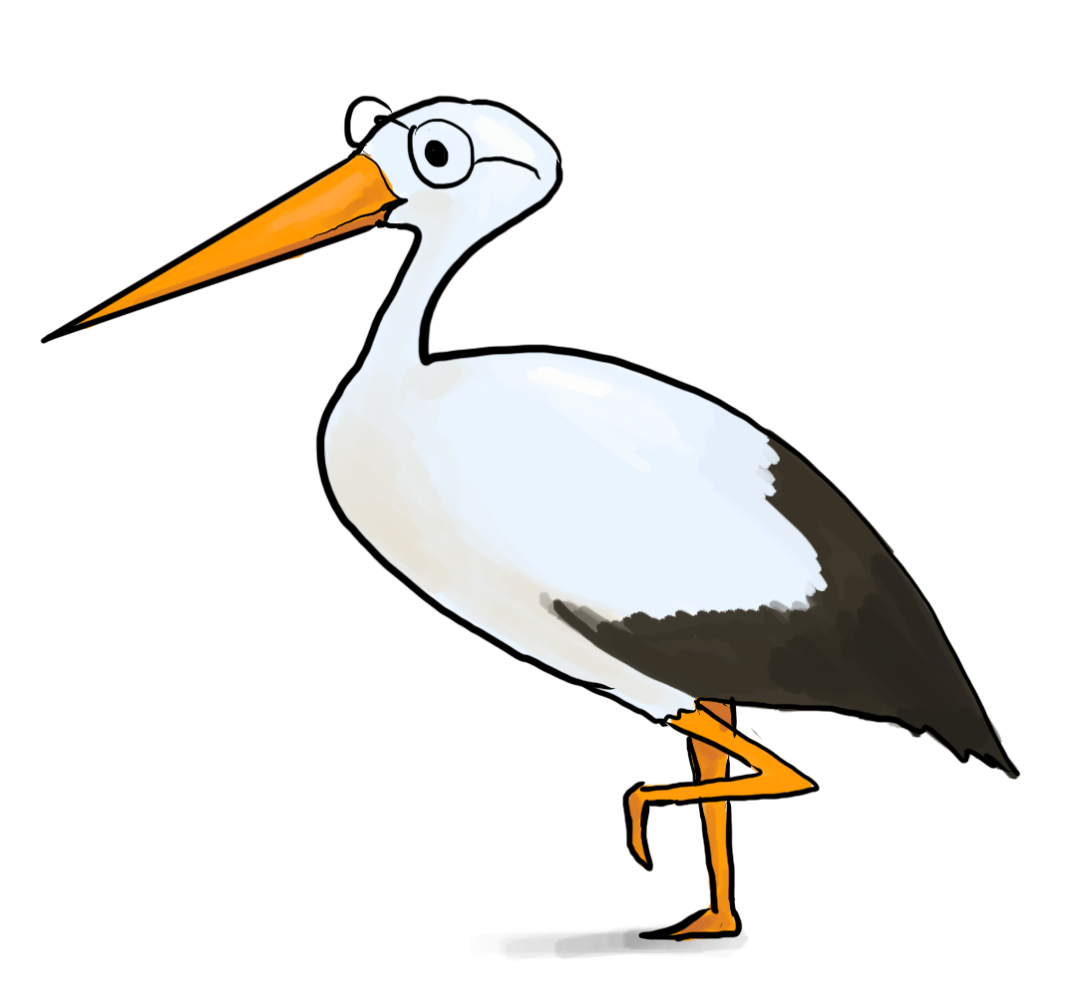
We’ve basically just shown
Theorem:
If there are no negative cycles in a weighted directed graph G, then the Floyd-Warshall algorithm, running on G, returns a matrix D^{(n)} so that:
D^{(n)}[u,v] = distance between u and v in G.
Running time: O(n³)
Better than running Bellman-Ford n times!
Storage:
Need to store two n-by-n arrays, and the original graph.
Work out the details of a proof!
As with Bellman-Ford, we don’t really need to store all n of the D^{(k)}.

Slide 85
Recap of today’s lecture

Slide 86
Thank you!

