Slide 1
Lecture 18
what we’ve done and what’s to come

Slide 2
Announcements
HW8 (last one) due today
Don’t forget about the final exam on March 17 (from 3:30pm – 6:30pm).

Slide 3
Today
What just happened?
  A whirlwind tour of CS161
What’s next?
  A few gems from future algorithms classes

Slide 4
It’s been a fun ride…
Greedy algorithms!
Sorting and friends!
Graphs!
Data structures:
BSTs and Hashing!
MinCuts and MaxFlows
Dynamic Programming!
Scheduling and etc.
Divide-and-conquer
and recurrence relations
Stable Matchings
LCS, Knapsack(s)
BFS, DFS, SCCs
MSTs: Prim and Kruskal
Bellman-Ford,
Floyd-Warshall
O() and worst-case analysis
Ford-Fulkerson
Randomized algorithms
Dijkstra’s algorithm

Slide 5
What have we learned?
17 lectures in 12 slides.

Slide 6

General approach to algorithm design and analysis
Can I do better?
To answer this question we need both rigor and intuition:
Plucky the
Pedantic Penguin
Lucky the
Lackadaisical Lemur
Algorithm designer
Detail-oriented
Precise
Rigorous
Big-picture
Intuitive
Hand-wavey

Slide 7

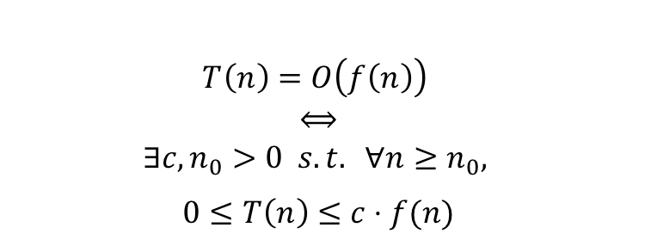
We needed more details
Does it work?
Is it fast?
What
does that mean??
Worst-case analysis
big-Oh notation
Here is an input!
$$T\left(n\right)=O\left(f\left(n\right)\right)$$
$$⟺$$
$$∃c, n_{0}>0 s.t. ∀n≥n_{0},$$
$$0≤T\left(n\right)≤c⋅f(n)$$
n

Slide 8
Algorithm design paradigm: divide and conquer
Big problem
Like MergeSort!
Or Karatsuba’s algorithm!
Or SELECT!
How do we analyze these?
Smaller problem
Smaller problem
By careful analysis!
Useful shortcut, the master method is.
Yet smaller problem
Yet smaller problem
Yet smaller problem
Yet smaller problem
Plucky the Pedantic Penguin
Jedi master Yoda

Slide 9
While we’re on the topic of sorting
Why not use randomness?
We analyzed QuickSort!
Still worst-case input, but we use randomness after the input is chosen.
Always correct, usually fast.
  This is a Las Vegas algorithm

Slide 10

All this sorting is making me wonder…
Can we do better?
Depends on who you ask:
RadixSort takes time O(n) if the objects are, for example, small integers!
Can’t do better in a comparison-based model.
$$≤$$

Slide 11
beyond sorted arrays/linked lists:
Binary Search Trees!
Useful data structure!
Especially the self-balancing ones!
Red-Black tree!
5
3
7
Maintain balance by stipulating that black nodes are balanced, and that there aren’t too many red nodes.
2
4
6
8
It’s just good sense!

Slide 12
Another way to store things
Hash tables!
The universe
All of the hash functions
h:U →{0,…,n-1}
hash function h
Choose h randomly from a universal hash family.
It’s better if the hash family is small!
Then it takes less space to store h.
Some buckets

Slide 13
OMG GRAPHS
BFS, DFS, and applications!
SCCs, Topological sorting, …

Slide 14
A fundamental graph problem: shortest paths
E.g., transit planning, packet routing, …
Dijkstra!
Bellman-Ford!
Floyd-Warshall!

Slide 15
Bellman-Ford and Floyd-Warshall were examples of…
Dynamic
Programming!
We saw many other examples, including Longest Common Subsequence and Knapsack Problems.
Not programming in an action movie.
Step 1: Identify optimal substructure.
Step 2: Find a recursive formulation for the value of the optimal solution.
Steps 3-5: Use dynamic programming: fill in a table to find the answer!
Instead, an algorithmic paradigm!
Big problem
sub
problem
sub
problem
sub
problem
sub
problem
sub
sub prob
sub sub prob
sub sub prob
sub sub prob

Slide 16
Sometimes we can take even better advantage of optimal substructure…with
Greedy algorithms
Make a series of choices, and commit!
Intuitively we want to show that our greedy choices never rule out success.
Rigorously, we usually analyzed these by induction.
Examples!
  Activity Selection
  Job Scheduling
  Huffman Coding
  Minimum Spanning Trees
Prim’s algorithm:
greedily grow a tree
Kruskal’s algorithm:
greedily grow a forest

Slide 17
Cuts and flows
Minimum s-t cut:
  is the same as maximum s-t flow!
  Ford-Fulkerson can find them!
    useful for routing
    also assignment problems
3
3
3
4
4
2
6
1
4
6
2
4
s
2
3
4
t
3
5
2
3
1
6
6
4
4
5
10

Slide 18






Stable matching
How to convince actors to use our matching?
Where do preferences come from?
Are the incentives set correctly?
B, A, C
X, Y, Z
X
Alice
A, C, B
Y, X, Z
Y
Bob
B, C, A
Deferred acceptance: a different kind of greedy algorithm, this time with recourse.
Y, Z, X
Z
Charlie

Slide 19
And now we’re here

Slide 20
What have we learned?
A few algorithm design paradigms:
  Divide and conquer, dynamic programming, greedy
A few analysis tools:
  Worst-case analysis, asymptotic analysis, recurrence relations, probability tricks, proofs by induction
A few common objects:
  Graphs, arrays, trees, hash functions
A LOT of examples!

Slide 21
What have we learned?
We’ve filled out a toolbox
Tons of examples give us intuition about what algorithmic techniques might work when.
The technical skills make sure our intuition works out.

Slide 22
But there’s lots more out there
What’s next???

Slide 23
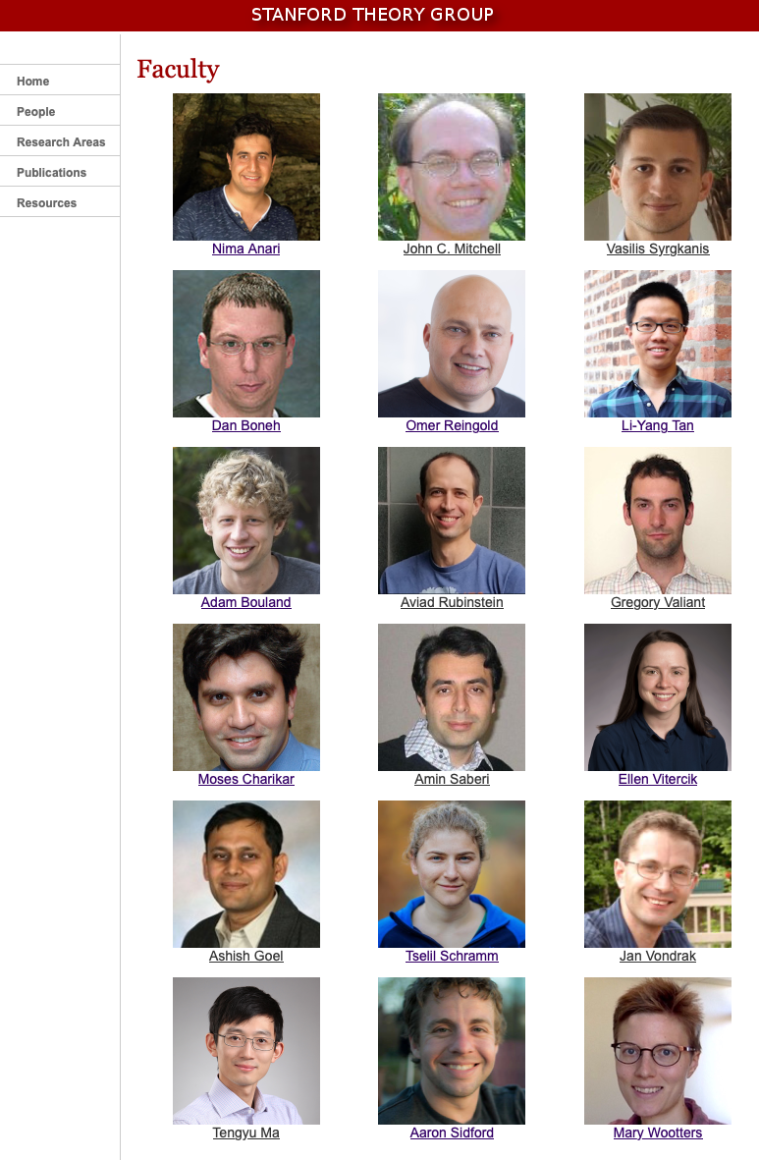
A taste of what’s to come
findSomeTheoryCourses():
go to theory.stanford.edu
Click on “People”
Look at what we’re teaching!
CS154 – Introduction to Automata and Complexity
CS163 – The Practice of Theory Research
CS166 – Data Structures
CS168 – The Modern Algorithmic Toolbox
MS&E 212 – Combinatorial Optimization
CS250 – Error Correcting Codes
CS252 – Analysis of Boolean Functions
CS254 – Computational Complexity
CS255 – Introduction to Cryptography
CS259Q – Quantum Computing
CS260 – Geometry of Polynomials in Algorithm Design
CS261 – Optimization and Algorithmic Paradigms
CS263 – Counting and Sampling
CS265 – Randomized Algorithms
CS269O – Introduction to Optimization Theory
MS&E 316 – Discrete Mathematics and Algorithms
CS352 – Pseudorandomness
CS366 – Computational Social Choice
CS368 – Algorithmic Techniques for Big Data
EE364A/B – Convex Optimization I and II
...and many many more!

Slide 24
Today
A few gems
Linear programming
Random projections
Low-degree polynomials
This will be fluffy, without much detail – take more CS theory classes for more detail!

Slide 25


Linear Programming
This is a fancy name for optimizing a linear function subject to linear constraints.
For example:
It turns out the be an extremely general problem.
$$x≥0$$
$$y≥0$$
$$4x+y≤2$$
$$x+2y≤1$$
Maximize
$x+y$
subject to

Slide 26
We’ve already seen an example!
None of the flows are bigger than the edge capacities
At every vertex, stuff going in = stuff going out.
Maximize
the sum of the flows leaving s
subject to
3
3
3
4
4
2
6
1
4
6
s
2
4
t
2
3
4
3
5
2
3
1
6
6
4
4
5
10

Slide 27
Another example, in machine learning
Support Vector Machines
Technically quadratic programming, not linear programming…
Maximize
the margin
all of the points are on the correct side of the line.
subject to
This can be written in a convex way
These are just linear inequalities
?

Slide 28
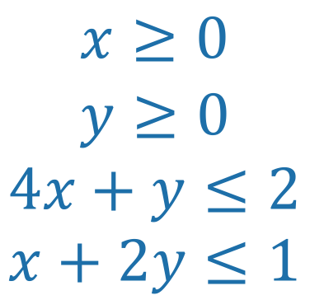
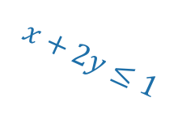

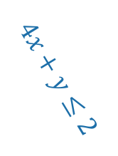


Linear Programming
Has a really nice geometric intuition
$$4x+y≤2$$
Maximize
$x+y$
subject to
$$x≥0$$
$$y≥0$$
$$4x+y≤2$$
$$x+2y≤1$$
$$x+2y≤1$$
$$y≥0$$
$$x≥0$$

Slide 29
Linear Programming
Has a really nice geometric intuition
$$4x+y≤2$$
Maximize
$x+y$
subject to
$$x≥0$$
$$y≥0$$
$$4x+y≤2$$
$$x+2y≤1$$
$$x+2y≤1$$
$$y≥0$$
$$x≥0$$

Slide 30
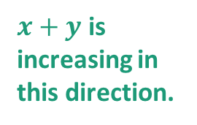
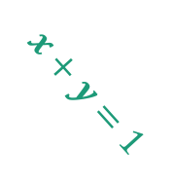

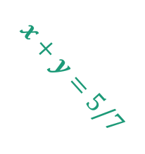
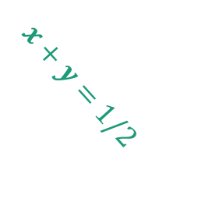
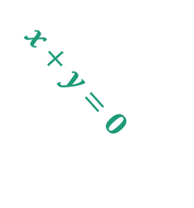
Linear Programming
Has a really nice geometric intuition
$$x+y=5/7$$
Maximize
$x+y$
$$x+y=1$$
$$x+y=1/2$$
$x+y$ is increasing in this direction.
subject to
The function is maximized here!
$$x≥0$$
$$y≥0$$
$$4x+y≤2$$
$$x+2y≤1$$
$$x+y=0$$

Slide 31
In general
The constraints define a polytope
The function defines a direction
We just want to find the vertex that is furthest in that direction.
The function is maximized here!

Slide 32
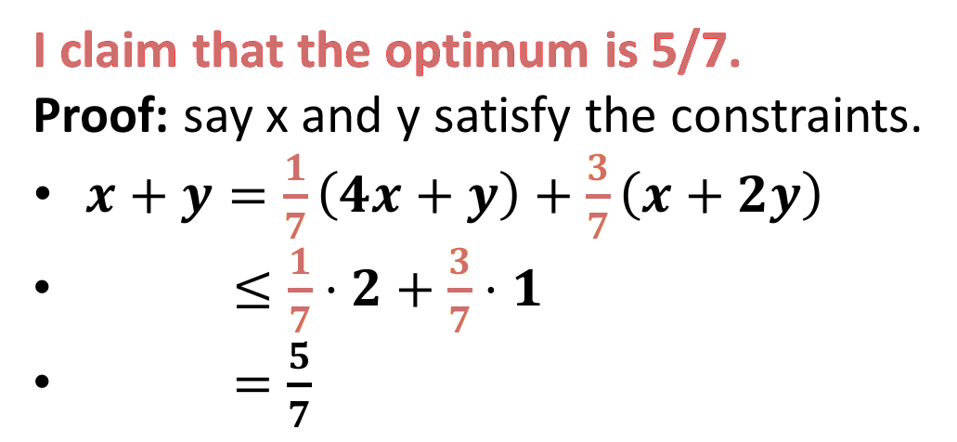
Duality
How do we know we have an optimal solution?
I claim that the optimum is 5/7.
Proof: say x and y satisfy the constraints.
$x+y=\frac{1}{7}\left(4x+y\right)+\frac{3}{7}\left(x+2y\right)$
$≤\frac{1}{7}⋅2+\frac{3}{7}⋅1$
$=\frac{5}{7}$
Maximize
$x+y$
subject to
$$x≥0$$
$$y≥0$$
$$4x+y≤2$$
$$x+2y≤1$$
You can check this point has value 5/7...but how would we prove it’s optimal other than by eyeballing it?

Slide 33

cute, but
How did you come up with 1/7, 3/7?
I claim that the optimum is 5/7.
Proof: say x and y satisfy the constraints.
$x+y≤\frac{1}{7}\left(4x+y\right)+\frac{3}{7}\left(x+2y\right)$
$≤\frac{1}{7}⋅2+\frac{3}{7}⋅1$
$=\frac{5}{7}$
Maximize
$x+y$
subject to
$$x≥0$$
$$y≥0$$
$$4x+y≤2$$
$$x+2y≤1$$
I want to choose things to put here
So that I minimize this
Subject to these things

Slide 34
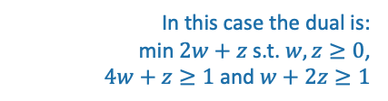
That’s a linear program!
Note: it’s not immediately obvious how to turn that into a linear program, this is just meant to convince you that it’s plausible.
In this case the dual is:
min $2w+z$ s.t. $w,z≥0$,
$4w+z≥1$ and $w+2z≥1$
How did I find those special values 1/7, 3/7?
I solved some linear program.
It’s called the dual program.
Minimize the upper bound you get, subject to the proof working.
The optimal values are the same!
Maximize stuff subject to stuff
Minimize other stuff subject to other stuff
Primal
Dual

Slide 35
We’ve actually already seen this too
The Min-Cut Max-Flow Theorem!
Maximize the sum of the flows leaving s
s.t
All the flow constraints are satisfied
The optimal values are the same!
Minimize the sum of the capacities on a cut
s.t.
it’s a legit cut
3
3
3
4
4
2
6
1
4
6
s
2
4
t
2
3
4
3
5
2
3
1
6
6
4
4
Dual
Primal
5
10

Slide 36
LPs and Duality are really powerful
This general phenomenon shows up all over the place
  Min-Cut Max-Flow is a special case.
Duality helps us reason about an optimization problem
  The dual provides a certificate that we’ve solved the primal.
  E.g., if you have a cut and a flow with the same value, you must have found a max flow and a min cut.
We can solve LPs quickly!
  For example, by intelligently bouncing around the vertices of the feasible region.
  This is an extremely powerful algorithmic primitive.

Slide 37
Today
A few gems
Linear programming
Random projections
Low-degree polynomials

Slide 38
A very useful trick
Take a random projection and hope for the best.
Choose a random subspace to project onto instead of the ground.
High-dimensional set of points
For example, each data point is a vector
(age, height, shoe size, … )
Their shadow is a projection onto the ground.

Slide 39
Why would we do this?
High dimensional data takes a long time to process.
Low dimensional data can be processed quickly.
“THEOREM”: Random projections approximately preserve properties of data that you care about.

Slide 40
Example: nearest neighbors
I want to find which point is closest to this one.
Johnson-Lindenstrauss Lemma: Euclidean distance is approximately preserved by random projections.
Find the closest point down here, you’re probably pretty correct.
That takes a really long time in high dimensions.

Slide 41
Another example:
Compressed Sensing
Start with a sparse vector
  Mostly zero or close to zero
For example:
(5 , 0 , 0 , 0 ,0 , 0.01 , 0.01 , 5.8 , 32 , 14 , 0 , 0 , 0 , 12 , 0 , 0 , 5 , 0 , .03)
This image is sparse
This image is sparse after I take a wavelet transform.

Slide 42

Compressed sensing continued
Take a random projection of that sparse vector:
Random short fat matrix
$$=$$
Short vector
Goal: Given the short vector, recover the long sparse vector.
Long sparse vector

Slide 43
Why would I want to do that?
Image compression and signal processing
Especially when you never have space to store the whole sparse vector to begin with.
Randomly sampling (in the time domain) a signal that is sparse in the Fourier domain.
Random measurements in an fMRI means you spend less time inside an fMRI
A “single pixel camera” is a thing.

Slide 44
All examples of this:
Random short fat matrix
$$=$$
Short vector
Goal: Given the short vector, recover the long sparse vector.
Long sparse vector

Slide 45
But why should this be possible?
There are tons of long vectors that map to the short vector!
Random short fat matrix
$$=$$
Short vector
Goal: Given the short vector, recover the long sparse vector.
Long sparse vector

Slide 46
Back to the geometry
Choose a random subspace to project onto instead of the ground.
All of the sparse vectors
(Infinitely many of them)
Theorem:
random projections preserve the geometry of sparse vectors too.

Slide 47
If we don’t care about algorithms, that’s more than enough.
All of the sparse vectors
Multiply by
Random short fat matrix
There may be tons of vectors that map to this point, but only one of them is sparse!
This means that, in theory, we can invert that arrow.
How do we do this efficiently??

Slide 48
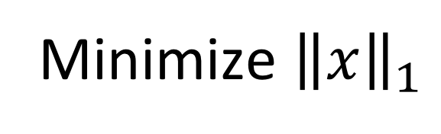

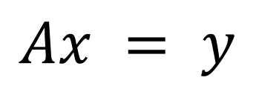
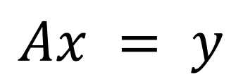
An efficient algorithm?
Goal: Given the short vector, recover the long sparse vector.
Random short fat matrix A
$$=$$
What we’d like to do is:
Short vector y
Minimize number of nonzero entries in x
Long sparse vector
$$Ax = y$$
s.t.
This norm is the sum of the absolute values of the entries of x
Problem: I don’t know how to do that efficiently!
This isn’t a nice function
Instead:
Minimize ${\left\|x\right\|}_{1}$
$$Ax = y$$
s.t.
It turns out that because the geometry of sparse vectors is preserved, this optimization problem gives the same answer.
We can use linear programming to solve this quickly!

Slide 49
Today
A few gems
Linear programming
Random projections
Low-degree polynomials

Slide 50
Another very useful trick
Polynomial interpolation
Say we have a few evaluation points of a low-degree polynomial.
We can recover the polynomial.
  2 pts determine a line, 3 pts determine a parabola, etc.
We can recover the whole polynomial really fast.
Even works if some of the points are wrong.
f(x)

Slide 51
One application:
Communication and Storage
Alice wants to send a message to Bob
“Hi, Bob!”
$$f\left(x\right)= H+I⋅x+B⋅x^{2}+O⋅x^{3}+B⋅x^{4}$$
f(x)
Bob can do super-fast polynomial interpolation and figure out what Alice meant to say!
Noisy channel
Alice
Bob

Slide 52
This is used in practice
It’s called “Reed-Solomon Encoding”

Slide 53

Another application:
Designing “random” projections that are better than random
Random short fat matrix
$$=$$
The matrix that treats the big long vector as Alice’s message polynomial and evaluates it REALLY FAST at random points.
This is still “random enough” to make the LP solution work.
It is much more efficient to manipulate and store!

Slide 54
Today
A few gems
To learn more:
CS168, CS261, …
Linear programming
Random projections
Low-degree polynomials
CS168, CS261, CS265, …
CS168, CS250, …

Slide 55
What have we learned?
CS161
Tons more cool algorithms stuff!

Slide 56
To see more…
Take more classes!
Come hang out with the theory group!
  Theory lunch, most Thursdays at noon.
  Join the theory-seminar mailing list for updates.
theory.stanford.edu
Stanford theory group (circa 2017):
We are very friendly.

Slide 57
A few final messages…

Slide 58


Thanks to our course coordinators Amelie Byun and John Cho!
They have been making all the logistics work behind the scenes.

Slide 59

Thanks to Dan Webber!
Dan has been helping integrate EthiCS components into the course.

Slide 60
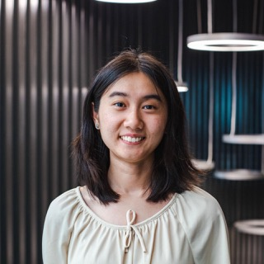








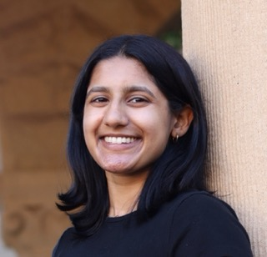

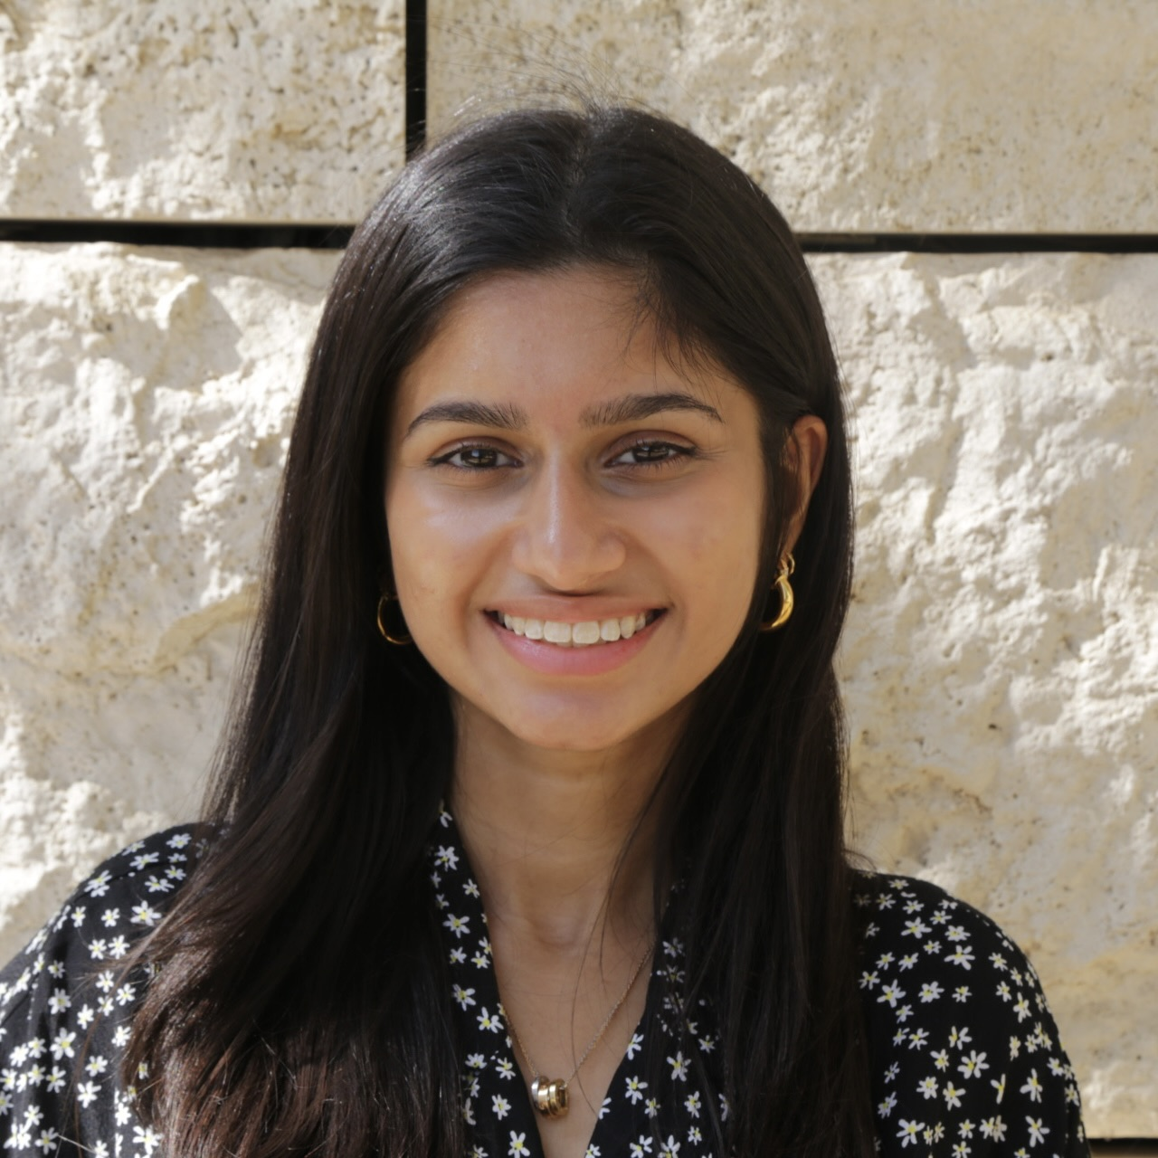

Thanks to our superstar CAs!!! tell them you appreciate them!
Samantha
Aidan
Alex
Allison
Chirag
Ishaan
Josh
Matthew
Max
Ramya
Ruiquan
Shreya
Shreyas

Slide 61
THANKS to you!!!!!!
4.

