Slide 1
Lecture 4
Median and Selection

Slide 2
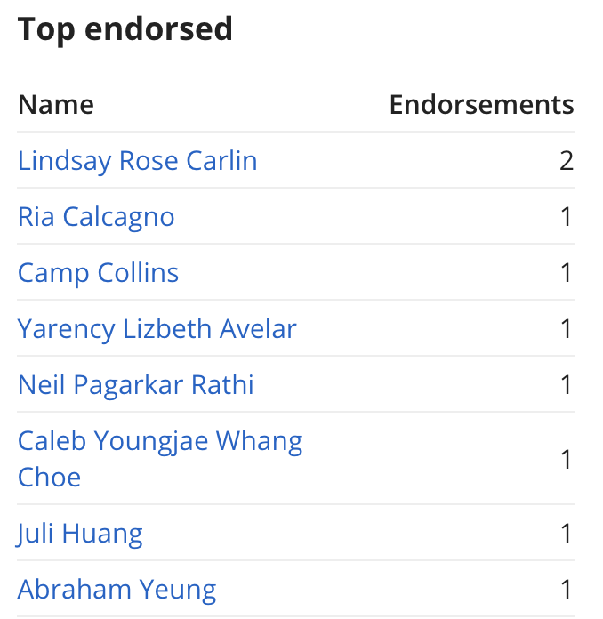
Ed Heroes

Slide 3
Ed Heroes
Bonus points for Ed participation!

Slide 4
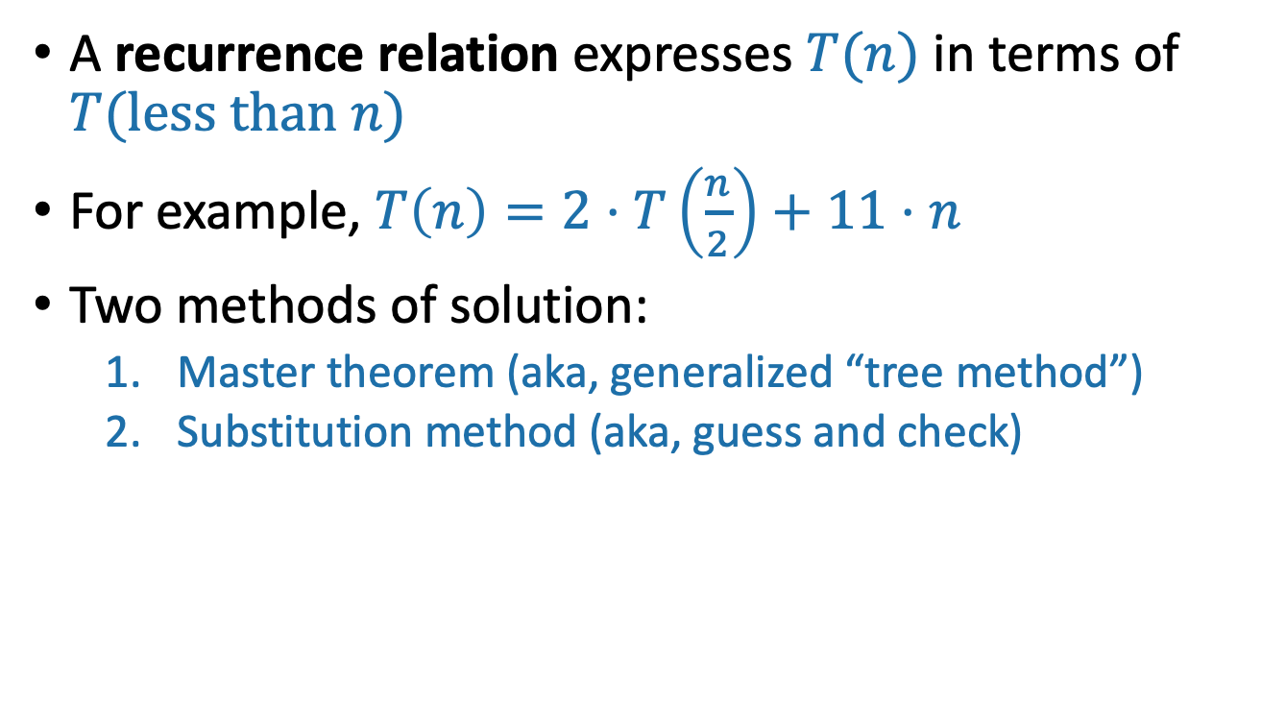
Last Time:
Solving Recurrence Relations
A recurrence relation expresses $T(n)$ in terms of $T(less than n)$
For example, $T\left(n\right)=2⋅T\left(\frac{n}{2}\right)+11⋅n$
Two methods of solution:
  Master theorem (aka, generalized “tree method”)
  Substitution method (aka, guess and check)

Slide 5
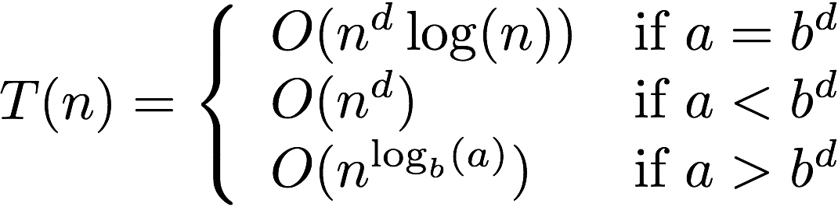

The Master Theorem
Suppose $a≥1,b>1,and d$ are constants (that don’t depend on n).
Suppose $T\left(n\right)=a⋅T\left(\frac{n}{b}\right)+O\left(n^{d}\right)$. Then
Three parameters:
a : number of subproblems
b : factor by which input size shrinks
d : need to do n^{d} work to create all the subproblems and combine their solutions.
A powerful theorem it is…
Jedi master Yoda

Slide 6
The Substitution Method
Step 1: Guess what the answer is.
Step 2: Prove by induction that your guess is correct.
Step 3: Profit.

Slide 7
The plan for today
More practice with the Substitution Method.
k-SELECT problem
k-SELECT solution
Return of the Substitution Method.

Slide 8

A fun recurrence relation
$T\left(n\right)≤T\left(\frac{n}{5}\right)+T\left(\frac{7n}{10}\right)+n$ for $n>10.$
Base case: $T\left(n\right)=1 when 1≤n≤10$
Apply here, the Master Theorem does NOT.
Jedi master Yoda

Slide 9
The Substitution Method
Step 1: Guess what the answer is.
Step 2: Prove by induction that your guess is correct.
Step 3: Profit.

Slide 10
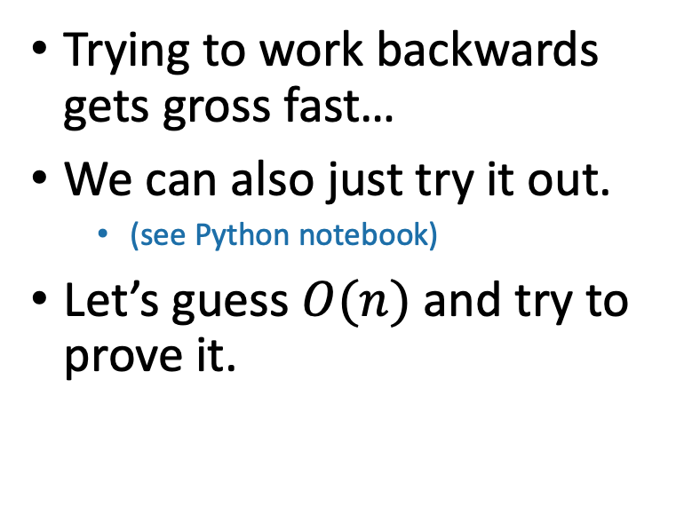
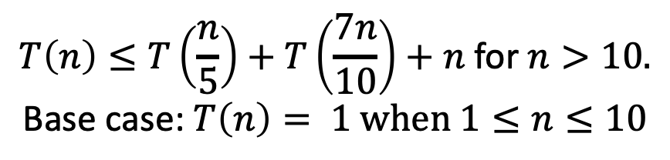
Step 1: guess the answer
$$T\left(n\right)≤T\left(\frac{n}{5}\right)+T\left(\frac{7n}{10}\right)+n \text{for} n>10.$$
$$\text{Base} \text{case}\text{: }T\left(n\right)= 1 when 1≤n≤10$$
Trying to work backwards gets gross fast…
We can also just try it out.
  (see Python notebook)
Let’s guess $O(n)$ and try to prove it.
Looks pretty linear?

Slide 11
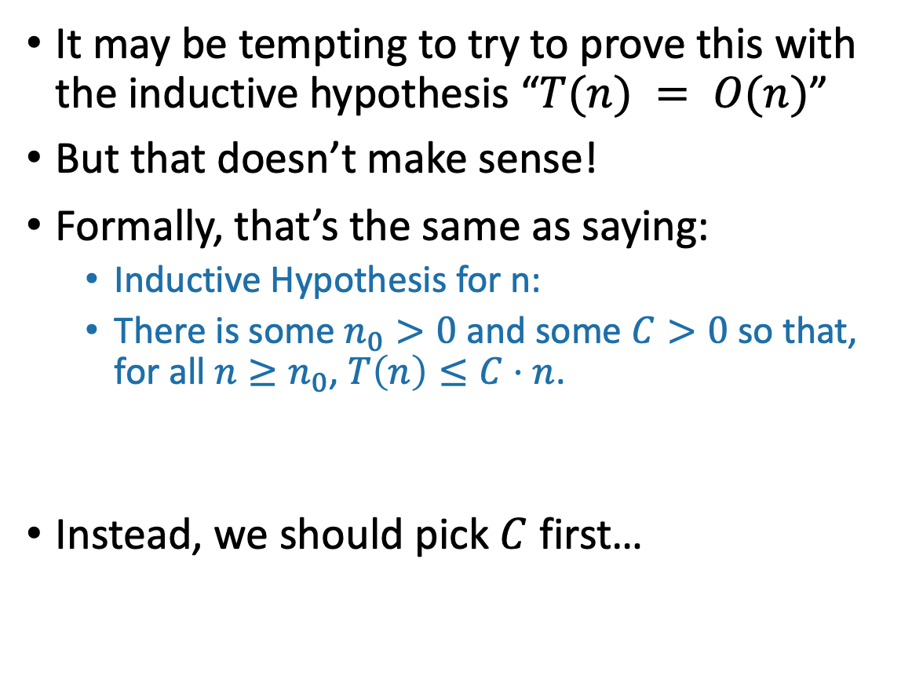
Aside: Warning!
It may be tempting to try to prove this with the inductive hypothesis “$T(n) = O(n)$”
But that doesn’t make sense!
Formally, that’s the same as saying:
  Inductive Hypothesis for n:
  There is some $n_{0}>0$ and some $C>0$ so that, for all $n≥n_{0}$, $T\left(n\right)≤C⋅n$.
Instead, we should pick $C$ first…
The IH is supposed to hold for a specific n.
But now we are letting n be anything big enough!

Slide 12
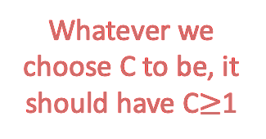
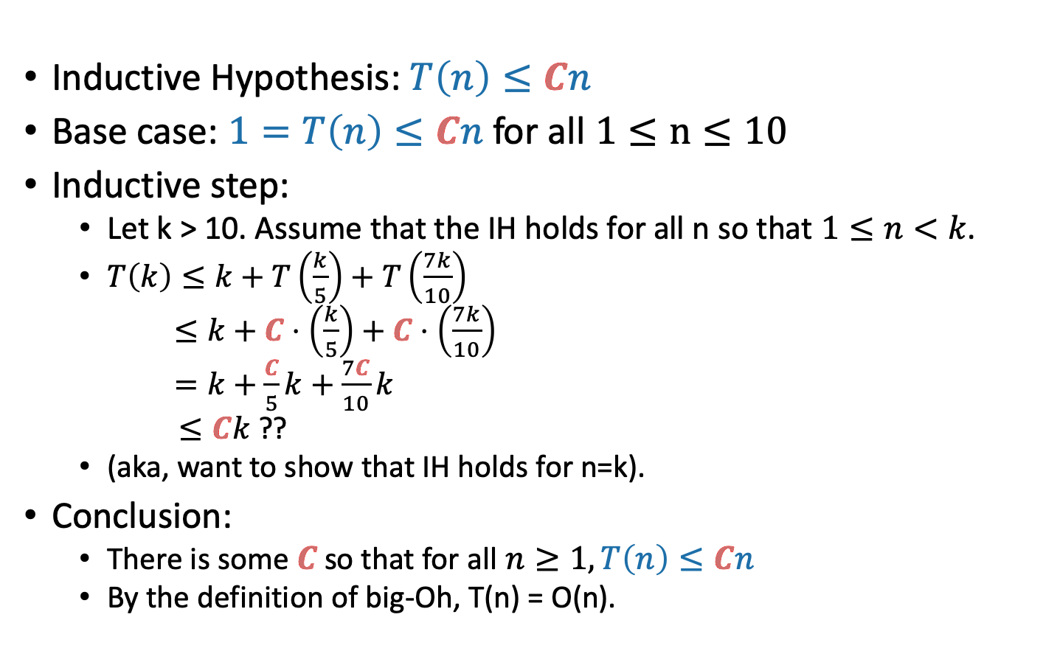
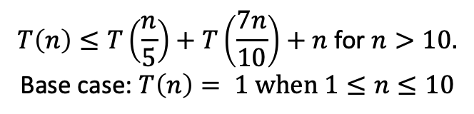
Step 2: prove our guess is right
We don’t know what C should be yet! Let’s go through the proof leaving it as “C” and then figure out what works…
$$T\left(n\right)≤T\left(\frac{n}{5}\right)+T\left(\frac{7n}{10}\right)+n \text{for} n>10.$$
$$\text{Base} \text{case}\text{: }T\left(n\right)= 1 when 1≤n≤10$$
Inductive Hypothesis: $T\left(n\right)≤Cn$
Base case: $1=T\left(n\right)≤Cn$ for all $1≤n≤10$
Inductive step:
  Let k > 10. Assume that the IH holds for all n so that $1≤n<k$.
  $T\left(k\right)≤k+T\left(\frac{k}{5}\right)+T\left(\frac{7k}{10}\right)$
  $≤k+C⋅\left(\frac{k}{5}\right)+C⋅\left(\frac{7k}{10}\right)$
  $=k+\frac{C}{5}k+\frac{7C}{10}k$
  $≤Ck$ ??
  (aka, want to show that IH holds for n=k).
Conclusion:
  There is some $C$ so that for all $n≥1, T\left(n\right)≤Cn$
  By the definition of big-Oh, T(n) = O(n).
Whatever we choose C to be, it should have C$≥$1
Let’s solve for C and make this true!
C = 10 works.
(write out)

Slide 13
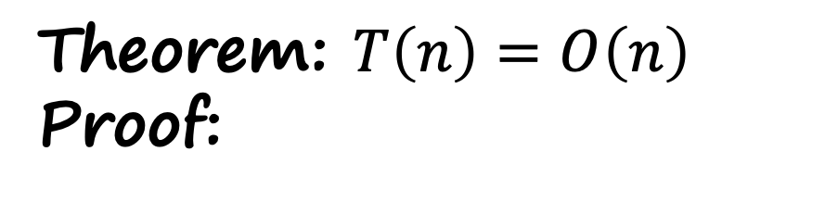
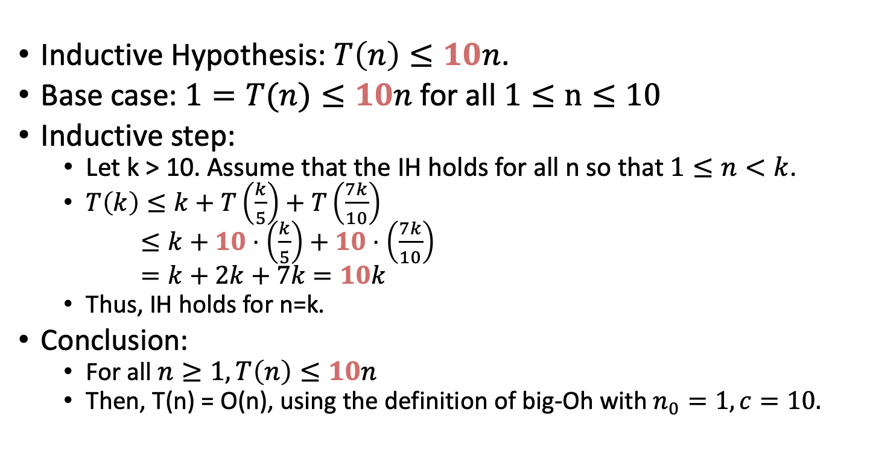
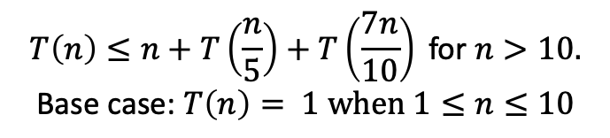
Step 3: Profit
$$T\left(n\right)≤n+T\left(\frac{n}{5}\right)+T\left(\frac{7n}{10}\right) \text{for} n>10.$$
$$\text{Base} \text{case}\text{: }T\left(n\right)= 1 when 1≤n≤10$$
(Aka, pretend we knew this all along).
Theorem: $T\left(n\right)=O\left(n\right)$
Proof:
Inductive Hypothesis: $T\left(n\right)≤10n$.
Base case: $1=T(n)≤10n$ for all $1≤n≤10$
Inductive step:
  Let k > 10. Assume that the IH holds for all n so that $1≤n<k$.
  $T\left(k\right)≤k+T\left(\frac{k}{5}\right)+T\left(\frac{7k}{10}\right)$
  $≤k+10⋅\left(\frac{k}{5}\right)+10⋅\left(\frac{7k}{10}\right)$
  $=k+2k+7k$ $=10k$
  Thus, IH holds for n=k.
Conclusion:
  For all $n≥1, T\left(n\right)≤10n$
  Then, T(n) = O(n), using the definition of big-Oh with $n_{0}=1, c=10.$

Slide 14
What have we learned?
The substitution method can work when the master theorem doesn’t.
  For example, with different-sized sub-problems.
Step 1: generate a guess
  Throw the kitchen sink at it.
Step 2: try to prove that your guess is correct
  You may have to leave some constants unspecified till the end – then see what they need to be for the proof to work!!
Step 3: profit
  Pretend you didn’t do Steps 1 and 2 and write down a nice proof.

Slide 15
The Plan
More practice with the Substitution Method.
k-SELECT problem
k-SELECT solution
Return of the Substitution Method.

Slide 16
The k-SELECT problem from your pre-lecture exercise
For today, assume all arrays have distinct elements.
A is an array of size n, k is in {1,…,n}
SELECT(A, k):
  Return the k-th smallest element of A.
7
4
3
8
1
5
9
14
SELECT(A, 1) = 1
SELECT(A, 2) = 3
SELECT(A, 3) = 4
SELECT(A, 8) = 14
SELECT(A, 1) = MIN(A)
SELECT(A, n/2) = MEDIAN(A)
SELECT(A, n) = MAX(A)
Being sloppy about floors and ceilings!
Note that the definition of Select is 1-indexed…

Slide 17
On your pre-lecture exercise…
An O(nlog(n))-time algorithm
SELECT(A, k):
  A = MergeSort(A)
  return A[k-1]
Running time is O(n log(n)).
So that’s the benchmark….
Can we do better?
It’s k-1 and not k since my pseudocode is 0-indexed and the problem is 1-indexed…
Show that you can’t do better than O(n).
We’re hoping to get O(n)

Slide 18
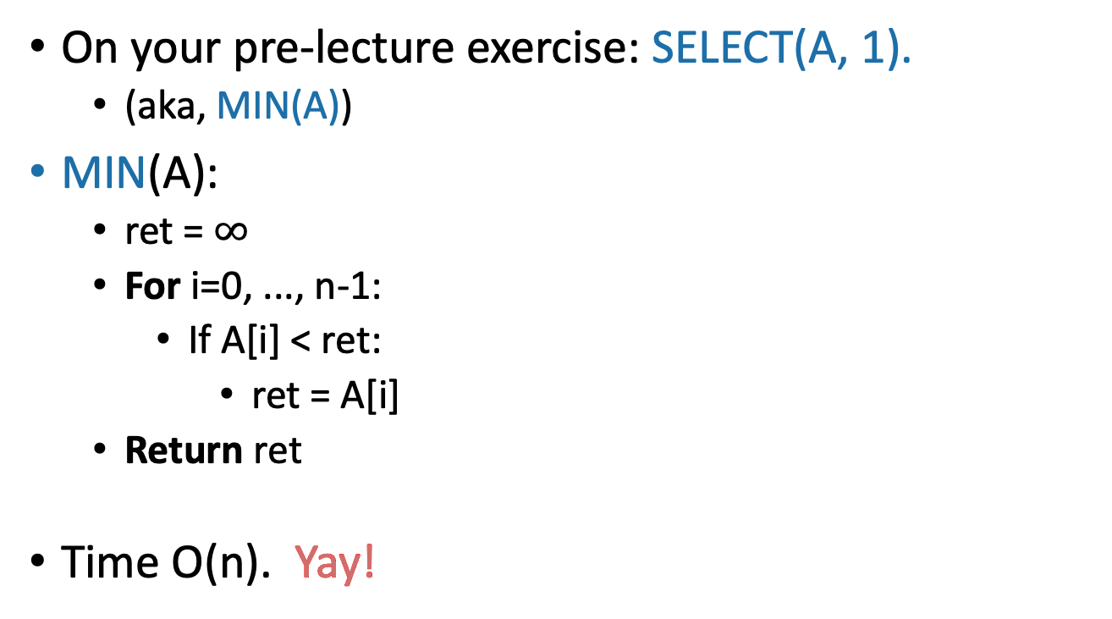
Goal: An O(n)-time algorithm
On your pre-lecture exercise: SELECT(A, 1).
  (aka, MIN(A))
MIN(A):
  ret = $∞$
  For i=0, ..., n-1:
    If A[i] < ret:
      ret = A[i]
  Return ret
Time O(n). Yay!
This loop runs O(n) times
This stuff is O(1)

Slide 19
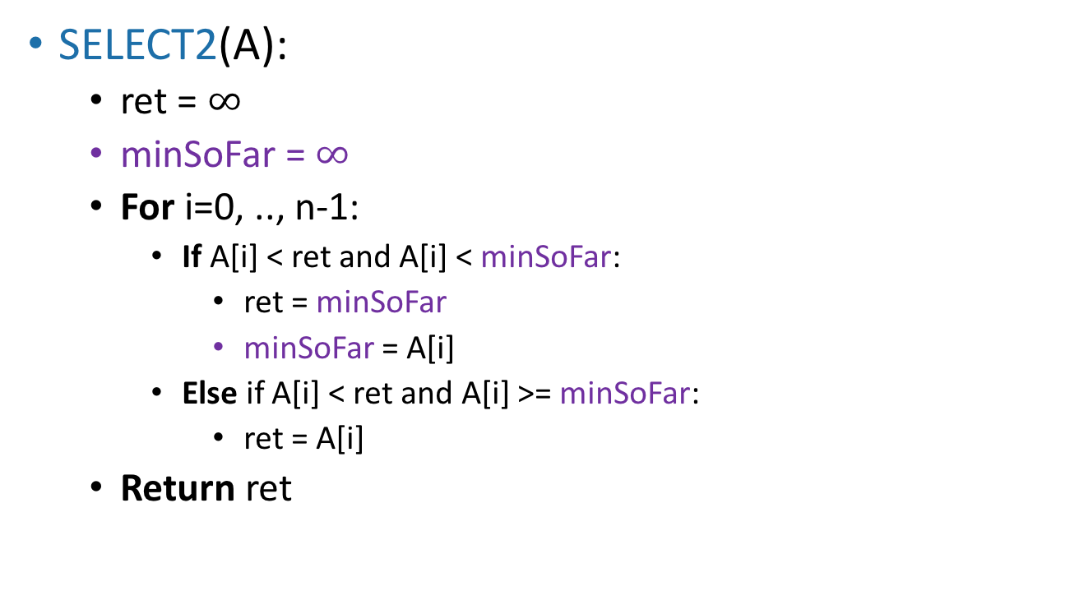
Also on your pre-lecture exercise
How about SELECT(A,2)?
(The actual algorithm here is not very important because this won’t end up being a very good idea…)
SELECT2(A):
  ret = $∞$
  minSoFar = $∞$
  For i=0, .., n-1:
    If A[i] < ret and A[i] < minSoFar:
      ret = minSoFar
      minSoFar = A[i]
    Else if A[i] < ret and A[i] >= minSoFar:
      ret = A[i]
  Return ret
Still O(n)
SO FAR SO GOOD.

Slide 20
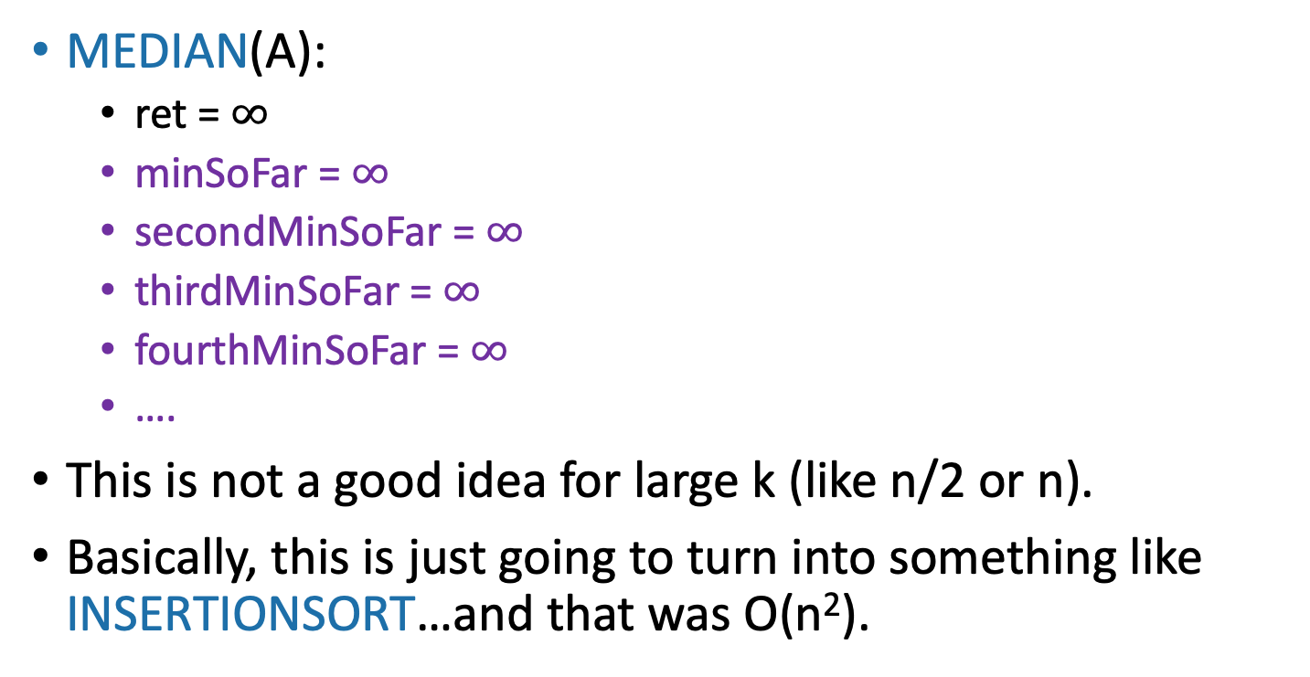
SELECT(A, n/2) aka MEDIAN(A)?
MEDIAN(A):
  ret = $∞$
  minSoFar = $∞$
  secondMinSoFar = $∞$
  thirdMinSoFar = $∞$
  fourthMinSoFar = $∞$
  ….
This is not a good idea for large k (like n/2 or n).
Basically, this is just going to turn into something like INSERTIONSORT…and that was O(n²).

Slide 21
The Plan
More practice with the Substitution Method.
k-SELECT problem
k-SELECT solution
Return of the Substitution Method.

Slide 22
Idea: divide and conquer!
Say we want to find SELECT(A, k)
9
8
3
6
1
4
2
9
8
3
6
1
4
2
How about this pivot?
First, pick a “pivot.”
We’ll see how to do this later.
This PARTITION step takes time O(n). (Notice that we don’t sort each half).
Next, partition the array into “bigger than 6” or “less than 6”
L = array with things smaller than A[pivot]
R = array with things larger than A[pivot]

Slide 23
Idea: divide and conquer!
Say we want to find SELECT(A, k)
6
6
How about this pivot?
First, pick a “pivot.”
We’ll see how to do this later.
This PARTITION step takes time O(n). (Notice that we don’t sort each half).
Next, partition the array into “bigger than 6” or “less than 6”
3
1
4
2
9
8
L = array with things smaller than A[pivot]
R = array with things larger than A[pivot]

Slide 24
Idea continued…
Say we want to find SELECT(A, k)
6
3
1
4
2
pivot
9
8
L = array with things smaller than A[pivot]
R = array with things larger than A[pivot]
If k = 5 = len(L) + 1:
  We should return A[pivot]
If k < 5:
  We should return SELECT(L, k)
If k > 5:
  We should return SELECT(R, k – 5)
This suggests a recursive algorithm
(still need to figure out how to pick the pivot…)

Slide 25
Pseudocode
getPivot(A)returns some pivot for us.
  How?? We’ll see later…
Partition(A,p) splits up A into L, A[p], R.
  See Lecture 4 Python notebook for code
Select(A,k):
  If len(A) <= 50:
    A = MergeSort(A)
    Return A[k-1]
  p = getPivot(A)
  L, pivotVal, R = Partition(A,p)
  if len(L) == k-1:
    return pivotVal
  Else if len(L) > k-1:
    return Select(L, k)
  Else if len(L) < k-1:
    return Select(R, k – len(L) – 1)
Base Case: If len(A) = O(1), then any sorting algorithm runs in time O(1).
Case 1: We got lucky and found exactly the k’th smallest value!
Case 2: The k’th smallest value is in the first part of the list
Case 3: The k’th smallest value is in the second part of the list

Slide 26
Does it work?
Convince yourself that Select is correct!
Check out the Python notebook for Lecture 4, which implements this with a bunch of different pivot-selection methods.
  Seems to work!
Check out the lecture notes for a rigorous proof based on induction that this works, with any pivot-choosing mechanism.
  It provably works!
  Also, this is a good example of proving that a recursive algorithm is correct.

Slide 27

What is the running time?
Assuming we pick the pivot in time O(n)…
$T\left(n\right)= \left\{\begin{matrix}T\left(len\left(L\right)\right)+O\left(n\right) len\left(L\right)>k −1 \\ T\left(len\left(R\right)\right)+O\left(n\right) len\left(L\right)<k −1 \\ O\left(n\right) len\left(L\right)=k−1\end{matrix}\right.$
What are len(L) and len(R)?
That depends on how we pick the pivot…
  What would be a “good” pivot?
  What would be a “bad” pivot?
  Think: one minute
  Share: (wait) one minute
The best way would be to always pick the pivot so that len(L) = k-1. But say we don’t have control over k, just over how we pick the pivot.
Think-Share Terrapins

Slide 28
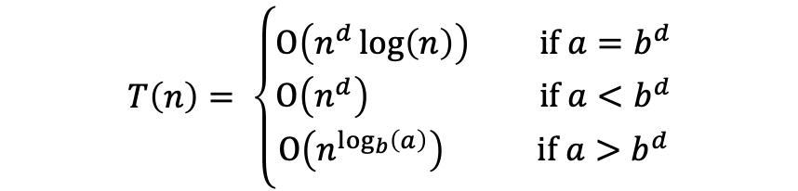
The ideal pivot
We split the input exactly in half:
  len(L) = len(R) = (n-1)/2
What happens in that case?
  Think: one minute
  Share: (wait) one minute
In case it’s helpful…
Suppose $T\left(n\right)=a⋅T\left(\frac{n}{b}\right)+O\left(n^{d}\right)$. Then
$$T\left(n\right)= \left\{\begin{aligned}O\left(n^{d}\log\left(n\right)\right) if a=b^{d} \\ O\left(n^{d}\right) if a<b^{d} \\ O\left(n^{\log_{b}\left(a\right)}\right) if a>b^{d}\end{aligned}\right.$$

Slide 29

The ideal pivot
Apply here, the Master Theorem does NOT. Making unsubstantiated assumptions about problem sizes, we are.
We split the input exactly in half:
  len(L) = len(R) = (n-1)/2
Let’s pretend that’s the case and use the Master Theorem!
$T\left(n\right)≤T\left(\frac{n}{2}\right)+O(n)$
So a = 1, b = 2, d = 1
$T\left(n\right)≤O\left(n^{d}\right)=O\left(n\right)$
Jedi master Yoda
Suppose $T\left(n\right)=a⋅T\left(\frac{n}{b}\right)+O\left(n^{d}\right)$. Then
$$T\left(n\right)= \left\{\begin{aligned}O\left(n^{d}\log\left(n\right)\right) if a=b^{d} \\ O\left(n^{d}\right) if a<b^{d} \\ O\left(n^{\log_{b}\left(a\right)}\right) if a>b^{d}\end{aligned}\right.$$
That would be great!

Slide 30
The worst pivot
Say our choice of pivot doesn’t depend on A.
A bad guy who knows what pivots we will choose gets to come up with A.
2
1
3
pivot

Slide 31
The distinction matters!
For this one I chose the worst possible pivot. Looks like O(n²).
MergeSort-based solution
This one is a random pivot, so it splits the array about in half.
Looks fast!
See Lecture 4 Python notebook for code that generated this picture.

Slide 32
How do we pick a good pivot?
Randomly?
  That works well if there’s no bad guy.
  But if there is a bad guy who gets to see our pivot choices, that’s just as bad as the worst-case pivot.
Aside:
In practice, there is often no bad guy. In that case, just pick a random pivot and it works really well!
(More on this next lecture)

Slide 33
How do we pick a good pivot?
For today, let’s assume there’s this bad guy.
Reasons:
  This gives us a very strong guarantee
  We’ll get to see a really clever algorithm.
    Necessarily it will look at A to pick the pivot.
  We’ll get to use the substitution method.

Slide 34
The Plan
More practice with the Substitution Method.
k-SELECT problem
k-SELECT solution
  The outline of the algorithm.
  How to pick the pivot.
Return of the Substitution Method.

Slide 35
Approach
First, we’ll figure out what the ideal pivot would be.
  But we won’t be able to get it.
Then, we’ll figure out what a pretty good pivot would be.
  But we still won’t know how to get it.
Finally, we will see how to get our pretty good pivot!
  And then we will celebrate.

Slide 36

How do we pick our ideal pivot?
We’d like to live in the ideal world.
Pick the pivot to divide the input in half.
Aka, pick the median!
Aka, pick SELECT(A, n/2)!

Slide 37
How about a good enough pivot?
We’d like to approximate the ideal world.
Pick the pivot to divide the input about in half!
Maybe this is easier!

Slide 38

A good enough pivot
We still don’t know that we can get such a pivot, but at least it gives us a goal and a direction to pursue!
We split the input not quite in half:
  3n/10 < len(L) < 7n/10
  3n/10 < len(R) < 7n/10
If we could do that (let’s say, in time O(n)), the Master Theorem would say:
Lucky the lackadaisical lemur
$T\left(n\right)≤T\left(\frac{7n}{10}\right)+O(n)$
So a = 1, b = 10/7, d = 1
$T\left(n\right)≤O\left(n^{d}\right)=O\left(n\right)$
Suppose $T\left(n\right)=a⋅T\left(\frac{n}{b}\right)+O\left(n^{d}\right)$. Then
STILL GOOD!

Slide 39
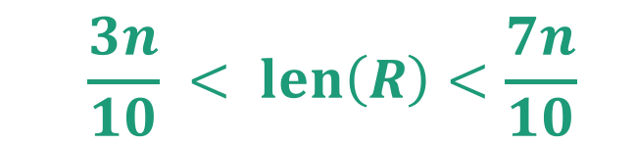
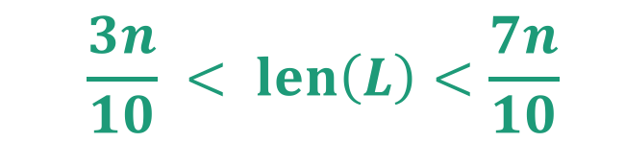
Goal
Efficiently pick the pivot so that
6
3
1
4
2
pivot
9
8
L = array with things smaller than A[pivot]
R = array with things larger than A[pivot]
  $$\frac{3n}{10} < len\left(L\right)<\frac{7n}{10}$$
  $$\frac{3n}{10} < len\left(R\right)<\frac{7n}{10}$$

Slide 40

Another divide-and-conquer alg!
We can’t solve SELECT(A,n/2) (yet)
But we can divide and conquer and solve SELECT(B,m/2) for smaller values of m (where len(B) = m).
Lemma*: The median of sub-medians is close to the median.
Ideal pivot
What we’ll use as the pivot
median of sub-medians
median of the whole thing
$$≈$$
sub-median
sub-median
sub-median
sub-median
sub-median
*we will make this a bit more precise.

Slide 41
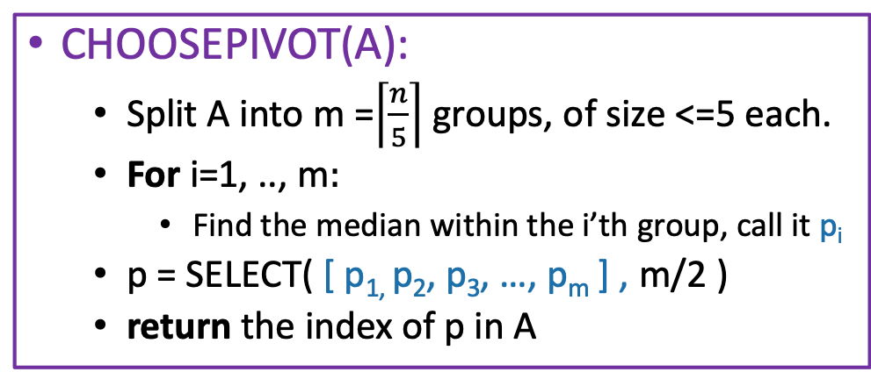
How to pick the pivot
CHOOSEPIVOT(A):
  Split A into m =$\left\lceil \frac{n}{5}\right\rceil$ groups, of size <=5 each.
  For i=1, .., m$:$
    Find the median within the i’th group, call it p_{i}
  p = SELECT( [ p_{1,} p₂, p₃, …, p_{m} ] , m/2 )
  return the index of p in A
Why 5 and not 3? See the concept check questions!
8
This takes time O(1) for each group, since each group has size 5. So that’s O(m)=O(n) total in the for loop.
4
12
2
1
5
20
1
8
9
3
15
5
9
1
3
4
5
15
13
2
4
6
12
1
15
22
3
6
8
4
5
6
12
Pivot is SELECT( , 3 ) = 6:
12
12
2
1
5
20
6
1
8
9
3
15
5
9
1
3
4
15
13
2
4
12
1
15
22
3
PARTITION around that 6:
6
1
3
5
1
3
4
2
1
2
4
1
3
5
8
9
15
9
12
20
15
13
12
15
22
This part is L
This part is R: it’s almost the same size as L.

Slide 42
CLAIM: this works divides the array approximately in half
Empirically (see Lecture 4 Python Notebook):

Slide 43

CLAIM: this works divides the array approximately in half
Formally, we will prove (later):
Lemma: If we choose the pivots like this, then
$$\left|L\right|≤\frac{7n}{10}+5$$
and
$$\left|R\right|≤\frac{7n}{10}+5$$

Slide 44
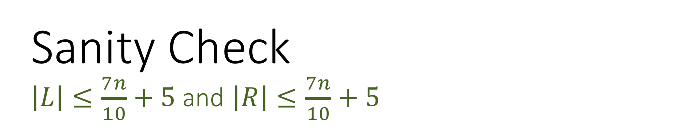
Sanity Check
$\left|L\right|≤\frac{7n}{10}+5$and $\left|R\right|≤\frac{7n}{10}+5$
In practice (on randomly chosen arrays) it looks even better!
But this is a worst-case bound.
That’s this window

Slide 45

How about the running time?
Suppose the Lemma is true. (It is).
  $\left|L\right|≤\frac{7n}{10}+5$and $\left|R\right|≤\frac{7n}{10}+5$
Recurrence relation:
$T\left(n\right)≤ ?$
Think: 1 minute
Share: (wait) 1 minute

Slide 46

Pseudocode
Lemma says that $\left|L\right|≤\frac{7n}{10}+5$and $\left|R\right|≤\frac{7n}{10}+5$
Suppose Partition runs in time O(n)
Come up with a recurrence relation for T(n), the running time of Select, using the choosePivot algorithm we just described.
Select(A,k):
  If len(A) <= 50:
    A = MergeSort(A)
    Return A[k-1]
  p = choosePivot(A)
  L, pivotVal, R = Partition(A,p)
  if len(L) == k-1:
    return pivotVal
  Else if len(L) > k-1:
    return Select(L, k)
  Else if len(L) < k-1:
    return Select(R, k – len(L) – 1)
Base Case: If len(A) = O(1), then any sorting algorithm runs in time O(1).
Case 1: We got lucky and found exactly the k’th smallest value!
Case 2: The k’th smallest value is in the first part of the list
Case 3: The k’th smallest value is in the second part of the list

Slide 47
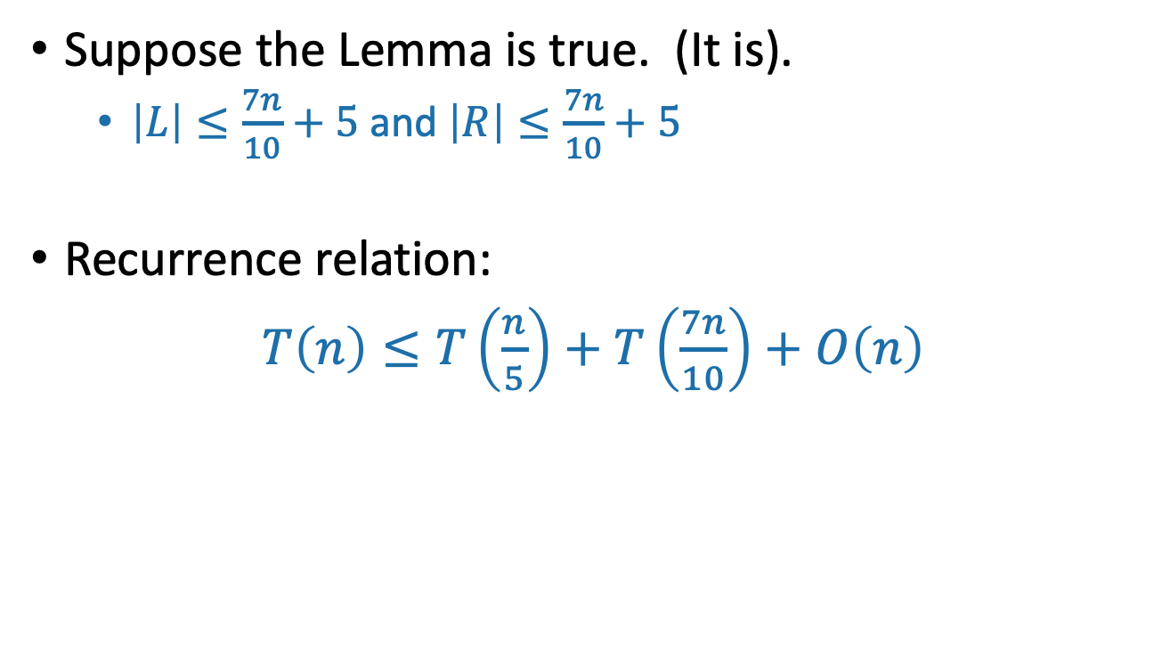
How about the running time?
Suppose the Lemma is true. (It is).
  $\left|L\right|≤\frac{7n}{10}+5$and $\left|R\right|≤\frac{7n}{10}+5$
Recurrence relation:
$T\left(n\right)≤T\left(\frac{n}{5}\right)+T\left(\frac{7n}{10}\right)+O\left(n\right)$
The call to CHOOSEPIVOT makes one further recursive call to SELECT on an array of size n/5.
Outside of CHOOSEPIVOT, there’s at most one recursive call to SELECT on array of size 7n/10 + 5.
We’re going to drop the “+5” for convenience,
but it does not change the final answer. Why?
Hint: Define T’(n) := T(n+1000) and write recurrence for T’
Siggi the Studious Stork

Slide 48
The Plan
More practice with the Substitution Method.
k-SELECT problem
k-SELECT solution
  The outline of the algorithm.
  How to pick the pivot.
Return of the Substitution Method.

Slide 49
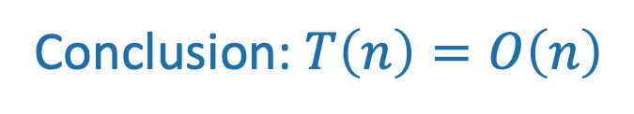
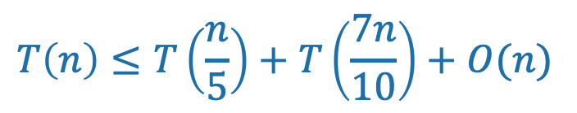
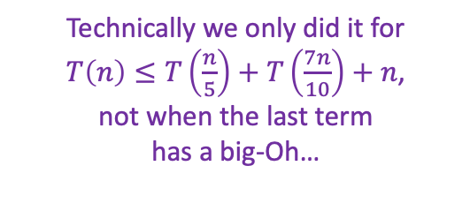
This sounds like a job for…
The Substitution Method!
Step 1: generate a guess
Step 2: try to prove that your guess is correct
Step 3: profit
$$T\left(n\right)≤T\left(\frac{n}{5}\right)+T\left(\frac{7n}{10}\right)+O(n)$$
That’s convenient! We did this at the beginning of lecture!
Technically we only did it for
$T\left(n\right)≤T\left(\frac{n}{5}\right)+T\left(\frac{7n}{10}\right)+n$,
not when the last term
has a big-Oh…
Conclusion: $T\left(n\right)=O\left(n\right)$
Plucky the Pedantic Penguin

Slide 50
Recap of approach
First, we figured out what the ideal pivot would be.
  Find the median
Then, we figured out what a pretty good pivot would be.
  An approximate median
Finally, we saw how to get our pretty good pivot!
  Median of medians and divide and conquer!
  Hooray!

Slide 51
In practice?
With not-very-slick implementation, our fancy version of SELECT is worse than the MergeSort-based SELECT ☹
  But O(n) is better than O(n log(n))! How can that be?
  What’s the constant in front of the n in our proof? 20? 30?
On non-adversarial inputs, random pivot choice is much better.
Moral:
Just pick a random pivot if you don’t expect nefarious arrays.
Optimize the implementation of SELECT (with the fancy pivot). Can you beat MergeSort?
Siggi the Studious Stork

Slide 52
What have we learned?
Pending the Lemma
It is possible to solve SELECT in time O(n).
  Divide and conquer!
If you want a deterministic algorithm or expect that a bad guy will be picking the list, choose a pivot cleverly.
  More divide and conquer!
If you don’t expect that a bad guy will be picking the list, in practice it’s better just to pick a random pivot.

Slide 53
The Plan
More practice with the Substitution Method.
k-SELECT problem
k-SELECT solution
  The outline of the algorithm.
  How to pick the pivot.
Return of the Substitution Method.
(If time) Proof of that Lemma.

Slide 54
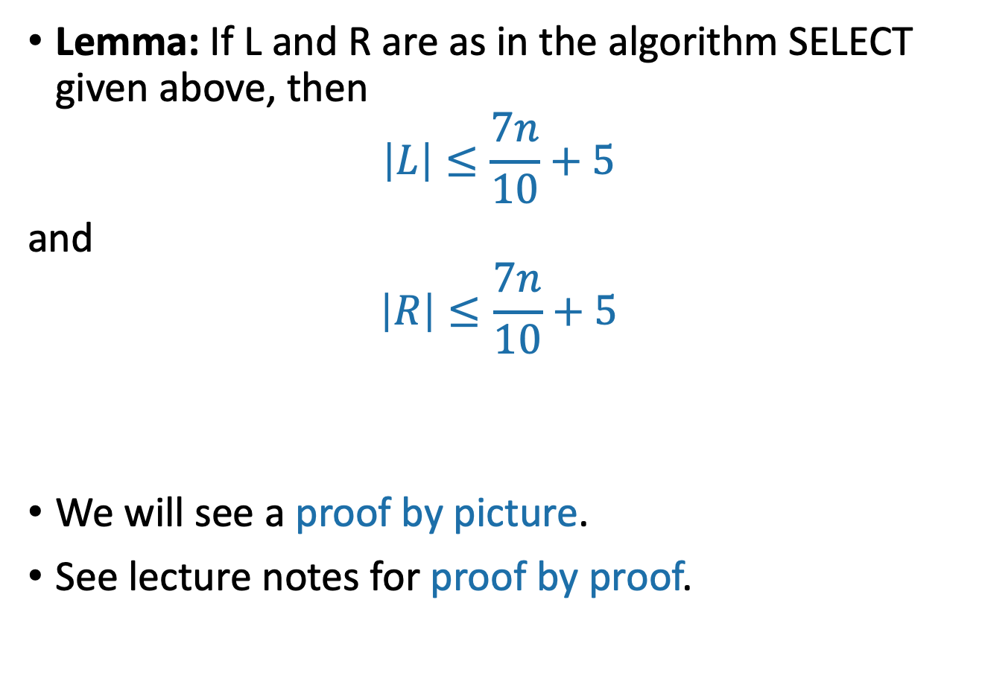
If time, back to the Lemma
Lemma: If L and R are as in the algorithm SELECT given above, then
$$\left|L\right|≤\frac{7n}{10}+5$$
and
$$\left|R\right|≤\frac{7n}{10}+5$$
We will see a proof by picture.
See lecture notes for proof by proof.

Slide 55
Proof by picture
1
5
2
3
6
8
18
10
13
7
5
9
4
7
70
17
3
6
12
4
22
15
35
11
2
m
Say these are our m = [n/5] sub-arrays of size at most 5.

Slide 56
Proof by picture
1
4
2
2
6
3
5
7
3
7
7
8
6
10
4
5
8
6
10
4
17
9
18
11
13
22
15
35
12
70
m
In our head, let’s sort them.
Then find medians.

Slide 57
Proof by picture
2
4
1
2
3
5
6
3
7
5
4
6
7
8
10
13
18
17
9
11
70
35
22
15
12
m
Then let’s sort them by the median

Slide 58
Proof by picture
2
4
1
2
3
5
6
3
7
5
4
6
7
8
10
13
18
17
9
11
70
35
22
15
12
m
The median of the medians is 7. That’s our pivot!

Slide 59
Proof by picture
We will show that lots of elements are smaller than the pivot, hence not too many are larger than the pivot.
2
4
1
2
3
5
6
3
7
5
4
6
7
8
10
13
18
17
9
11
70
35
22
15
12
m
How many elements are SMALLER than the pivot?

Slide 60
Proof by picture
2
4
1
2
3
5
6
3
7
5
4
6
7
8
10
13
18
17
9
11
70
35
22
15
12
m
At least these ones: everything above and to the left.

Slide 61
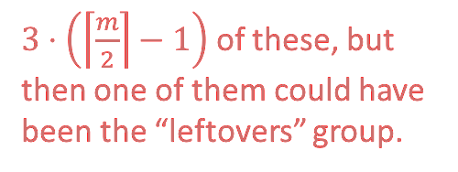

Proof by picture
$3⋅\left(\left\lceil \frac{m}{2}\right\rceil −1\right)$ of these, but then one of them could have been the “leftovers” group.
2
4
1
2
3
5
6
3
7
5
4
6
7
8
10
13
18
17
9
11
70
35
22
15
12
m
How many of those are there?
at least $3⋅\left(\left\lceil \frac{m}{2}\right\rceil −2\right)$

Slide 62


Proof by picture
2
4
1
2
3
5
6
3
7
5
4
6
7
8
10
13
18
17
9
11
70
35
22
15
12
m
So how many are LARGER than the pivot? At most…
$$n −1 −3\left(\left\lceil \frac{m}{2}\right\rceil −2\right)≤\frac{7n}{10}+5$$
Remember
$$m=\left\lceil \frac{n}{5}\right\rceil$$
(derivation on board)

Slide 63

That was one part of the lemma
Lemma: If L and R are as in the algorithm SELECT given above, then
$$\left|L\right|≤\frac{7n}{10}+5$$
and
$$\left|R\right|≤\frac{7n}{10}+5$$
The other part is exactly the same.

Slide 64
The Plan
More practice with the Substitution Method.
k-SELECT problem
k-SELECT solution
  The outline of the algorithm.
  How to pick the pivot.
Return of the Substitution Method.
(If time) Proof of that Lemma.
Recap

Slide 65
Recap
Substitution method can work when the master theorem doesn’t.
One place we needed it was for SELECT.
  Which we can do in time O(n)!

Slide 66
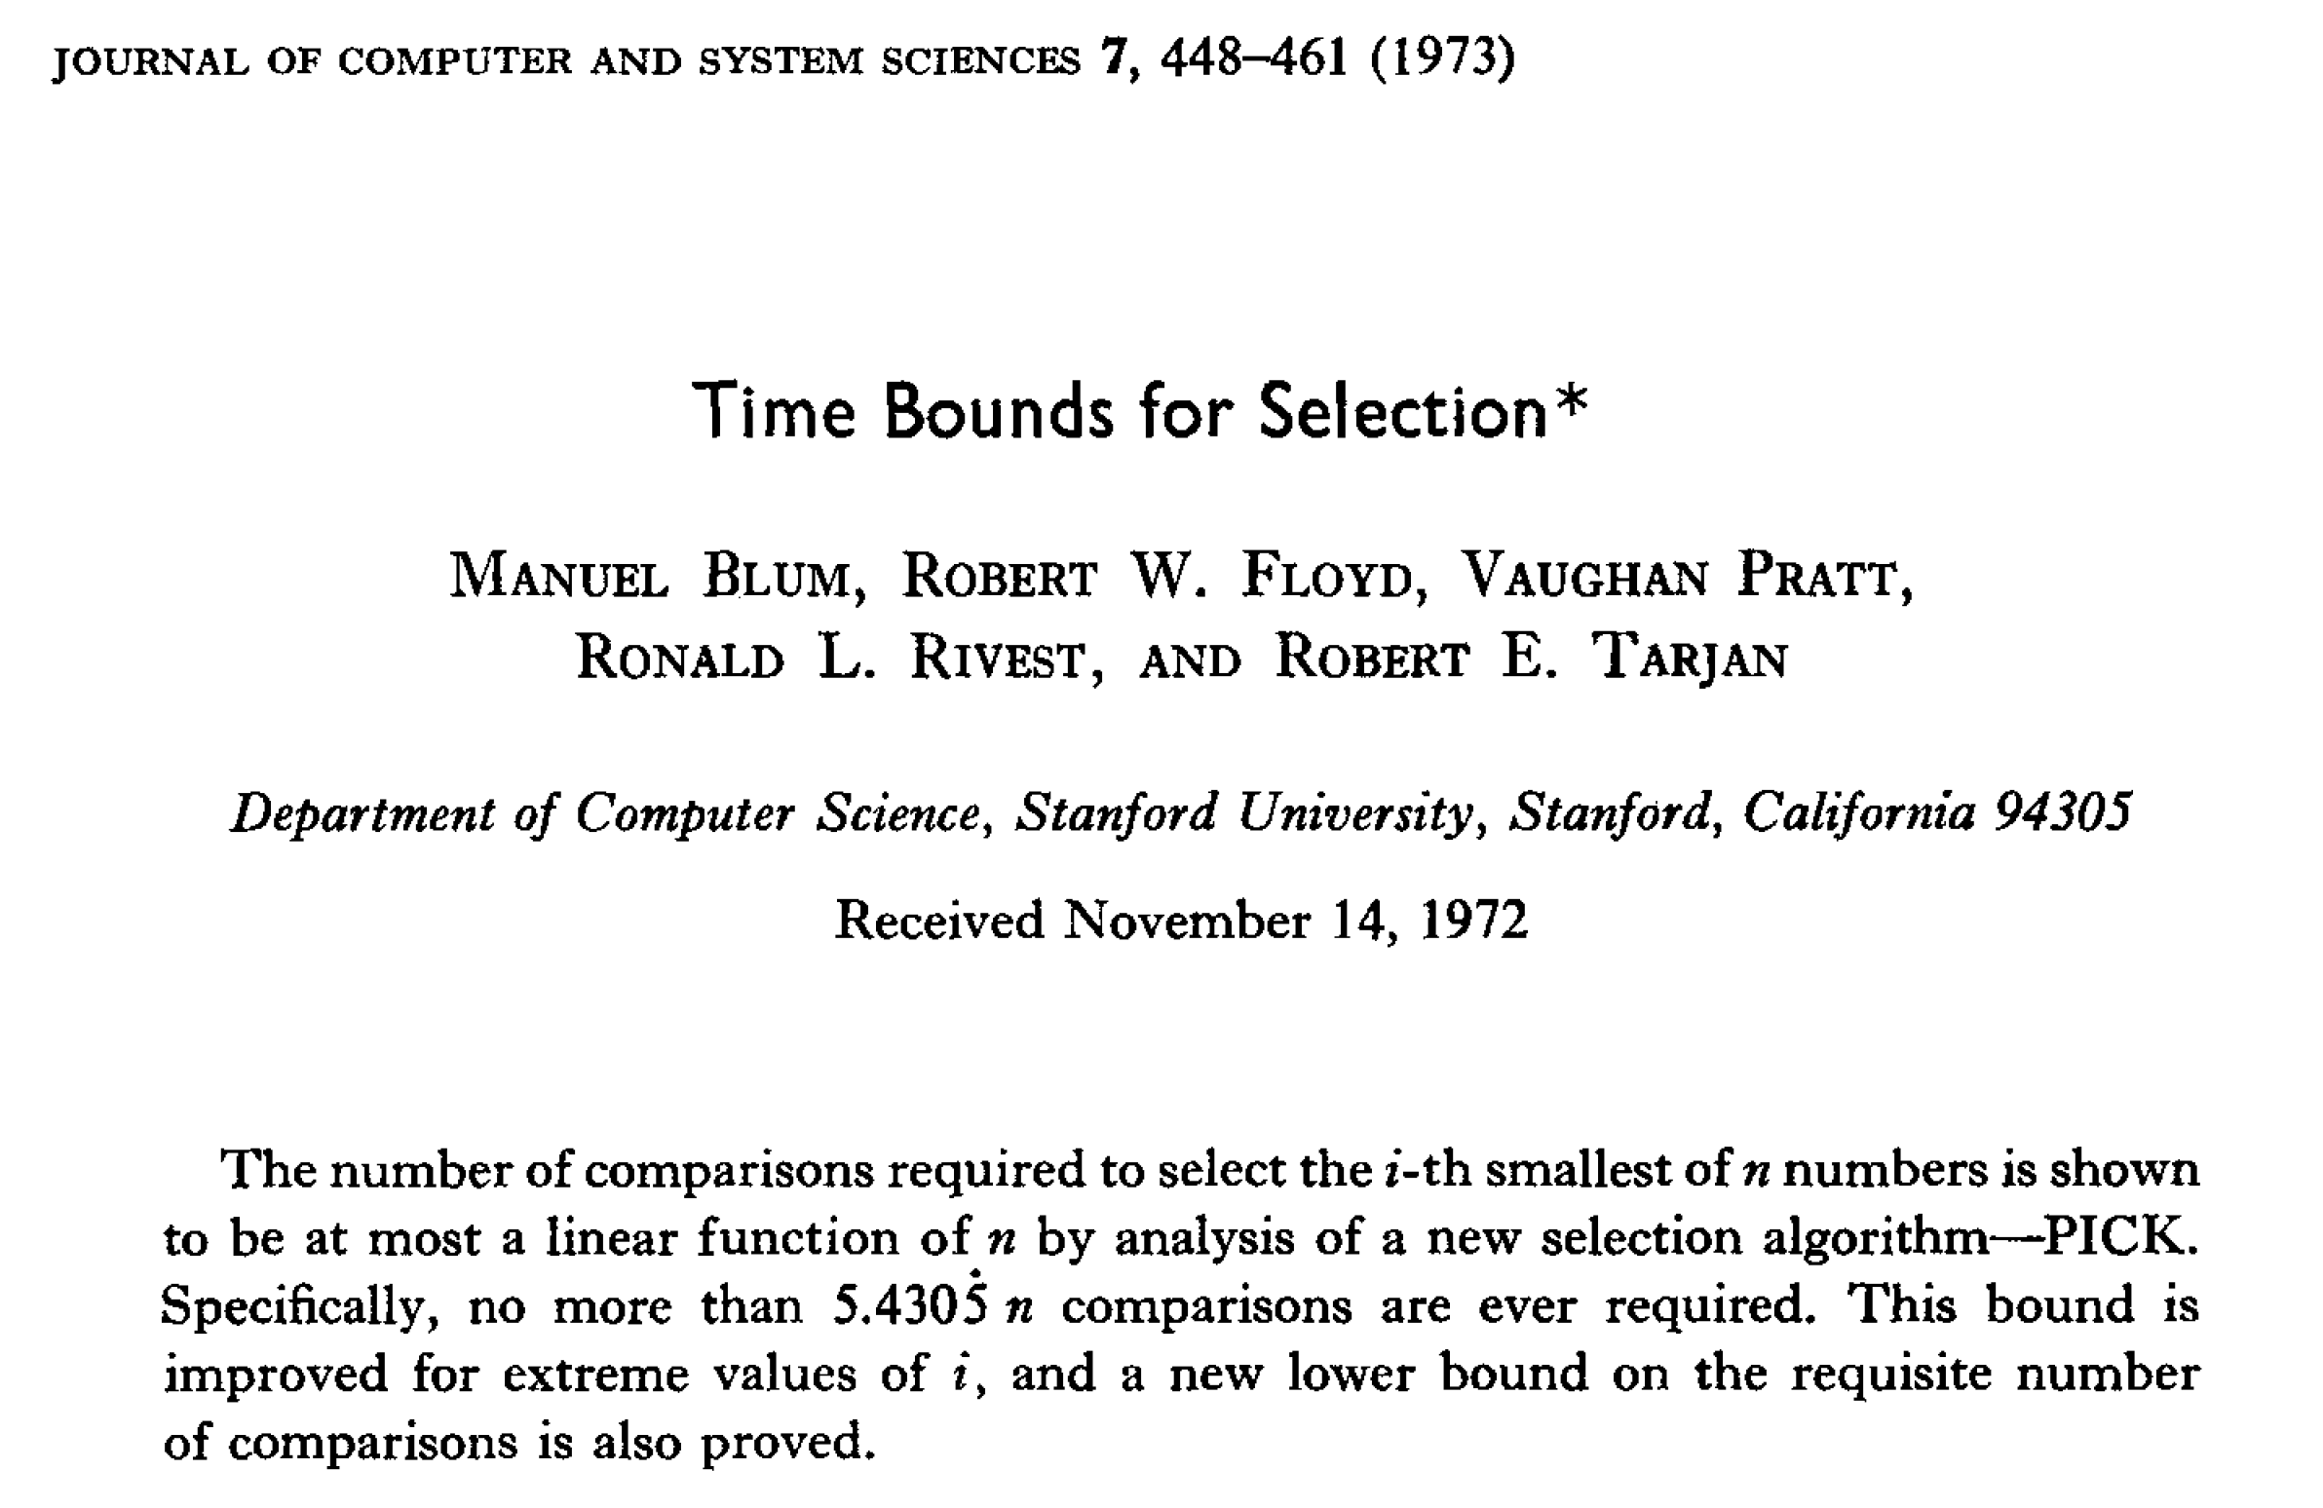

Slide 67
Next time
Randomized algorithms and QuickSort!
BEFORE next time
Pre-lecture 5 exercise
  Remember probability theory?
  The pre-lecture exercise will jog your memory.

