Slide 1
Lecture 6
Sorting lower bounds and O(n)-time sorting

Slide 2
Roadmap
More detailed schedule on the website!
5 lectures
Randomized Algs
2 lectures
Asymptotic Analysis
Data structures
Sorting
Divide and conquer
Recurrences
MIDTERM
Dynamic Programming
Greedy Algs
Graphs!
Longest, Shortest, Max and Min…
FINAL
9 lectures
The
Future!
1 lecture

Slide 3
Sorting
We’ve seen a few O(n log(n))-time algorithms.
  MERGESORT has worst-case running time O(n log(n))
  QUICKSORT has expected running time O(n log(n))
Can we do better?
Depends on who you ask…

Slide 4
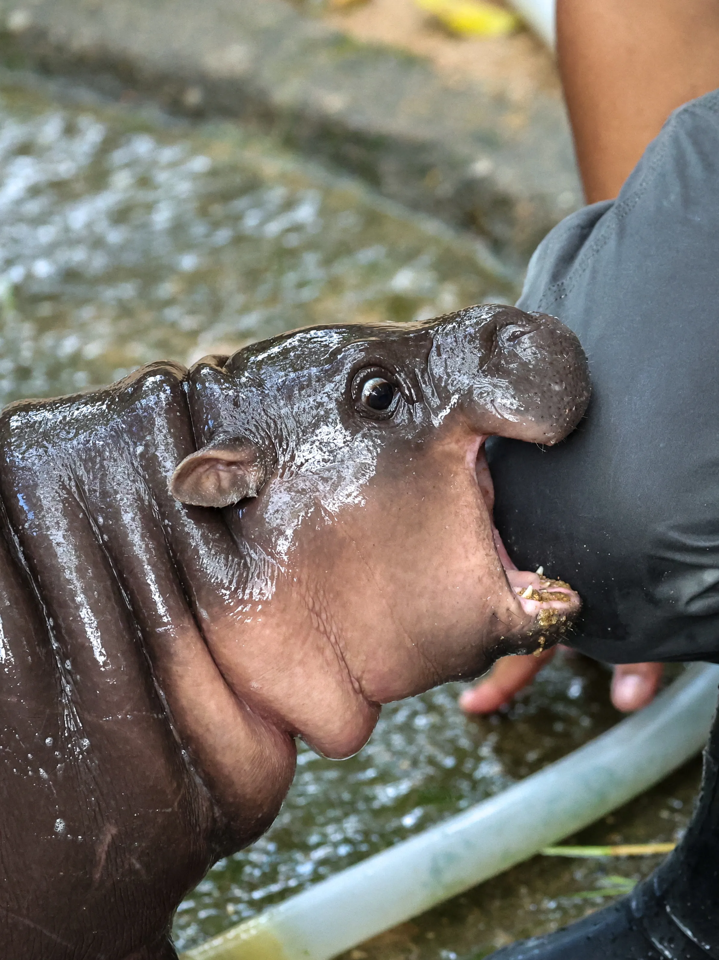
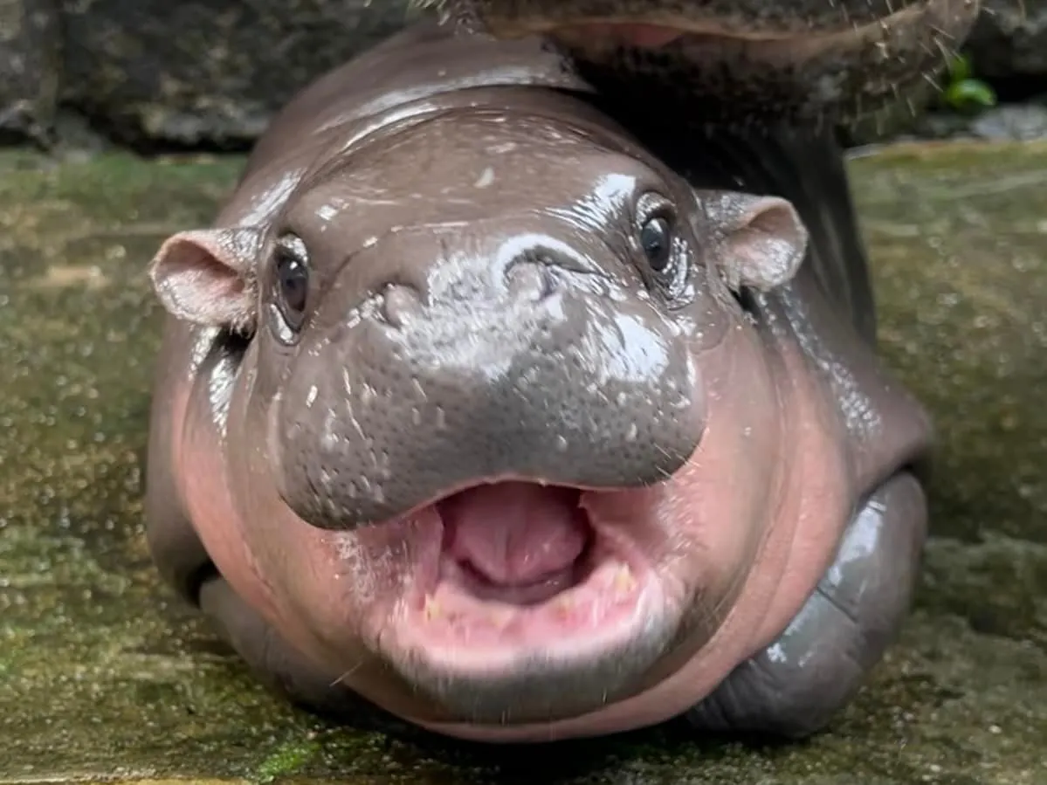
Moo Deng?
Khao Kheow Open Zoo/Facebook
Athit Perawongmetha/Reuters

Slide 5
An O(1)-time algorithm for sorting:
StickSort
Problem: sort these n sticks by length.
Now they are sorted this way.
Algorithm:
  Drop them on a table.

Slide 6
That may have been unsatisfying
But StickSort does raise some important questions:
  What is our model of computation?
    Input: array
    Output: sorted array
    Operations allowed: comparisons
    -vs-
    Input: sticks
    Output: sorted sticks in vertical order
    Operations allowed: dropping on tables
  What are reasonable models of computation?

Slide 7
Today: two models
Comparison-based sorting model
  This includes MergeSort, QuickSort, InsertionSort
  We’ll see that any algorithm in this model must take at least Ω(n log(n)) steps.
Another model (more reasonable than the stick model…)
  CountingSort and RadixSort
  Both run in time O(n)

Slide 8
Comparison-based sorting

Slide 9
Comparison-based sorting algorithms
You want to sort an array of items.
You can’t access the items’ values directly: you can only compare two items and find out which is bigger or smaller.

Slide 10
Comparison-based sorting algorithms
is shorthand for
“the first thing in the input list”
Want to sort these items.
There’s some ordering on them, but we don’t know what it is.
Is bigger than ?
YES
There is a genie who knows what the right order is.
The genie can answer YES/NO questions of the form:
is [this] bigger than [that]?
The algorithm’s job is to output a correctly sorted list of all the objects.
Algorithm

Slide 11
All the sorting algorithms we have seen work like this.
Pivot!
eg, QuickSort:
7
6
3
5
1
4
2
7
6
3
7
5
YES
Is bigger than ?
6
5
YES
Is bigger than ?
3
5
NO
Is bigger than ?
5
etc.

Slide 12
Lower bound of Ω(n log(n)).
Theorem:
  Any deterministic comparison-based sorting algorithm must take Ω(n log(n)) steps.
  Any randomized comparison-based sorting algorithm must take Ω(n log(n)) steps in expectation.
How might we prove this?
  Consider all comparison-based algorithms, one-by-one, and analyze them.
  Don’t do that.
This covers all the sorting algorithms we know!!!
Instead, argue that all comparison-based sorting algorithms give rise to a decision tree.
Then analyze decision trees.

Slide 13



Decision trees
Sort these three things.
$$≤$$
?
YES
NO
$$≤$$
?
etc…
YES
NO
$$≤$$
?
YES
NO

Slide 14
Decision trees
Internal nodes correspond to yes/no questions.
Each internal node has two children, one for “yes” and one for “no.”
Leaf nodes correspond to outputs.
  In this case, all possible orderings of the items.
Running an algorithm on a particular input corresponds to a particular path through the tree.
?
YES
NO
?
?
YES
NO
YES
NO
?
?
?
?

Slide 15



Comparison-based algorithms look like decision trees.
Pivot!
$$≤$$
?
NO
Example: Sort these three things using QuickSort.
YES
L
R
L
R
$$≤$$
?
etc...
YES
NO
Pivot!
L
R
L
R
Now recurse on R
Return
$$≤$$
?
Then we’re done (after some base-case stuff)
YES
NO
L
R
L
R
Return
Return
In either case, we’re done (after some base case stuff and returning recursive calls).

Slide 16
Q: What’s the runtime on a particular input?
A: At least the length of the path from the root to the corresponding leaf.
If we take this path through the tree, the runtime is
Ω(length of the path).
?
YES
NO
?
?
YES
NO
YES
NO
?
?
?
?

Slide 17
Q: What’s the worst-case runtime?
A: At least Ω(length of the longest path).
?
YES
NO
?
?
YES
NO
YES
NO
?
?
?
?

Slide 18
How long is the longest path?
being sloppy about floors and ceilings!
We want a statement: in all such trees, the longest path is at least _____
?
This is a binary tree with at least _____ leaves.
The shallowest tree with n! leaves is the completely balanced one, which has depth ______.
So in all such trees, the longest path is at least log(n!).
YES
NO
n!
?
?
YES
NO
YES
NO
?
?
?
?
log(n!)
n! is about (n/e)^{n} (Stirling’s approx.*).
log(n!) is about n log(n/e) = Ω(n log(n)).
Conclusion: the longest path has length at least Ω(n log(n)).
*Stirling’s approximation is a bit more complicated than this, but this is good enough for the asymptotic result we want.

Slide 19
Lower bound of Ω(n log(n)).
Theorem:
  Any deterministic comparison-based sorting algorithm must take Ω(n log(n)) steps.
Proof recap:
  Any deterministic comparison-based algorithm can be represented as a decision tree with n! leaves.
  The worst-case running time is at least the depth of the decision tree.
  All decision trees with n! leaves have depth Ω(n log(n)).
  So any comparison-based sorting algorithm must have worst-case running time at least Ω(n log(n)).

Slide 20
\end{Aside}
Aside:
What about randomized algorithms?
For example, QuickSort?
Theorem:
  Any randomized comparison-based sorting algorithm must take Ω(n log(n)) steps in expectation.
Proof:
  (same ideas as deterministic case)
  (you are not responsible for this proof in this class)
Try to prove this yourself!
Ollie the over-achieving ostrich

Slide 21
So that’s bad news
Theorem:
  Any deterministic comparison-based sorting algorithm must take Ω(n log(n)) steps.
Theorem:
  Any randomized comparison-based sorting algorithm must take Ω(n log(n)) steps in expectation.

Slide 22
On the bright side,
MergeSort is optimal!
This is one of the cool things about lower bounds like this: we know when we can declare victory!

Slide 23
But what about StickSort?
StickSort can’t be implemented as a comparison-based sorting algorithm. So these lower bounds don’t apply.
But StickSort was kind of silly.
Especially if I have to spend time cutting all those sticks to be the right size!
Can we do better?
Is there another model of computation that’s less silly than the StickSort model, in which we can sort faster than nlog(n)?

Slide 24
Beyond comparison-based sorting algorithms

Slide 25
Another model of computation
The items you are sorting have meaningful values.
9
6
3
5
2
1
2
instead of

Slide 26
Pre-lecture exercise
How long does it take to sort n people by their month of birth?
Share your answers
1 (Jan)
1 (Jan)
4 (Apr)
5 (May)

Slide 27
Another model of computation
The items you are sorting have meaningful values.
9
6
3
5
2
1
2
instead of

Slide 28
Why might this help?
Implement the buckets as linked lists. They are first-in, first-out. This will be useful later.
CountingSort:
9
6
3
5
2
1
2
2
1
2
3
5
6
9
1
2
3
4
5
6
7
8
9
Concatenate the buckets!
SORTED!
In time O(n).

Slide 29
Assumptions
Need to be able to know what bucket to put something in.
  We assume we can evaluate the items directly, not just by comparison
Need to know what values might show up ahead of time.
Need to assume there are not too many such values.
2
12345
13
2¹⁰⁰⁰
50
100000000
1

Slide 30
RadixSort
For sorting integers up to size M
  or more generally for lexicographically sorting strings
Can use less space than CountingSort
Idea: CountingSort on the least-significant digit first, then the next least-significant, and so on.

Slide 31
Step 1: CountingSort on least significant digit
21
345
13
101
50
234
1
1
101
234
345
50
13
21
0
1
2
3
4
5
6
7
8
9
50
21
101
1
13
234
345

Slide 32
Step 2: CountingSort on the 2nd least sig. digit
50
21
101
1
13
234
345
1
345
13
21
234
50
101
0
1
2
3
4
5
6
7
8
9
101
1
13
21
234
345
50

Slide 33
Step 3: CountingSort on the 3rd least sig. digit
101
1
13
21
234
345
50
50
21
13
234
345
1
101
0
1
2
3
4
5
6
7
8
9
1
13
21
50
101
234
345
It worked!!

Slide 34
Why does this work?
Original array:
21
345
13
101
50
234
1
Next array is sorted by the first digit.
50
21
101
1
13
234
345
50
21
101
1
13
234
345
Next array is sorted by the first two digits.
101
1
13
21
234
345
50
101
01
13
21
234
345
50
Next array is sorted by all three digits.
1
13
21
50
101
234
345
001
013
021
050
101
234
345
Sorted array

Slide 35
To prove this is correct…
What is the inductive hypothesis?
Original array:
21
345
13
101
50
234
1
Next array is sorted by the first digit.
50
21
101
1
13
234
345
50
21
101
1
13
234
345
Next array is sorted by the first two digits.
101
1
13
21
234
345
50
Think-Share Terrapins
101
01
13
21
234
345
50
Next array is sorted by all three digits.
1
13
21
50
101
234
345
001
013
021
050
101
234
345
Sorted array

Slide 36
RadixSort is correct
Inductive hypothesis:
  After the k’th iteration, the array is sorted by the first k least-significant digits.
Base case:
  “Sorted by 0 least-significant digits” means not yet sorted, so the IH holds for k=0.
Inductive step:
  TO DO
Conclusion:
  The inductive hypothesis holds for all k, so after the last iteration, the array is sorted by all the digits. Hence, it’s sorted!

Slide 37
Inductive step
Inductive hypothesis:
  After the k’th iteration, the array is sorted by the first k least-significant digits.
Need to show: if IH holds for k=i-1, then it holds for k=i.
  Suppose that after the i-1’st iteration, the array is sorted by the first i-1 least-significant digits.
  Need to show that after the i’th iteration, the array is sorted by the first i least-significant digits.
IH: this array is sorted by first digit.
050
021
101
002
013
234
345
002
EXAMPLE: i=2
234
345
101
013
021
050
0
1
2
3
4
5
6
7
8
9
101
002
013
021
234
345
050
Want to show: this array is sorted by 1st and 2nd digits.

Slide 38
Proof sketch… proof on next (skipped) slide
Want to show: after the i’th iteration, the array is sorted by the first i least-significant digits.
Let x=[x_{d}x_{d-1}…x₂x₁] and y=[y_{d}y_{d-1}…y₂y₁] be any x,y.
Suppose [x_{i}x_{i-1}…x₂x₁] < [y_{i}y_{i-1}…y₂y₁].
Want to show that x appears before y at end of i’th iteration.
CASE 1: x_{i}<y_{i}
  x is in an earlier bucket than y.
Aka, we want to show that for any x and y so that x belongs before y, we put x before y.
IH: this array is sorted by first digit.
x
y
050
021
101
002
013
234
345
002
x
y
EXAMPLE: i=2
234
345
101
013
021
050
0
1
2
3
4
5
6
7
8
9
x
y
101
002
013
021
234
345
050
Want to show: this array is sorted by 1st and 2nd digits.

Slide 39
Proof sketch… proof on next (skipped) slide
Want to show: after the i’th iteration, the array is sorted by the first i least-significant digits.
Let x=[x_{d}x_{d-1}…x₂x₁] and y=[y_{d}y_{d-1}…y₂y₁] be any x,y.
Suppose [x_{i}x_{i-1}…x₂x₁] < [y_{i}y_{i-1}…y₂y₁].
Want to show that x appears before y at end of i’th iteration.
CASE 1: x_{i}<y_{i}
  x is in an earlier bucket than y.
CASE 2: x_{i}=y_{i}
  [x_{i-1}…x₂x₁] < [y_{i-1}…y₂y₁],
  x and y in same bucket, but x was put in the bucket first.
Aka, we want to show that for any x and y so that x belongs before y, we put x before y.
IH: this array is sorted by first digit.
y
050
021
x
101
002
013
234
345
y
002
EXAMPLE: i=2
234
345
101
x
013
021
050
0
1
2
3
4
5
6
7
8
9
x
y
101
002
013
021
234
345
050
Want to show: this array is sorted by 1st and 2nd digits.

Slide 40
Want to show: after the i’th iteration, the array is sorted by the first i least-significant digits.
SLIDE SKIPPED IN CLASS. Here for reference.
Let x=[x_{d}x_{d-1}…x₂x₁] and y=[y_{d}y_{d-1}…y₂y₁] be any x,y.
Suppose [x_{i}x_{i-1}…x₂x₁] < [y_{i}y_{i-1}…y₂y₁].
Want to show that x appears before y at end of i’th iteration.
CASE 1: x_{i}<y_{i}.
  x appears in an earlier bucket than y, so x appears before y after the i’th iteration.
CASE 2: x_{i}=y_{i}.
  x and y end up in the same bucket.
  In this case, [x_{i-1}…x₂x₁] < [y_{i-1}…y₂y₁], so by the inductive hypothesis, x appeared before y after i-1’st iteration.
  Then x was placed into the bucket before y was, so it also comes out of the bucket before y does.
    Recall that the buckets are FIFO queues.
  So x appears before y in the i’th iteration.

Slide 41
Inductive step
Inductive hypothesis:
  After the k’th iteration, the array is sorted by the first k least-significant digits.
Need to show: if IH holds for k=i-1, then it holds for k=i.
  Suppose that after the i-1’st iteration, the array is sorted by the first i-1 least-significant digits.
  Need to show that after the i’th iteration, the array is sorted by the first i least-significant digits.
IH: this array is sorted by first digit.
050
021
101
002
013
234
345
002
EXAMPLE: i=2
234
345
101
013
021
050
0
1
2
3
4
5
6
7
8
9
101
002
013
021
234
345
050
Want to show: this array is sorted by 1st and 2nd digits.

Slide 42
RadixSort is correct
Inductive hypothesis:
  After the k’th iteration, the array is sorted by the first k least-significant digits.
Base case:
  “Sorted by 0 least-significant digits” means not sorted, so the IH holds for k=0.
Inductive step:
  TO DO
Conclusion:
  The inductive hypothesis holds for all k, so after the last iteration, the array is sorted by all the digits. Hence, it’s sorted!

Slide 43
What is the running time?
for RadixSorting numbers base-10.
Suppose we are sorting n d-digit numbers (in base 10).
How many iterations are there?
How long does each iteration take?
What is the total running time?
e.g., n=7, d=3:
021
345
013
101
050
234
001
Think-Share Terrapins

Slide 44
What is the running time?
for RadixSorting numbers base-10.
Suppose we are sorting n d-digit numbers (in base 10).
How many iterations are there?
  d iterations
How long does each iteration take?
  Time to initialize 10 buckets, plus time to put n numbers in 10 buckets. O(n).
What is the total running time?
  O(nd)
e.g., n=7, d=3:
021
345
013
101
050
234
001
Think-Share Terrapins

Slide 45
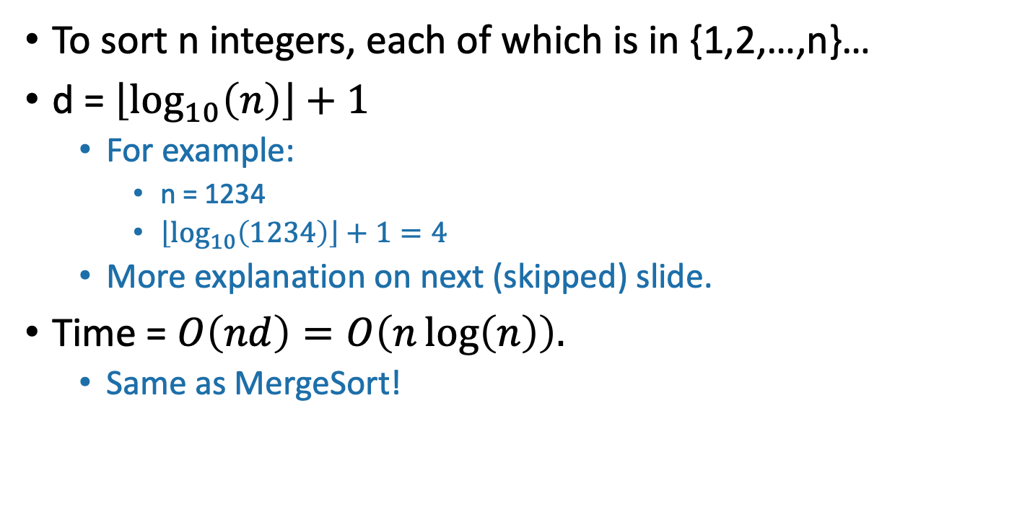
This doesn’t seem so great
To sort n integers, each of which is in {1,2,…,n}…
d = $\left\lfloor \log_{10}\left(n\right)\right\rfloor +1$
  For example:
    n = 1234
    $\left\lfloor \log_{10}\left(1234\right)\right\rfloor +1=4$
  More explanation on next (skipped) slide.
Time = $O\left(nd\right)=O\left(n\log\left(n\right)\right).$
  Same as MergeSort!

Slide 46
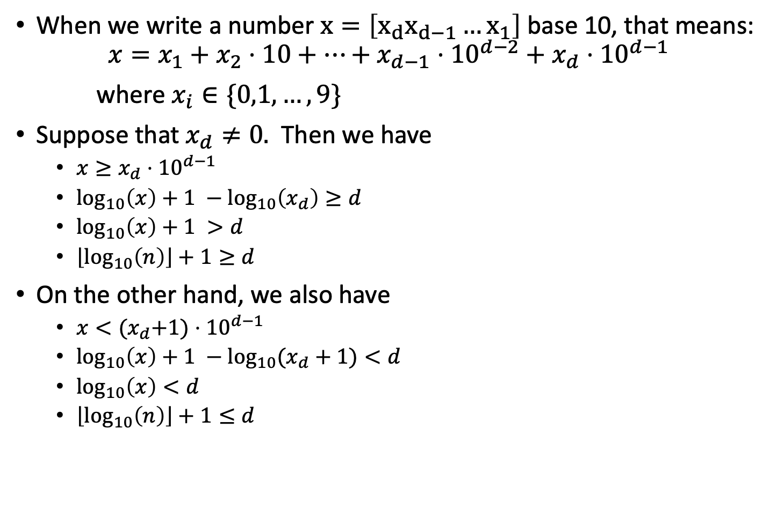
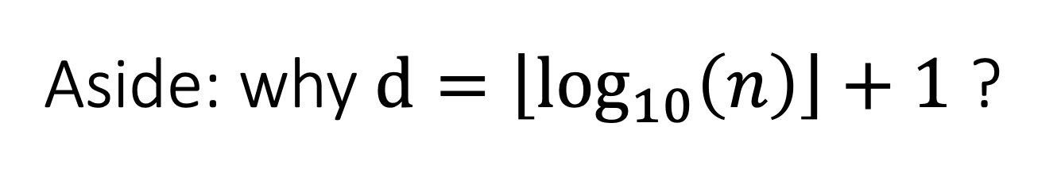


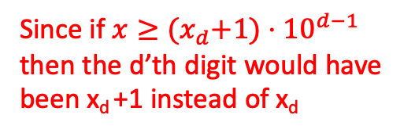
Aside: why $d=\left\lfloor \log_{10}\left(n\right)\right\rfloor +1$ ?
Slide skipped in class
When we write a number $x=\left[x_{d}x_{d−1}…x_{1}\right]$ base 10, that means:
$$x=x_{1}+x_{2}⋅10+⋯+x_{d−1}⋅{10}^{d−2}+x_{d}⋅{10}^{d−1}$$
where $x_{i}∈\{0,1,…,9\}$
Suppose that $x_{d}≠0.$ Then we have
  $x≥x_{d}⋅{10}^{d−1}$
  $\log_{10}\left(x\right)+1 −\log_{10}\left(x_{d}\right)≥d$
  $\log_{10}\left(x\right)+1 >d$
  $\left\lfloor \log_{10}\left(n\right)\right\rfloor +1≥d$
On the other hand, we also have
  $x<{(x}_{d}+1)⋅{10}^{d−1}$
  $\log_{10}\left(x\right)+1 −\log_{10}{(x_{d}+1)}<d$
  $\log_{10}\left(x\right)<d$
  $\left\lfloor \log_{10}\left(n\right)\right\rfloor +1≤d$
Since x is bigger than just the last term in that sum!
(take logs of both sides and rearrange)
$\log_{10}\left(x_{d}\right)> 0$since $x_{d}>0$
Since d is an integer
Since if $x≥{(x}_{d}+1)⋅{10}^{d−1}$ then the d’th digit would have been x_{d} +1 instead of x_{d}
(take logs of both sides and rearrange)
$\log_{10}\left(x_{d}+1\right)≤1$since $x_{d}<10$
Since d is an integer

Slide 47
Can we do better?
RadixSort base 10 doesn’t seem to be such a good idea…
But what if we change the base? (Let’s say base r)
We will see there’s a trade-off:
  Bigger r means more buckets
  Bigger r means fewer digits

Slide 48
Example: base 100
Original array:
21
345
13
101
50
234
1

Slide 49
Example: base 100
Original array:
0021
0345
0013
0101
0050
0234
0001
100 buckets:
…
…
…
0001
0101
0234
0050
00
01
02
34
50
98
99
0101
0001
0013
0021
0234
0345
0050

Slide 50
Example: base 100
0101
0001
0013
0021
0234
0345
0050
100 buckets:
0050
0021
…
…
0013
0001
0101
0234
0345
00
01
02
03
50
98
99
0001
0013
0021
0050
0101
0234
0345
Sorted!

Slide 51
Example: base 100
Original array
0021
0345
0013
0101
0050
0234
0001
0101
0001
0013
0021
0234
0345
0050
0001
0013
0021
0050
0101
0234
0345
Sorted array
Base 100:
d=2, so only 2 iterations.
100 buckets
Base 10:
d=3, so 3 iterations.
10 buckets
vs.
Bigger base means more buckets but fewer iterations.

Slide 52
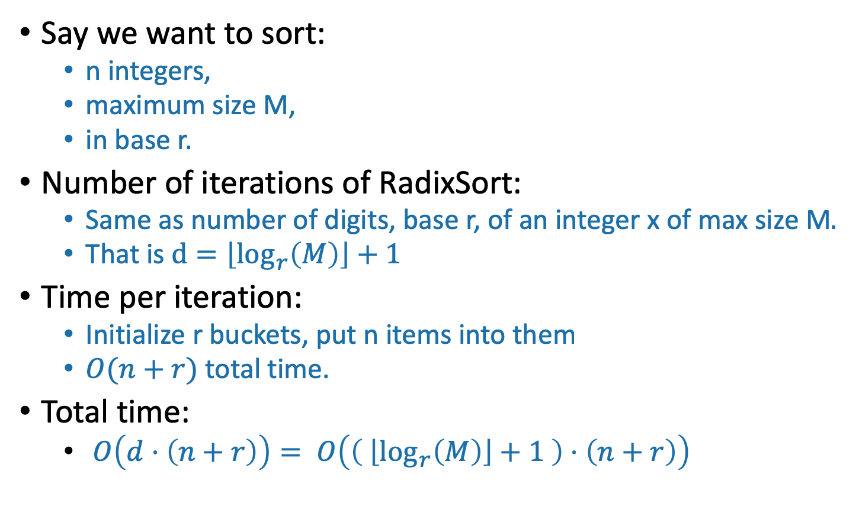
General running time of RadixSort
Say we want to sort:
  n integers,
  maximum size M,
  in base r.
Number of iterations of RadixSort:
  Same as number of digits, base r, of an integer x of max size M$.$
  That is $d=\left\lfloor \log_{r}\left(M\right)\right\rfloor +1$
Time per iteration:
  Initialize r buckets, put n items into them
  $O(n+r)$ total time.
Total time:
  $O\left(d⋅\left(n+r\right)\right)= O\left(\left( \left\lfloor \log_{r}\left(M\right)\right\rfloor +1 \right)⋅\left(n+r\right)\right)$
Convince yourself that this is the right formula for d.

Slide 53

Trade-offs
Running time: $O\left(\left( \left\lfloor \log_{r}\left(M\right)\right\rfloor +1 \right)⋅\left(n+r\right)\right)$
Given n, M, how should we choose r?
Looks like there’s some sweet spot:
IPython Notebook for Lecture 6

Slide 54
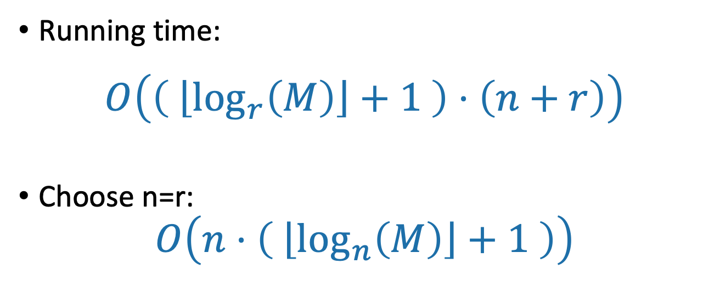
A reasonable choice: r=n
Running time:
$$O\left(\left( \left\lfloor \log_{r}\left(M\right)\right\rfloor +1 \right)⋅\left(n+r\right)\right)$$
Choose n=r:
$$O\left(n⋅\left( \left\lfloor \log_{n}\left(M\right)\right\rfloor +1 \right)\right)$$
Intuition: balance n and r here.
Choosing r = n is pretty good. What choice of r optimizes the asymptotic running time? What if I also care about space?
Ollie the over-achieving ostrich

Slide 55
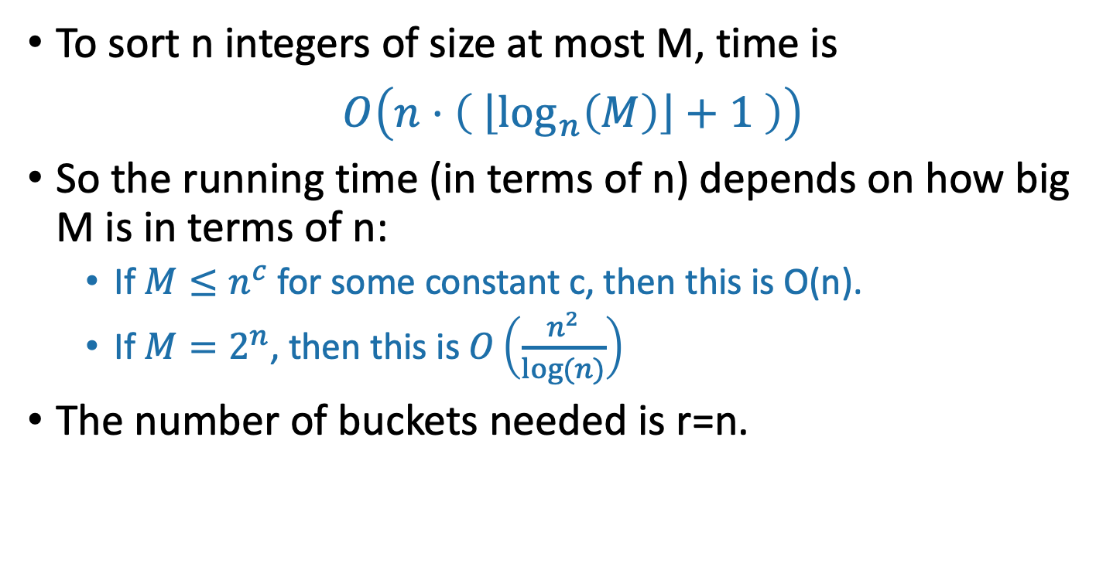
Running time of RadixSort with r=n
To sort n integers of size at most M, time is
$O\left(n⋅\left( \left\lfloor \log_{n}\left(M\right)\right\rfloor +1 \right)\right)$
So the running time (in terms of n) depends on how big M is in terms of n:
  If $M≤n^{c}$ for some constant c, then this is O(n).
  If $M=2^{n}$, then this is $O\left(\frac{n^{2}}{log⁡(n)}\right)$
The number of buckets needed is r=n.

Slide 56
What have we learned?
You can put any constant here instead of 100.
RadixSort can sort n integers of size at most n¹⁰⁰ in time O(n), and needs enough space to store O(n) integers.
If your integers have size much much bigger than n (like 2^{n}), maybe you shouldn’t use RadixSort.
It matters how we pick the base.

Slide 57
Recap
How difficult sorting is depends on the model of computation.
How reasonable a model of computation is is up for debate.
Comparison-based sorting model
  This includes MergeSort, QuickSort, InsertionSort
  Any algorithm in this model must use at least Ω(n log(n)) operations. ☹
  But it can handle arbitrary comparable objects. ☺
If we are sorting small integers (or other reasonable data):
  CountingSort and RadixSort
  Both run in time O(n) ☺
  Might take more space and/or be slower if integers get too big ☹

Slide 58
Next time
Binary search trees!
Balanced binary search trees!
Pre-lecture exercise for Lecture 7
  Remember binary search trees?
Before next time

