Slide 1
Lecture 9
Graphs, BFS and DFS

Slide 2
Announcements!
Homework 4 due today.
No new homework this week: use the time to study for the midterm!

Slide 3
Roadmap
More detailed schedule on the website!
5 lectures
2 lectures
Randomized Algs
EthiCS 1
On MIDTERM
Asymptotic Analysis
Data structures
Sorting
Today
Divide and conquer
Recurrences
We are here
Dynamic Programming
Greedy Algs
EthiCS 2
Graphs!
Longest, Shortest, Max and Min…
On FINAL
8 lectures
The
Future!
2 lectures

Slide 4
Outline
Part 0: Graphs and terminology
Part 1: Depth-first search
  Application: topological sorting
  Application: in-order traversal of BSTs
Part 2: Breadth-first search
  Application: shortest paths
  Application (if time): is a graph bipartite?

Slide 5
Part 0: Graphs

Slide 6
Graphs
Graph of the internet (circa 1999…it’s a lot bigger now…)

Slide 7
Graphs
Citation graph of literary theory academic papers

Slide 8
Graphs
Theoretical Computer Science academic communities

Slide 9
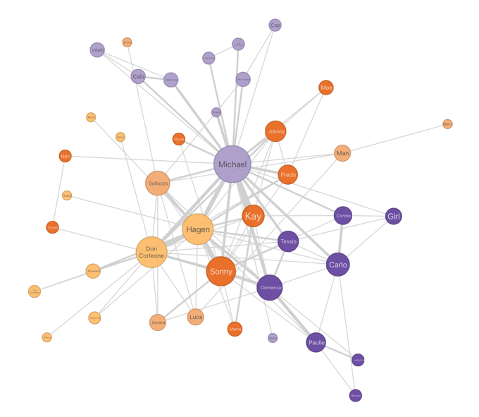
Graphs
The Godfather Characters Interaction Network

Slide 10
Graphs
jetblue flights

Slide 11
Graphs
Complexity Zoo
containment graph

Slide 12
Graphs
debian dependency (sub)graph

Slide 13
Graphs
Immigration flows

Slide 14
Graphs
Potato trade

Slide 15
Graphs
Soybeans
Water

Slide 16
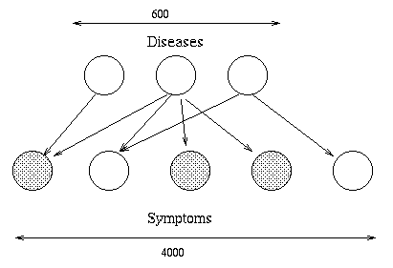
Graphs
Graphical models

Slide 17
Graphs
What eats what in the Atlantic ocean?

Slide 18
Graphs
Neural connections in the brain

Slide 19
Graphs
There are a lot of graphs.
We want to answer questions about them.
  Efficient routing?
  Community detection/clustering?
  From pre-lecture exercise:
    Computing Bacon numbers
    Signing up for classes without violating pre-req constraints
    How to distribute fish in tanks so that none of them will fight.
This is what we’ll do for the next several lectures.

Slide 20
Undirected Graphs
2
1
Has vertices and edges
  V is the set of vertices
  E is the set of edges
  Formally, a graph is G = (V,E)
Example
  V = {1,2,3,4}
  E = { {1,3}, {2,4}, {3,4}, {2,3} }
3
  G = (V,E)
4
The degree of vertex 4 is 2.
  There are 2 edges coming out.
Vertex 4’s neighbors are 2 and 3

Slide 21
Directed Graphs
2
1
Has vertices and edges
  V is the set of vertices
  E is the set of DIRECTED edges
  Formally, a graph is G = (V,E)
Example
  V = {1,2,3,4}
  E = { (1,3), (2,4), (3,4), (4,3), (3,2) }
3
  G = (V,E)
4
The in-degree of vertex 4 is 2.
The out-degree of vertex 4 is 1.
Vertex 4’s incoming neighbors are 2,3
Vertex 4’s outgoing neighbor is 3.

Slide 22

How do we represent graphs?
Option 1: adjacency matrix
2
1 2 3 4
1
$$\left[\begin{matrix}\begin{matrix}0 & 0 \\ 0 & 0\end{matrix} & \begin{matrix}1 & 0 \\ 1 & 1\end{matrix} \\ \begin{matrix}1 & 1 \\ 0 & 1\end{matrix} & \begin{matrix}0 & 1 \\ 1 & 0\end{matrix}\end{matrix}\right]$$
3
4
1 2 3 4

Slide 23

How do we represent graphs?
Option 1: adjacency matrix
2
1 2 3 4
1
$$\left[\begin{matrix}\begin{matrix}1 & 0 \\ 0 & 0\end{matrix} & \begin{matrix}1 & 0 \\ 1 & 1\end{matrix} \\ \begin{matrix}1 & 1 \\ 0 & 1\end{matrix} & \begin{matrix}0 & 1 \\ 1 & 0\end{matrix}\end{matrix}\right]$$
3
4
1 2 3 4

Slide 24

How do we represent graphs?
2
Option 1: adjacency matrix
Destination
1 2 3 4
1
$$\left[\begin{matrix}\begin{matrix}0 & 0 \\ 0 & 0\end{matrix} & \begin{matrix}1 & 0 \\ 0 & 1\end{matrix} \\ \begin{matrix}0 & 1 \\ 0 & 0\end{matrix} & \begin{matrix}0 & 1 \\ 1 & 0\end{matrix}\end{matrix}\right]$$
3
4
1 2 3 4
Source

Slide 25
How do we represent graphs?
Option 2: adjacency lists.
2
1
2
3
4
1
3
3
4
1
2
4
4
3
3
How would you modify this for directed graphs?
2
4’s neighbors are 2 and 3

Slide 26
In either case
Vertices can store other information
  Attributes (name, IP address, …)
  Helper info for algorithms that we will perform on the graph
Want to be able to do the following operations:
  Edge Membership: Is edge e in E?
  Neighbor Query: What are the neighbors of vertex v?

Slide 27
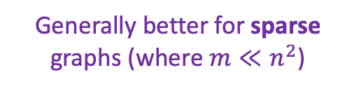
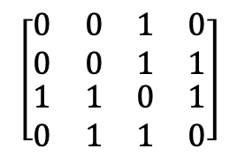
Trade-offs
Generally better for sparse graphs (where $m≪n^{2}$)
1
2
3
4
Say there are n vertices and m edges.
$$\left[\begin{matrix}\begin{matrix}0 & 0 \\ 0 & 0\end{matrix} & \begin{matrix}1 & 0 \\ 1 & 1\end{matrix} \\ \begin{matrix}1 & 1 \\ 0 & 1\end{matrix} & \begin{matrix}0 & 1 \\ 1 & 0\end{matrix}\end{matrix}\right]$$
3
4
1
2
3
4
3
2
Edge membership
Is e = {v,w} in E?
O(1)
O(deg(v)) or O(deg(w))
Neighbor query
Give me a list of v’s neighbors.
O(n)
O(deg(v))
Space requirements
O(n²)
O(n + m)
See Lecture 9 Python notebook for an actual implementation!
We’ll assume this representation for the rest of the class

Slide 28
Part 1: Depth-first search

Slide 29
How do we explore a graph?
At each node, you can get a list of neighbors, and choose to go there if you want.
6
5
7
2
8
1
3
4
Notes:
This is how Theseus did it.

Slide 30
Depth First Search
Exploring a labyrinth with chalk and a piece of string
Not been there yet
Been there, haven’t explored all the paths out.
Been there, have explored all the paths out.
start

Slide 31
Depth First Search
Exploring a labyrinth with chalk and a piece of string
Not been there yet
Been there, haven’t explored all the paths out.
Been there, have explored all the paths out.
start

Slide 32
Depth First Search
Exploring a labyrinth with chalk and a piece of string
Not been there yet
Been there, haven’t explored all the paths out.
Been there, have explored all the paths out.
start

Slide 33
Depth First Search
Exploring a labyrinth with chalk and a piece of string
Not been there yet
Been there, haven’t explored all the paths out.
Been there, have explored all the paths out.
start

Slide 34
Depth First Search
Exploring a labyrinth with chalk and a piece of string
Not been there yet
Been there, haven’t explored all the paths out.
Been there, have explored all the paths out.
start

Slide 35
Depth First Search
Exploring a labyrinth with chalk and a piece of string
Not been there yet
Been there, haven’t explored all the paths out.
Been there, have explored all the paths out.
start

Slide 36
Depth First Search
Exploring a labyrinth with chalk and a piece of string
Not been there yet
Been there, haven’t explored all the paths out.
Been there, have explored all the paths out.
start

Slide 37
Depth First Search
Exploring a labyrinth with chalk and a piece of string
Not been there yet
Been there, haven’t explored all the paths out.
Been there, have explored all the paths out.
start

Slide 38
Depth First Search
Exploring a labyrinth with chalk and a piece of string
Not been there yet
Been there, haven’t explored all the paths out.
Been there, have explored all the paths out.
start

Slide 39
Depth First Search
Exploring a labyrinth with chalk and a piece of string
Not been there yet
Been there, haven’t explored all the paths out.
Been there, have explored all the paths out.
start

Slide 40
Depth First Search
Exploring a labyrinth with chalk and a piece of string
Not been there yet
Been there, haven’t explored all the paths out.
Been there, have explored all the paths out.
start

Slide 41
Depth First Search
Exploring a labyrinth with chalk and a piece of string
Not been there yet
Been there, haven’t explored all the paths out.
Been there, have explored all the paths out.
start

Slide 42
Depth First Search
Exploring a labyrinth with chalk and a piece of string
Not been there yet
Been there, haven’t explored all the paths out.
Been there, have explored all the paths out.
start

Slide 43
Depth First Search
Exploring a labyrinth with chalk and a piece of string
Not been there yet
Been there, haven’t explored all the paths out.
Been there, have explored all the paths out.
start

Slide 44
Depth First Search
Exploring a labyrinth with chalk and a piece of string
Not been there yet
Been there, haven’t explored all the paths out.
Been there, have explored all the paths out.
start

Slide 45
Depth First Search
Exploring a labyrinth with chalk and a piece of string
Not been there yet
Been there, haven’t explored all the paths out.
Been there, have explored all the paths out.
start
Labyrinth:
explored!

Slide 46
Depth First Search
Exploring a labyrinth with pseudocode
Each vertex keeps track of whether it is:
  Unvisited
  In progress
  All done
Each vertex will also keep track of:
  The time we first enter it.
  The time we finish with it and mark it all done.
You might have seen other ways to implement DFS than what we are about to go through. This way has more bookkeeping – the bookkeeping will be useful later!

Slide 47
Depth First Search
currentTime = 0
DFS(w, currentTime):
  w.startTime = currentTime
  currentTime += 1
  Mark w as in progress.
  for v in w.neighbors:
    if v is unvisited:
      currentTime
      = DFS(v, currentTime)
      currentTime += 1
  w.finishTime = currentTime
  Mark w as all done
  return currentTime
D
w
A
C
unvisited
in progress
all done

Slide 48
Depth First Search
currentTime = 1
DFS(w, currentTime):
  w.startTime = currentTime
  currentTime += 1
  Mark w as in progress.
  for v in w.neighbors:
    if v is unvisited:
      currentTime
      = DFS(v, currentTime)
      currentTime += 1
  w.finishTime = currentTime
  Mark w as all done
  return currentTime
D
w
A
Start:0
C
unvisited
in progress
all done

Slide 49
Depth First Search
currentTime = 1
DFS(w, currentTime):
  w.startTime = currentTime
  currentTime += 1
  Mark w as in progress.
  for v in w.neighbors:
    if v is unvisited:
      currentTime
      = DFS(v, currentTime)
      currentTime += 1
  w.finishTime = currentTime
  Mark w as all done
  return currentTime
D
A
Start:0
C
w
unvisited
in progress
all done

Slide 50
Depth First Search
currentTime = 2
DFS(w, currentTime):
  w.startTime = currentTime
  currentTime += 1
  Mark w as in progress.
  for v in w.neighbors:
    if v is unvisited:
      currentTime
      = DFS(v, currentTime)
      currentTime += 1
  w.finishTime = currentTime
  Mark w as all done
  return currentTime
D
A
Start:0
C
w
Start: 1
unvisited
in progress
all done

Slide 51
Depth First Search
0
DFS(w, currentTime):
  w.startTime = currentTime
  currentTime += 1
  Mark w as in progress.
  for v in w.neighbors:
    if v is unvisited:
      currentTime
      = DFS(v, currentTime)
      currentTime += 1
  w.finishTime = currentTime
  Mark w as all done
  return currentTime
currentTime = 2
D
A
Start:0
C
Start: 1
unvisited
in progress
Takes until currentTime = 20
all done

Slide 52
Depth First Search
1
DFS(w, currentTime):
  w.startTime = currentTime
  currentTime += 1
  Mark w as in progress.
  for v in w.neighbors:
    if v is unvisited:
      currentTime
      = DFS(v, currentTime)
      currentTime += 1
  w.finishTime = currentTime
  Mark w as all done
  return currentTime
currentTime = 2
D
A
Start:0
C
Start: 1
unvisited
in progress
Takes until currentTime = 20
all done

Slide 53
Depth First Search
currentTime = 21
DFS(w, currentTime):
  w.startTime = currentTime
  currentTime += 1
  Mark w as in progress.
  for v in w.neighbors:
    if v is unvisited:
      currentTime
      = DFS(v, currentTime)
      currentTime += 1
  w.finishTime = currentTime
  Mark w as all done
  return currentTime
D
A
Start:0
C
w
Start: 1
End: 21
unvisited
in progress
Takes until currentTime = 20
all done

Slide 54
Depth First Search
currentTime = 22
DFS(w, currentTime):
  w.startTime = currentTime
  currentTime += 1
  Mark w as in progress.
  for v in w.neighbors:
    if v is unvisited:
      currentTime
      = DFS(v, currentTime)
      currentTime += 1
  w.finishTime = currentTime
  Mark w as all done
  return currentTime
etc
D
w
A
Start:0
C
Start: 1
End: 21
unvisited
in progress
Takes until currentTime = 20
all done

Slide 55
This is not the only way to write DFS!
See the lecture notes for an iterative version (using stacks)! If your graph is large and stack overflow a concern, use this version.
(Or figure out how to do it yourself!)

Slide 56
DFS finds all the nodes reachable from the starting point
In an undirected graph, this is called a connected component.
start
One application of DFS: finding connected components.

Slide 57
To explore the whole graph
Do it repeatedly!
start
start

Slide 58
Why is it called depth-first?
We are implicitly building a tree:
First, we go as deep as we can.
YOINK!
D
E
A
F
B
A
E
C
B
Call this the “DFS tree”
G
G
C
F
D

Slide 59
Running time
To explore just the connected component we started in
We look at each edge at most twice.
  Once from each of its endpoints
And basically, we don’t do anything else.
So…
O(m)

Slide 60
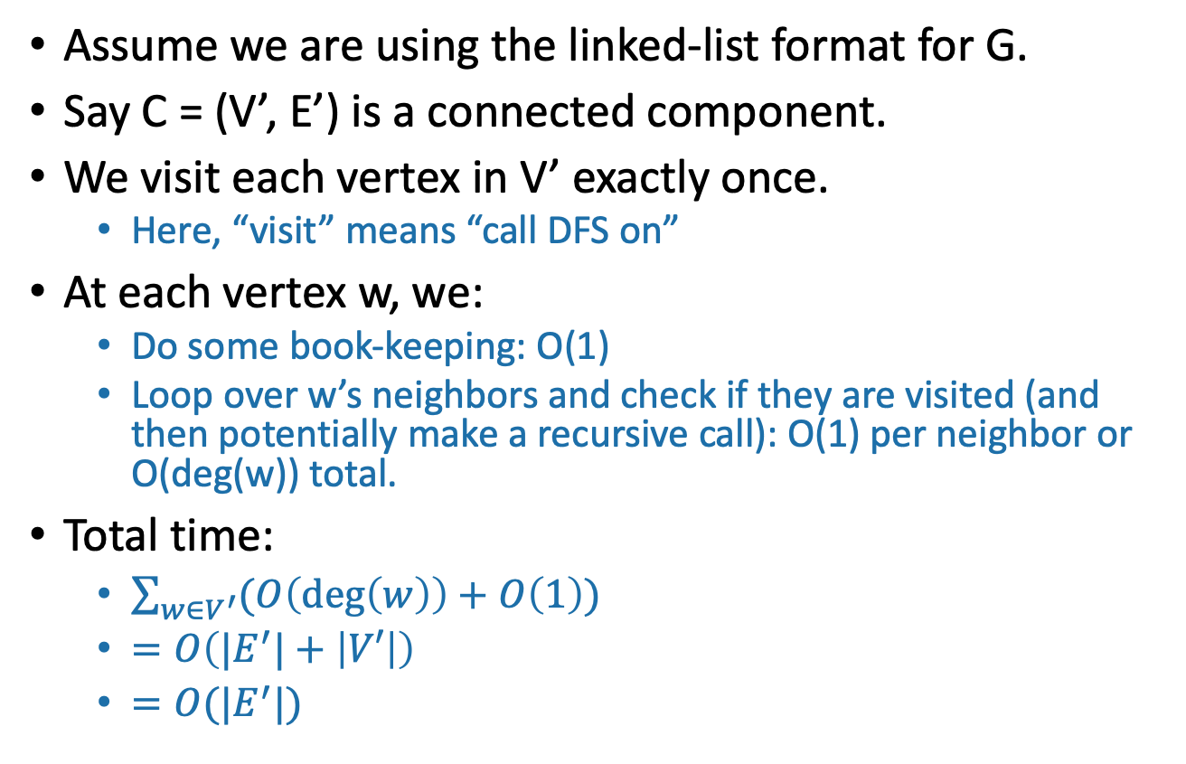
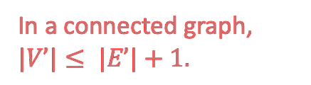
Running time
To explore just the connected component we started in
Assume we are using the linked-list format for G.
Say C = (V’, E’) is a connected component.
We visit each vertex in V’ exactly once.
  Here, “visit” means “call DFS on”
At each vertex w, we:
  Do some book-keeping: O(1)
  Loop over w’s neighbors and check if they are visited (and then potentially make a recursive call): O(1) per neighbor or O(deg(w)) total.
Total time:
  $\sum_{w∈V^{′}}{(O\left(\deg\left(w\right)\right)+O\left(1\right))}$
  $=O\left(|E^{′}|+\left|V′\right|\right)$
  $=O(|E^{′}|)$
In a connected graph, $|V’|≤ |E’|+1.$

Slide 61

Running time
To explore the whole graph
Explore the connected components one-by-one.
This takes time O(n + m)
  Same computation as before:
  $\sum_{w∈V}{(O\left(\deg\left(w\right)\right)+O\left(1\right))}=O\left(|E|+\left|V\right|\right)=O(n+m)$
or
Here the running time is O(m) like before
Here m=0 but it still takes time O(n) to explore the graph.

Slide 62
You check:
DFS works fine on directed graphs too!
C
A
B
Only walk to C, not to B.
Siggi the studious stork

Slide 63
Pre-lecture exercise
How can you sign up for classes so that you never violate the pre-req requirements?
More practically, how can you install packages without violating dependency requirements?

Slide 64
Application of DFS: topological sorting
Find an ordering of vertices so that all of the dependency requirements are met.
  Aka, if v comes before w in the ordering, there is not an edge from w to v.
coreutils
multiarch-support
tar
dpkg
libselinux1
libbz2
Suppose the dependency graph has no cycles:
it is a Directed Acyclic Graph (DAG)

Slide 65
Can’t always eyeball it.

Slide 66
Let’s do DFS
What do you notice about the finish times? Any ideas for how we should do topological sort?
start:9
finish:10
coreutils
start:7
finish:8
multiarch-support
tar
start:3
finish:4
dpkg
start:0
finish:11
libselinux1
libbz2
start:2
start:1
finish:5
finish:6

Slide 67
Finish times seem useful
Suppose the underlying graph has no cycles
Claim: In general, we’ll always have:
A
B
finish: [larger]
finish: [smaller]
To understand why, let’s go back to that DFS tree.

Slide 68
A more general statement
(this holds even if there are cycles)
(check this statement carefully!)
If v is a descendant of w in this tree:
If w is a descendant of v in this tree:
If neither are descendants of each other:
w.start
v.start
v.finish
w.finish
timeline
w
w
v.start
w.start
w.finish
v.finish
v.start
v.finish
w.start
w.finish
v
v
(or the other way around)

Slide 69

So to prove this $→$
A
B
If
Then B.finishTime < A.finishTime
Suppose the underlying graph has no cycles
Case 1: B is a descendant of A in the DFS tree.
Then
aka, B.finishTime < A.finishTime.
A
B.startTime
A.finishTime
A.startTime
B.finishTime
B

Slide 70
So to prove this $→$
A
B
If
Then B.finishTime < A.finishTime
Suppose the underlying graph has no cycles
Case 2: B is a NOT descendant of A in the DFS tree.
  Notice that A can’t be a descendant of B in the DFS tree or else there’d be a cycle; so it looks like this
Then we must have explored B before A.
  Otherwise we would have gotten to B from A, and B would have been a descendant of A in the DFS tree.
Then
aka, B.finishTime < A.finishTime.
A
B.finishTime
A.finishTime
B.startTime
A.startTime
B

Slide 71
Theorem
If we run DFS on a directed acyclic graph,
A
B
If
Then B.finishTime < A.finishTime

Slide 72
Back to topological sorting
A
B
If
Then B.finishTime < A.finishTime
In what order should I install packages?
In reverse order of finishing time in DFS!
start:3
start:9
finish:4
coreutils
finish:10
multiarch-support
start:7
finish:8
tar
dpkg
start:0
start:2
start:1
finish:11
finish:5
finish:6
libselinux1
libbz2
Suppose the dependency graph has no cycles:
it is a Directed Acyclic Graph (DAG)

Slide 73
Topological Sorting (on a DAG)
Do DFS
When you mark a vertex as all done, put it at the beginning of the list.
dpkg
coreutils
tar
libbz2
libselinux1
multiarch_support
start:3
start:9
finish:4
coreutils
finish:10
multiarch-support
start:7
finish:8
tar
dpkg
start:0
start:2
start:1
finish:11
finish:5
finish:6
libselinux1
libbz2

Slide 74
For implementation, see Python notebook

Slide 75
What did we just learn?
DFS can help you solve the topological sorting problem
  That’s the fancy name for the problem of finding an ordering that respects all the dependencies
Thinking about the DFS tree is helpful.

Slide 76
Example:
This example skipped in class – here for reference.
B
Unvisited
In progress
A
All done
Start:0
C
D

Slide 77
Example
This example skipped in class – here for reference.
B
Unvisited
In progress
A
All done
Start:0
C
Start:1
D

Slide 78
Example
This example skipped in class – here for reference.
B
Unvisited
In progress
A
All done
Start:0
C
Start:1
D
Start:2

Slide 79
Example
This example skipped in class – here for reference.
Start:3
B
Unvisited
In progress
A
All done
Start:0
C
Start:1
D
Start:2

Slide 80
Example
This example skipped in class – here for reference.
Start:3
Leave:4
B
Unvisited
In progress
A
All done
Start:0
C
Start:1
D
B
Start:2

Slide 81
Example
This example skipped in class – here for reference.
Start:3
Leave:4
B
Unvisited
In progress
A
All done
Start:0
C
Start:1
D
D
B
Start:2
Leave:5

Slide 82
Example
This example skipped in class – here for reference.
Start:3
Leave:4
B
Unvisited
In progress
A
All done
Start:0
C
Start:1
Leave: 6
D
C
D
B
Start:2
Leave:5

Slide 83
Example
This example skipped in class – here for reference.
Start:3
Leave:4
B
Unvisited
In progress
A
All done
Start:0
Leave: 7
C
Start:1
Leave: 6
Do them in this order:
D
A
C
D
B
Start:2
Leave:5

Slide 84
Another use of DFS that we’ve already seen
In-order enumeration of binary search trees
5
3
7
2
4
8
Do DFS and print a node’s label when you are done with the left child and before you begin the right child.
1

Slide 85
Part 2: breadth-first search

Slide 86
How do we explore a graph?
If we can fly
5
4
1
3
7
8
6
2
9

Slide 87
Breadth-First Search
Exploring the world with a bird’s-eye view
Not been there yet
Can reach there in zero steps
Can reach there in one step
start
Can reach there in two steps
Can reach there in three steps

Slide 88
Breadth-First Search
Exploring the world with a bird’s-eye view
Not been there yet
Can reach there in zero steps
Can reach there in one step
start
Can reach there in two steps
Can reach there in three steps

Slide 89
Breadth-First Search
Exploring the world with a bird’s-eye view
Not been there yet
Can reach there in zero steps
Can reach there in one step
start
Can reach there in two steps
Can reach there in three steps

Slide 90
Breadth-First Search
Exploring the world with a bird’s-eye view
Not been there yet
Can reach there in zero steps
Can reach there in one step
start
Can reach there in two steps
Can reach there in three steps

Slide 91
Breadth-First Search
Exploring the world with a bird’s-eye view
Not been there yet
Can reach there in zero steps
Can reach there in one step
start
Can reach there in two steps
Can reach there in three steps
World:
explored!

Slide 92
Breadth-First Search
Exploring the world with pseudocode
Same disclaimer as for DFS: you may have seen other ways to implement this, this will be convenient for us.
L_{i} is the set of nodes we can reach in i steps from w
Set L_{i} = [] for i=1,…,n
L₀ = [w], where w is the start node
Mark w as visited
For i = 0, …, n-1:
  For u in L_{i}:
    For each v which is a neighbor of u:
      If v isn’t yet visited:
        mark v as visited, and put it in L_{i+1}
-
L₀
L₁
Go through all the nodes in L_{i} and add their unvisited neighbors to L_{i+1}
L₂
L₃

Slide 93
BFS also finds all the nodes reachable from the starting point
start
It is also a good way to find all the connected components.

Slide 94
Running time and extension to directed graphs
To explore the whole graph, explore the connected components one-by-one.
  Same argument as DFS: BFS running time is O(n + m)
Like DFS, BFS also works fine on directed graphs.
Verify these!
Siggi the Studious Stork

Slide 95
Why is it called breadth-first?
We are implicitly building a tree:
First we go as broadly as we can.
YOINK!
D
L₀
E
A
F
L₁
B
A
E
L₂
F
B
C
D
G
L₃
C
G
Call this the “BFS tree”

Slide 96
Pre-lecture exercise
What Samuel L. Jackson’s Bacon number?
Jurassic Park
Samuel L.
Jackson
Kevin
Bacon
Tremors
Ariana Richards
(Answer: 2)

Slide 97
An example with distance 3
James McAvoy
X-men
Kevin
Bacon
Narnia
When Bjork Met Attenborough
Tilda Swinton
Oliver Sacks
It is really hard to find people with Bacon number 3!

Slide 98
Application of BFS: shortest path
How long is the shortest path between w and v?
w
v

Slide 99
Application of BFS: shortest path
How long is the shortest path between w and v?
Not been there yet
Can reach there in zero steps
w
Can reach there in one step
Can reach there in two steps
v
Can reach there in three steps
It’s three!

Slide 100
To find the distance between w and all other vertices v
The distance between two vertices is the number of edges in the shortest path between them.
Do a BFS starting at w
For all v in L_{i}
  The shortest path between w and v has length i.
  A shortest path between w and v is given by the path in the BFS tree.
If we never found v, the distance is infinite.
L₀
w
L₁
L₂
Modify the BFS pseudocode to return shortest paths!
Prove that this indeed returns shortest paths!
Gauss has no Bacon number
L₃
v
Call this the “BFS tree”

Slide 101
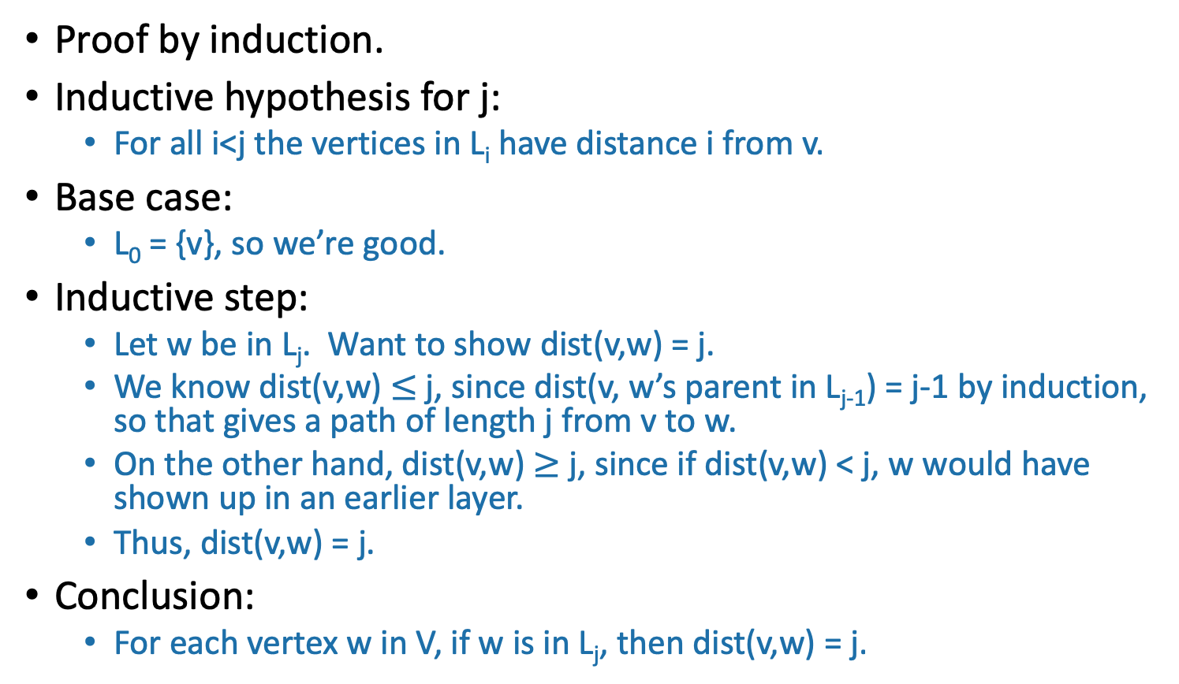
Why do the vertices in L_{i} have distance i from v?
High-level idea!
Proof by induction.
Inductive hypothesis for j:
  For all i<j the vertices in L_{i} have distance i from v.
Base case:
  L₀ = {v}, so we’re good.
Inductive step:
  Let w be in L_{j}. Want to show dist(v,w) = j.
  We know dist(v,w) $≤$ j, since dist(v, w’s parent in L_{j-1}) = j-1 by induction, so that gives a path of length j from v to w.
  On the other hand, dist(v,w) $≥$ j, since if dist(v,w) < j, w would have shown up in an earlier layer.
  Thus, dist(v,w) = j.
Conclusion:
  For each vertex w in V, if w is in L_{j}, then dist(v,w) = j.
THIS SLIDE SKIPPED IN CLASS

Slide 102
What have we learned?
The BFS tree is useful for computing distances between pairs of vertices.
We can find the shortest path between u and v in time O(m).

Slide 103
Another application of BFS (if time)
Testing bipartite-ness

Slide 104
Pre-lecture exercise: fish
You have a bunch of fish and two fish tanks.
Some pairs of fish will fight if put in the same tank.
  Model this as a graph: connected fish will fight.
Can you put the fish in the two tanks so that there is no fighting?

Slide 105
Bipartite graphs
Can color the vertices red and orange so that there are no edges between any same-colored vertices
A bipartite graph looks like this:
Example:
are in tank A
are in tank B
if the fish fight
Example:
are students
are classes
if the student is enrolled in the class

Slide 106
Is this graph bipartite?

Slide 107
How about this one?

Slide 108
How about this one?

Slide 109
This one?

Slide 110
Application of BFS:
Testing Bipartiteness
Does DFS work here too?
Color the levels of the BFS tree in alternating colors.
If you never color two connected nodes the same color, then it is bipartite.
Otherwise, it’s not.
A
B
E
F
C
D
G

Slide 111
Breadth-First Search
For testing bipartite-ness
Not been there yet
Can reach there in zero steps
Can reach there in one step
start
Can reach there in two steps
Can reach there in three steps

Slide 112
Breadth-First Search
For testing bipartite-ness
Not been there yet
Can reach there in zero steps
Can reach there in one step
start
Can reach there in two steps
Can reach there in three steps

Slide 113
Breadth-First Search
For testing bipartite-ness
Not been there yet
Can reach there in zero steps
Can reach there in one step
start
Can reach there in two steps
Can reach there in three steps

Slide 114
Breadth-First Search
For testing bipartite-ness
Not been there yet
Can reach there in zero steps
Can reach there in one step
start
Can reach there in two steps
Can reach there in three steps

Slide 115
Breadth-First Search
For testing bipartite-ness
Not been there yet
Can reach there in zero steps
Can reach there in one step
start
Can reach there in two steps
Can reach there in three steps
CLEARLY BIPARTITE!

Slide 116
Breadth-First Search
For testing bipartite-ness
Not been there yet
Can reach there in zero steps
Can reach there in one step
start
Can reach there in two steps
Can reach there in three steps

Slide 117
Breadth-First Search
For testing bipartite-ness
Not been there yet
Can reach there in zero steps
Can reach there in one step
start
Can reach there in two steps
Can reach there in three steps

Slide 118
Breadth-First Search
For testing bipartite-ness
Not been there yet
Can reach there in zero steps
Can reach there in one step
start
Can reach there in two steps
Can reach there in three steps

Slide 119
Breadth-First Search
For testing bipartite-ness
Not been there yet
Can reach there in zero steps
Can reach there in one step
start
Can reach there in two steps
Can reach there in three steps

Slide 120
Breadth-First Search
For testing bipartite-ness
Not been there yet
Can reach there in zero steps
Can reach there in one step
start
Can reach there in two steps
WHOA NOT BIPARTITE!
Can reach there in three steps

Slide 121
Hang on now.
Just because this coloring doesn’t work, why does that mean that there is no coloring that works?
I can come up with plenty of bad colorings on this legitimately bipartite graph…
Plucky the pedantic penguin

Slide 122
Some proof required
Make this proof sketch formal!
Ollie the over-achieving ostrich
If BFS colors two neighbors the same color, then it’s found a cycle of odd length in the graph.
A
There must be an even number of these edges
B
E
start
F
C
D
This one extra makes it odd
G

Slide 123
Some proof required
Make this proof sketch formal!
Ollie the over-achieving ostrich
If BFS colors two neighbors the same color, then it’s found a cycle of odd length in the graph.
But you can never color an odd cycle with two colors so that no two neighbors have the same color.
  [Fun exercise!]
So you can’t legitimately color the whole graph either.
Thus it’s not bipartite.

Slide 124
What have we learned?
BFS can be used to detect bipartite-ness in time O(n + m).

Slide 125
Outline
Part 0: Graphs and terminology
Part 1: Depth-first search
  Application: topological sorting
  Application: in-order traversal of BSTs
Part 2: Breadth-first search
  Application: shortest paths
  Application (if time): is a graph bipartite?
Recap

Slide 126
Recap
Depth-first search
  Useful for topological sorting
  Also in-order traversals of BSTs
Breadth-first search
  Useful for finding shortest paths
  Also for testing bipartiteness
Both DFS, BFS:
  Useful for exploring graphs, finding connected components, etc

Slide 127
Still open (next few lectures)
We can now find components in undirected graphs…
  What if we want to find strongly connected components in directed graphs?
How can we find shortest paths in weighted graphs?
What is Samuel L. Jackson’s Erdos number?
  (Or, what if I want everyone’s everyone-else number?)

Slide 128
Next Time
Strongly Connected Components
Pre-lecture exercise: Strongly Connected What-Now?
Before Next Time

